Slide 1
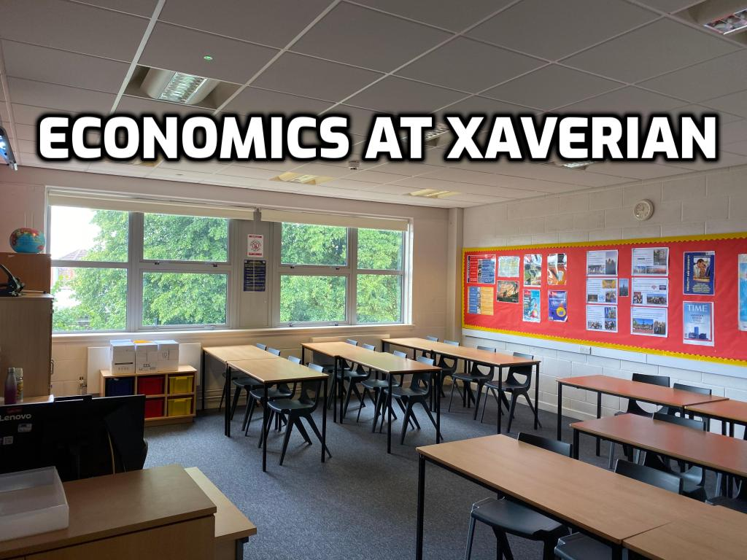

Slide 2
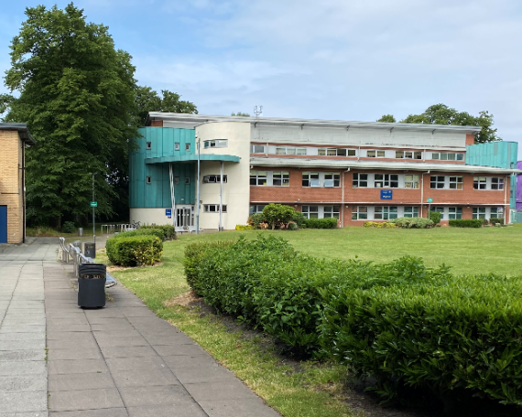

Slide 3
The Economics Department
Nathan Warren
Joanne Bratsiotis
N.WARREN@XAVERIAN.AC.UK

Slide 4
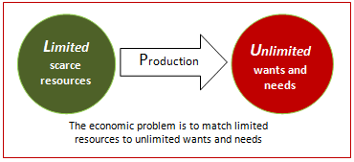
“The basic economic problem is that resources are scarce, yet wants are unlimited.”
Because resources are scarce and our wants are unlimited a choice has to be made about how to use scarce resources in the best way.
Therefore economics is all about choices, and how to use the Earth’s limited resources in the best possible way.

Slide 5
Economics is about choice and the impact of our choices on each other.
It relates to every aspect of our lives, from the decisions we make as individuals or families to the structures created by governments and firms.
The economic way of thinking can help us make better choices

Slide 6
Many people hear the word “economics” and think it is all about money.
Economics is not just about money. It is about weighing different choices or alternatives.
Some of those important choices involve money, but most do not.
Most of your daily, monthly, or life choices have nothing to do with money, yet they are still the subject of economics.

Slide 7
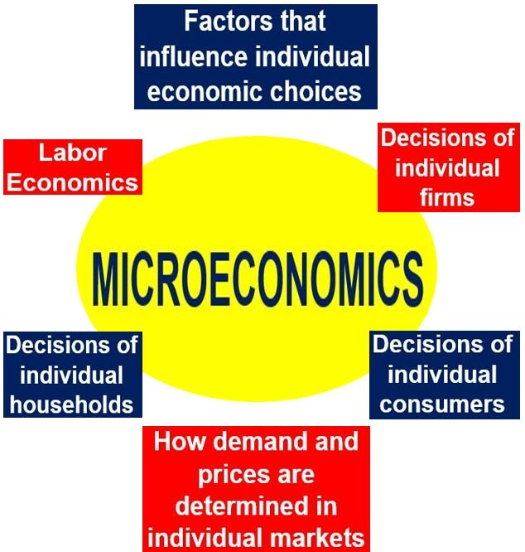
Economics is split into two parts

Slide 10
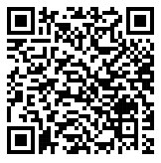
Economics at Xaverian follows the OCR specification
Click here to visit the OCR Economics website
The course is split into three components

Slide 11
Component 01: Microeconomics
For this component, microeconomic theories are introduced and applied to the behaviour of economic agents in the real world, especially the theoretical workings of the free market.
Exploring imperfections and market failures introduces the merits and drawbacks of government intervention. This encourages students to evaluate the effectiveness of the theories in explaining real-world behaviour.

Slide 12
Component 02: Macroeconomics
This component introduces the technical and analytical tools required for understanding of how the macroeconomy functions on both a domestic and global level, and the potential impacts and limitations of a variety of governmental policies and approaches.

Slide 13
Component 03: Themes in economics
This component draws on the topics covered in the previous two components and applies the content of both, as appropriate, to a specific unseen theme.
Themes in the past have included:
The macroeconomic stimulus gained from hosting the Olympics. The Bank of Japan has estimated that the Japanese economy could be boosted by up to $249bn as a result of hosting the games in Tokyo.
The challenge of affordable housing in the UK.
The effects of the UK leaving the European Single Market.

Slide 14
One of the first topics that we study in microeconomics is how the forces of supply and demand work

Slide 15
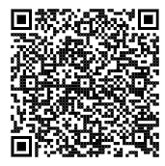
Click this to read how the forces of supply and demand have affected the price of housing in the UK

Slide 16
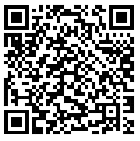
Click this to read how a fall in the supply of Vanilla caused the price per kilo to jump from $50 in 2013 to $400 in 2017, which is the same as the price of gold.

Slide 17
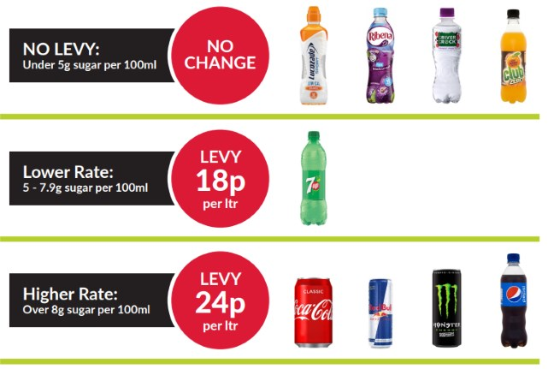
Market Failure
Sometimes when left to their own devices markets can fail. This means that certain products are over or under provided or consumed.
Recently, for example, the UK government decided that too many sugary drinks were being consumed as the price set by supply and demand was too low. To fix this problem they introduced a sugar tax.

Slide 18
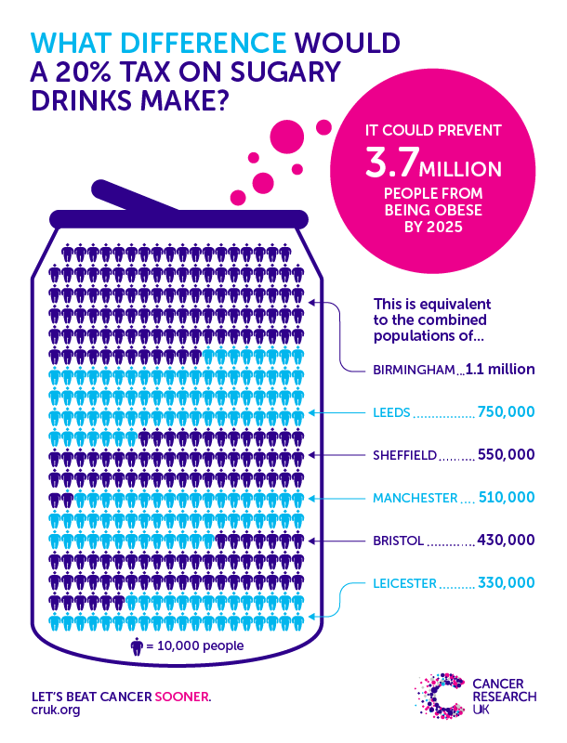

Slide 19
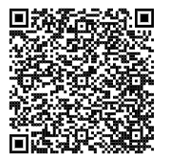
Legal highs ban comes into force across the UK
Click this for another example. This would be the governments blanket ban on so-called legal highs. In this case the government decided that the product should not be supplied at all and made the products illegal.

Slide 20
Go grab a pen and some paper before you get to the next slide.

Slide 21
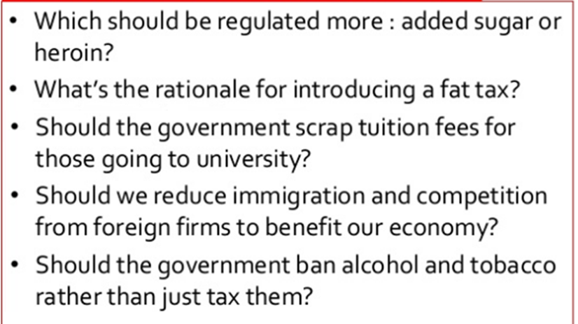
Here are some of the sort of discussions that will take place in lessons when studying Microeconomics. Spend the next 5 minutes considering your answer to these 5 scenarios. Click on the circle to start a 5 minute timer.
5 minutes

Slide 22
The Macro Economy and the Coronavirus
The coronavirus outbreak, which was first detected in China, has infected people in 185 countries. Its spread has left businesses around the world counting the costs.
Let’s look at how the virus has affected the Macroeconomy
Remember that the macroeconomy refers to the economy as a whole.

Slide 23
In the United States, the number of people filing for unemployment hit a record high, signalling an end to a decade of expansion for one of the world's largest economies.

Slide 24
Close to one million people in the United Kingdom also applied for benefits in just two weeks at the end of March.
The surge in universal credit applications followed government measures to limit the spread of the virus, including closing pubs, restaurants and non-essential shops.

Slide 25
Oil prices crash
Demand for oil has all but dried up as lockdowns across the world have kept people inside.
The crude oil price had already been affected by a row between Opec, the group of oil producers, and Russia. Coronavirus has driven the price down further

Slide 26
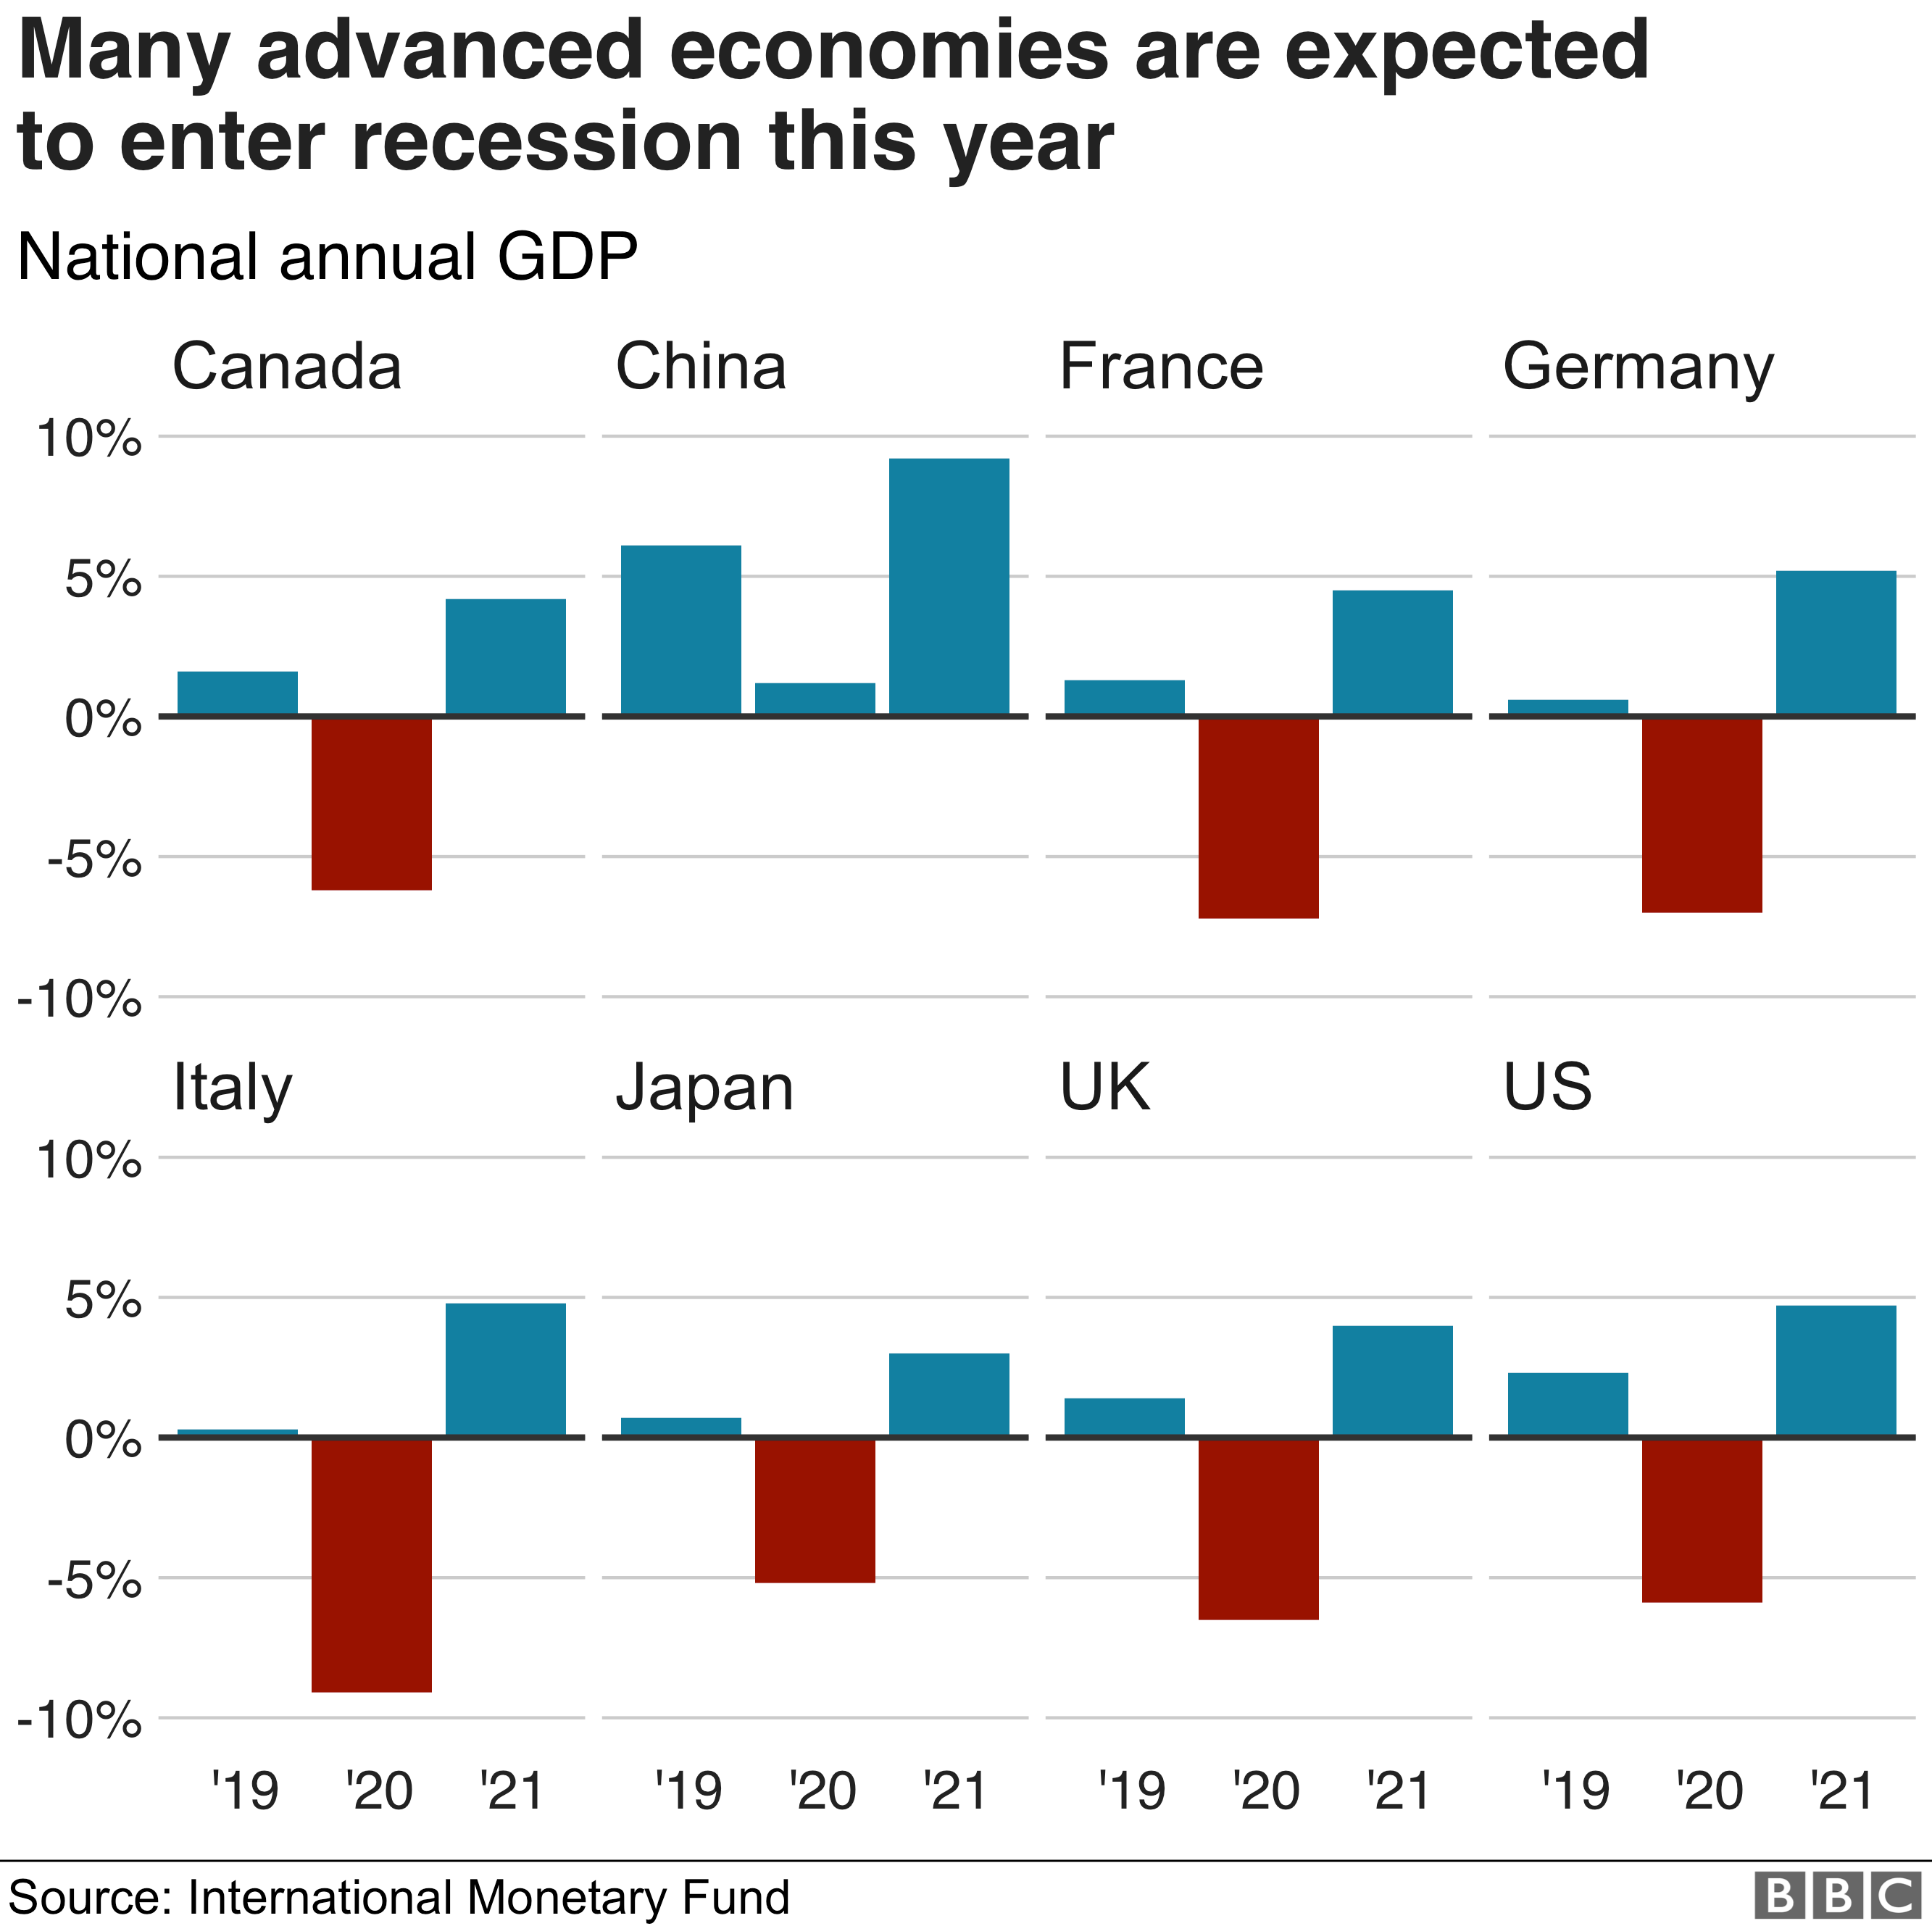
Risk of recession
If the economy is growing, that generally means more wealth and more new jobs.
It's measured by looking at the percentage change in gross domestic product, or the value of goods and services produced, typically over three months or a year.
But the International Monetary Fund (IMF) says that the global economy will shrink by 3% this year

Slide 27
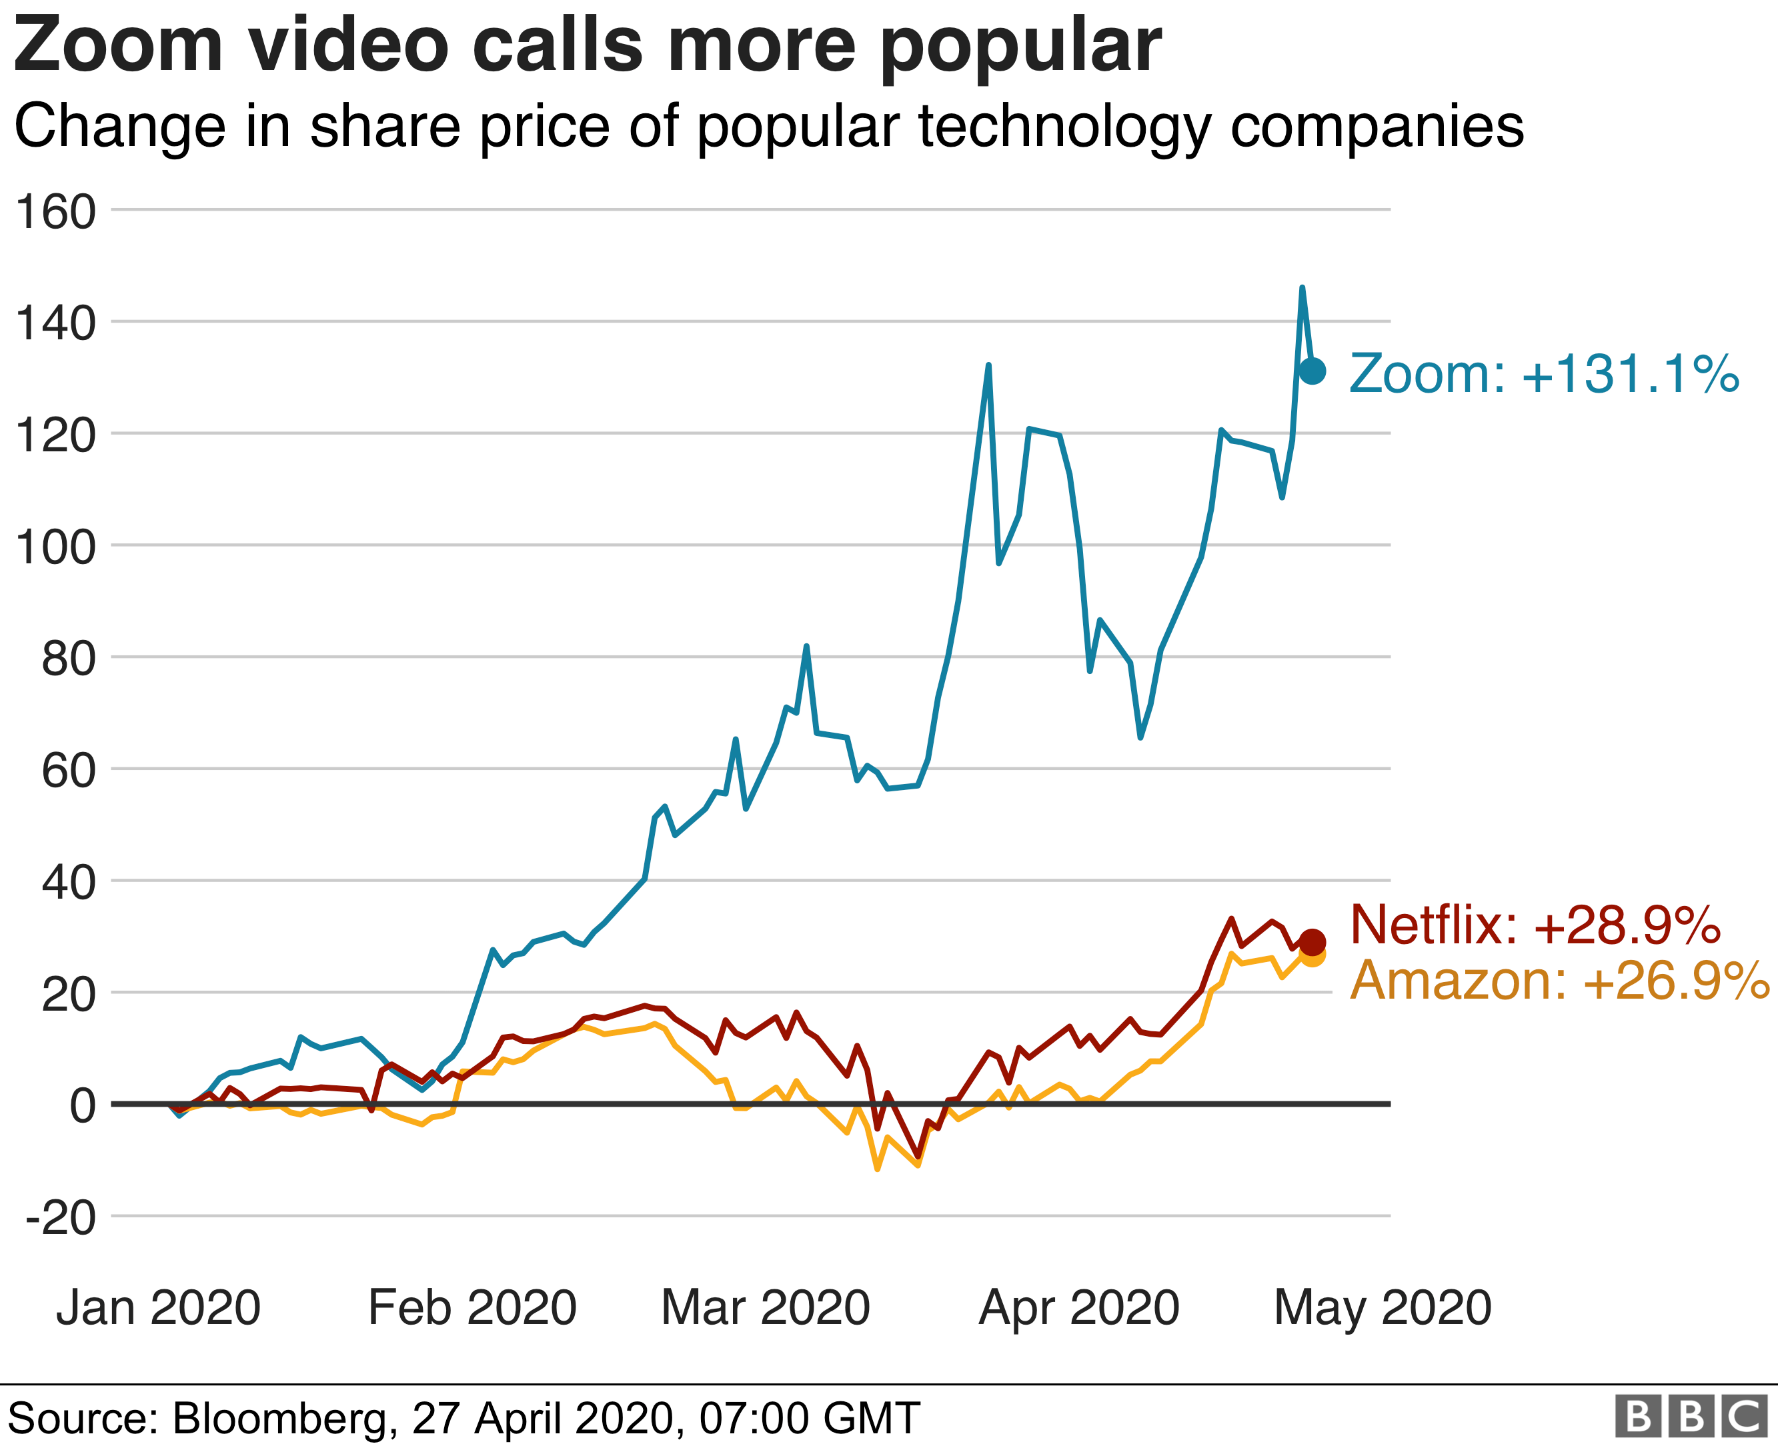
Turn to technology
Governments around the world have urged employees to work from home where possible.
Shares in technology companies such as Zoom have shot up as more people rely on video conference calls and email to hold meetings or get tasks done
The demand for online shopping and entertainment has also soared as people stay indoors.
Amazon's share price has hit new highs, while streaming platform Netflix was at one point a more valuable company than oil giant ExxonMobil.

Slide 31
Entry Requirements
Economics is a unique subject in the sense that it is an essay based subject but it is also a maths based subject. At least 20% of the marks in the 3 end of year 2 exams that form the A level are based upon quantitative (maths) skills
Because of this the Entry requirements to study Economics at Xaverian includes:
At least a grade 6 in GCSE Maths
At least a grade 5 in GCSE English Language and English Literature.

Slide 32
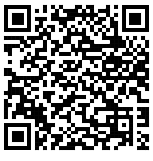
If you are keen to complete some background Economics studying over the summer prior to your enrolment in September than I suggest using the website Physics & Maths tutor.
Click here to go to the OCR Micro Economics section of this website.

Slide 33
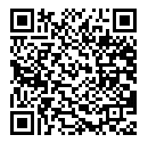
Click here to go to further activities that will help you to prepare to study A – Level Economics.

Slide 34
Enrichment in Economics
Extra-curricular activities are an import aspect of studying at Xaverian, and I’d like to explain some of the activities that have taken place in the Economics department over the past few years.
Perhaps the biggest activity that has taken place for the last 3 years is an opportunity to take part in a trip to New York.

Slide 41
For the past 6 years now a selection of students complete a pre-university course at Manchester University. Completion of this course reduces the entry requirements to study Economics at Manchester University.

Slide 42
Manchester has a great selection of Museums, and if there is an appropriate exhibition we will always provide the opportunity to attend.

Slide 43
Xaverian students have recently competed in both the Bank of England Target 2.0 competition and the Royal Economic Society Young Economist of the Year competition

Slide 44
Students have also had opportunities to attend a Careers in Finance event held at AJ Bell
Compete in a stock market competition at Manchester University
Complete work experience at management consultancy firm Regeneris
Visit a taster day event at Manchester Metropolitan University.

Slide 45
What can I do with an Economics degree?
A degree in Economics can lead to a wide range of career areas. Very few Economics graduates will go in to a career as a professional economist. Economics graduates are particularly competent in finding employment, with the majority gaining employment within six months of graduating.
A degree in Economics will equip you with sophisticated numerical and analytical skills.
Click on this link to find out the career paths available for people who study Economics.

Slide 46
Good luck with your GCSE results. See you in September!

