Slide 4
INSERT LINK TO ‘GRAPHICS CLASSROOM TOUR’ VIDEO

Slide 6
INSERT LINK TO
‘GRAPHICS FOLDER L6 1’
VIDEO

Slide 7
INSERT LINK TO
‘GRAPHICS FOLDER L6 2’
VIDEO

Slide 8
INSERT LINK TO
‘GRAPHICS FOLDER U6 1’
VIDEO

Slide 9
INSERT LINK TO
‘GRAPHICS FOLDER U6 2’
VIDEO

Slide 11
INSERT LINK TO
‘GRAPHICS STUDENT’
VIDEO

Slide 13
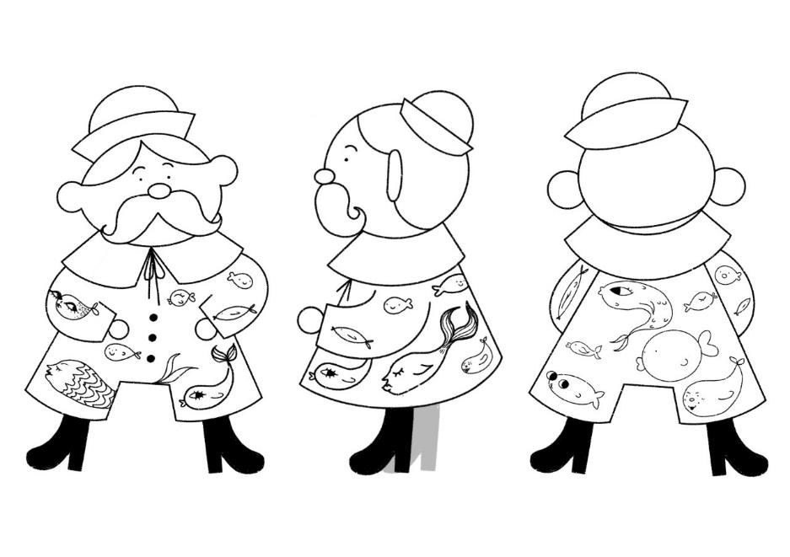
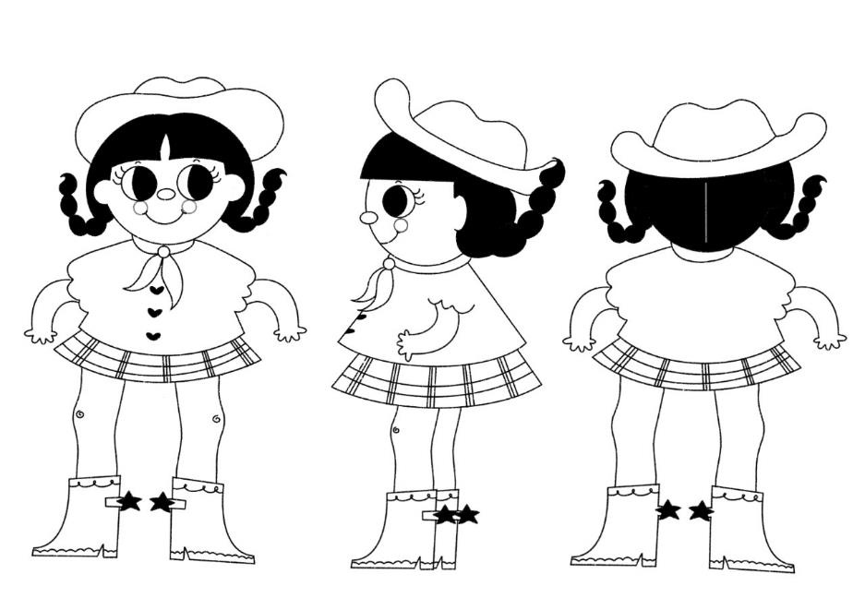
Mah-noor Anwar

Slide 14
Mah-noor Anwar

Slide 15
Mah-noor Anwar

Slide 22
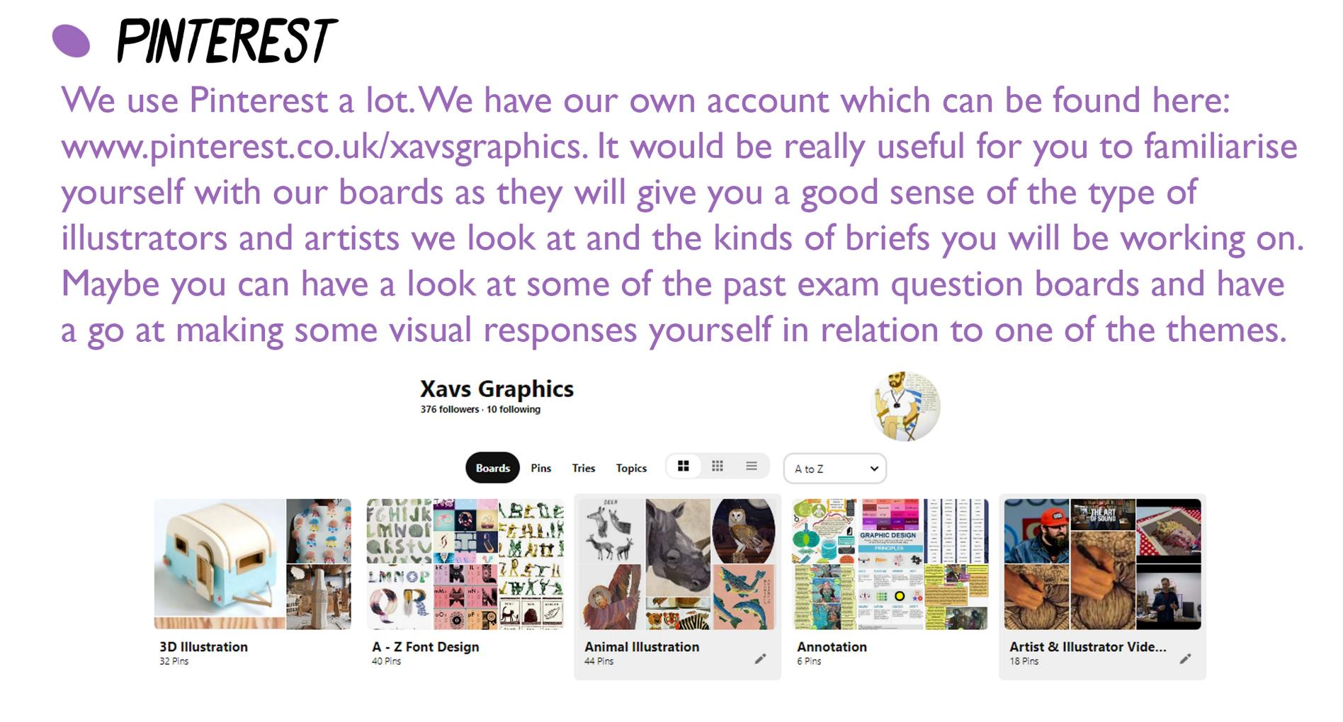

Slide 24
