Slide 1
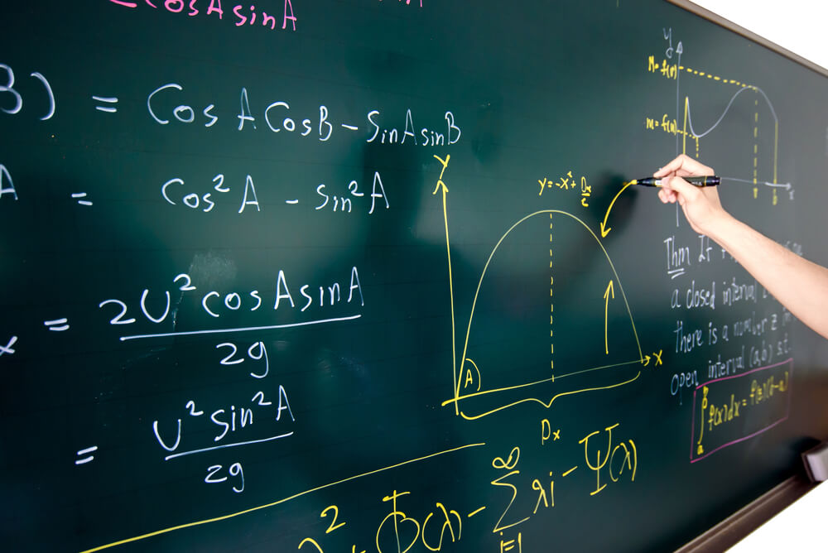
Maths at Xaverian

Slide 2
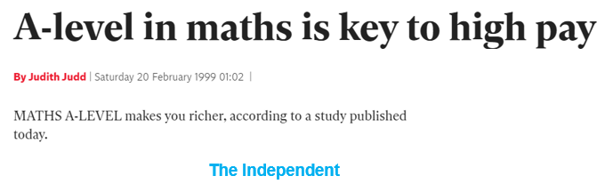
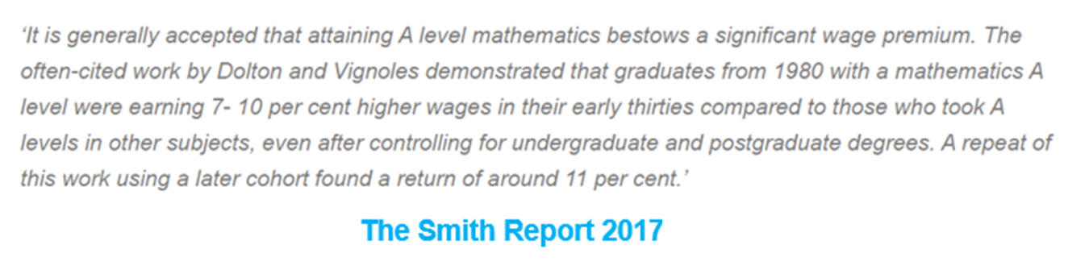
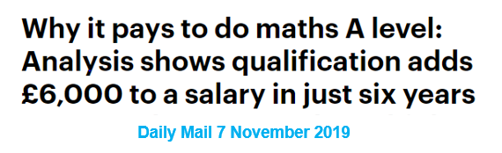
Why Maths?
It can lead to a well paid job?

Slide 3



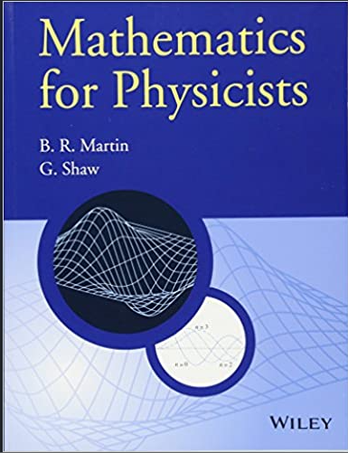
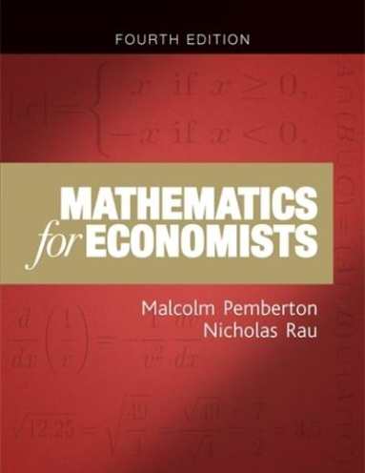
Why Maths?
It supports other subjects?

Slide 4
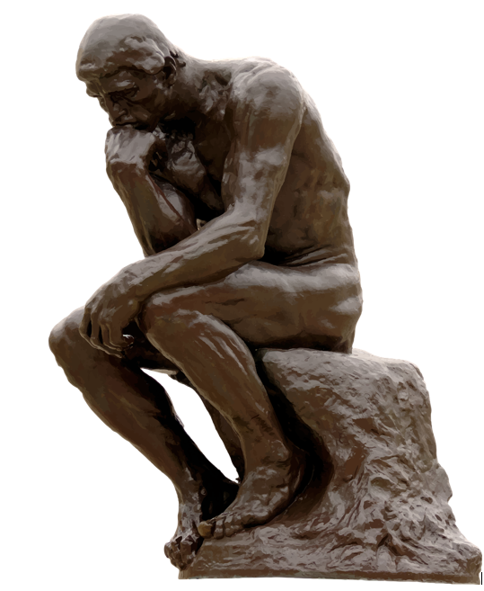




Why Maths?
It makes you a logical thinker?

Slide 5
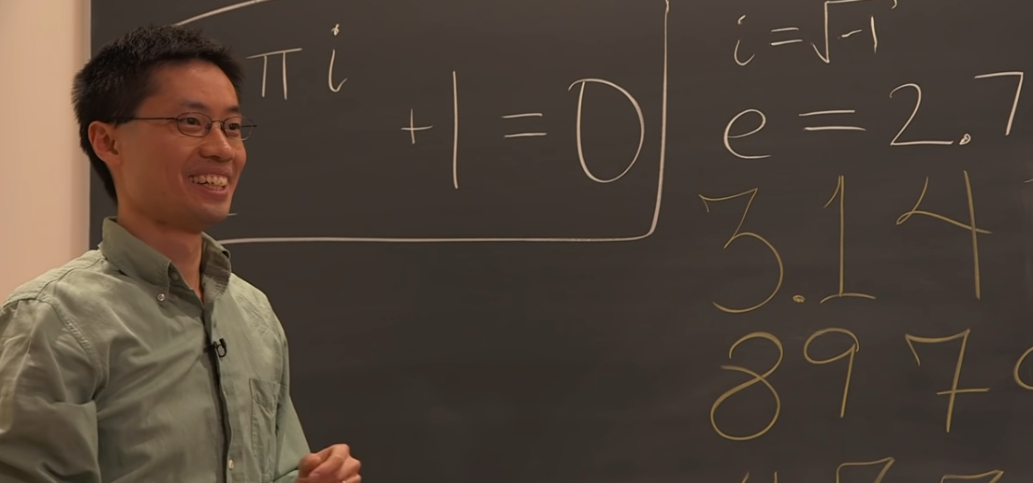

Why Maths?
Maths is a lot of fun!
Well, maybe ...
… but we think the best reason is …

Slide 6
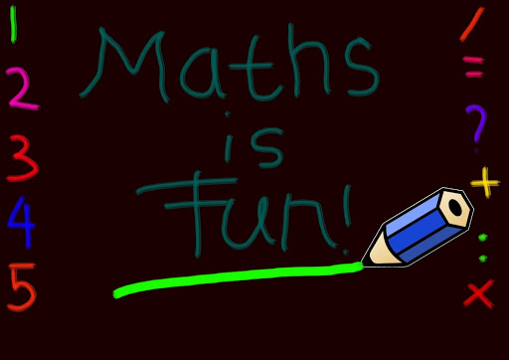
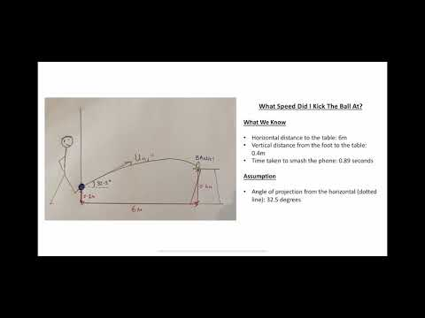



Mr Reding’s thoughts on what makes Maths fun and interesting for him …
If the embedded video does not play, try this link

Slide 7

Why Mr Ball thinks maths is great
If the embedded video does not play, try this link

Slide 8
Course content
Pure Mathematics
Algebra
Trigonometry
Sequences
Co-ordinate Geometry
Vectors
Binomial Expansion
Logarithms
Calculus
Proof
Statistics
Data Collection
Data Presentation
Probability
Bivariate Data
Binomial Distribution
Normal Distribution
Hypothesis Testing
Mechanics
1D Kinematics
Newton’s Laws
2D Kinematics
Projectiles
Friction
Moments
Paper 1 Paper 2
Paper 3

Slide 9

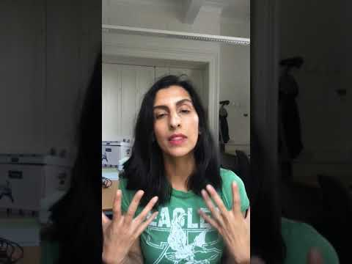
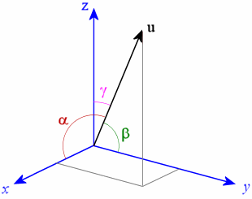

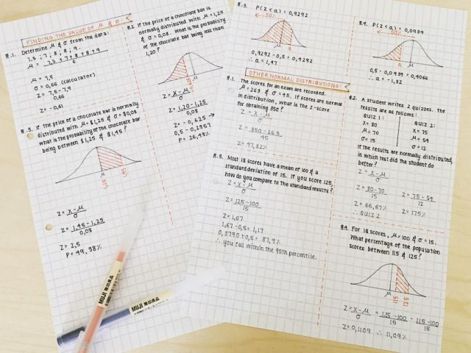
Why study Maths at Xaverian?
Ms Ahmed explains the course
link

Slide 10
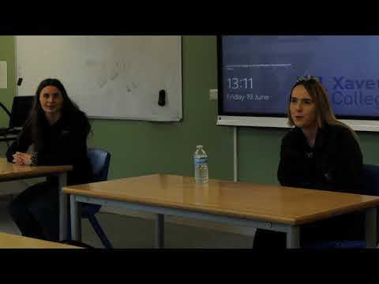
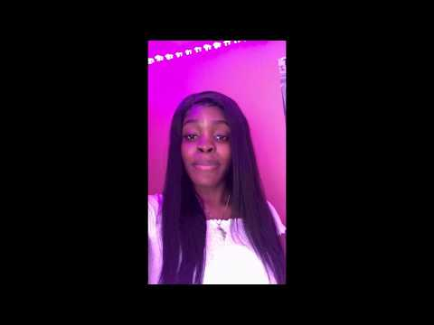
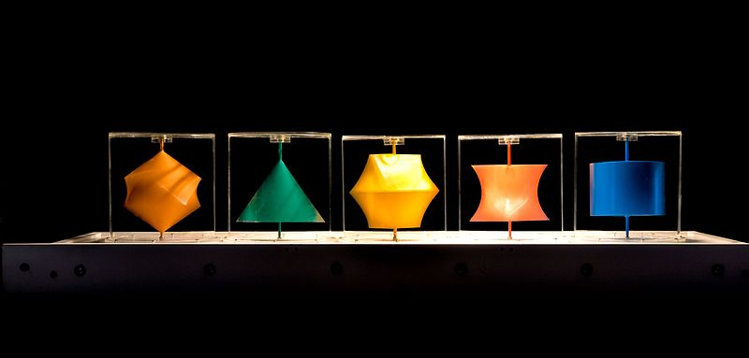
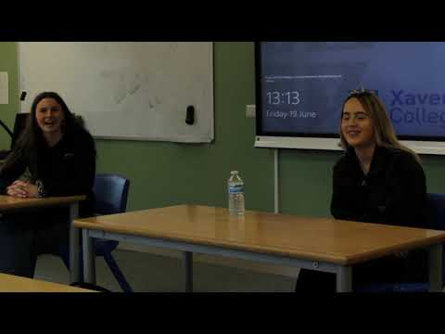
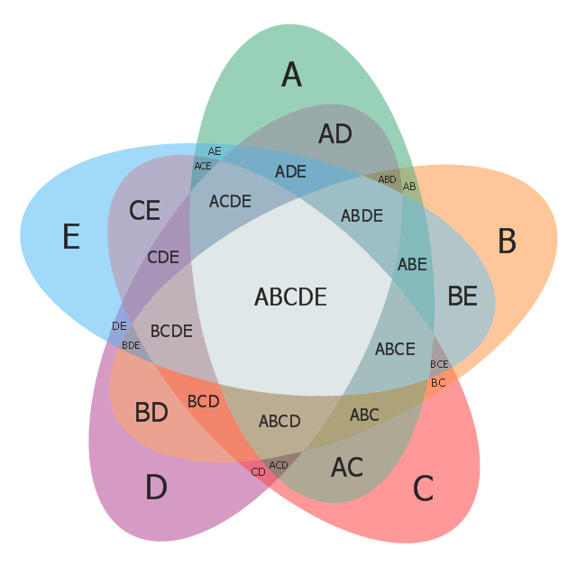
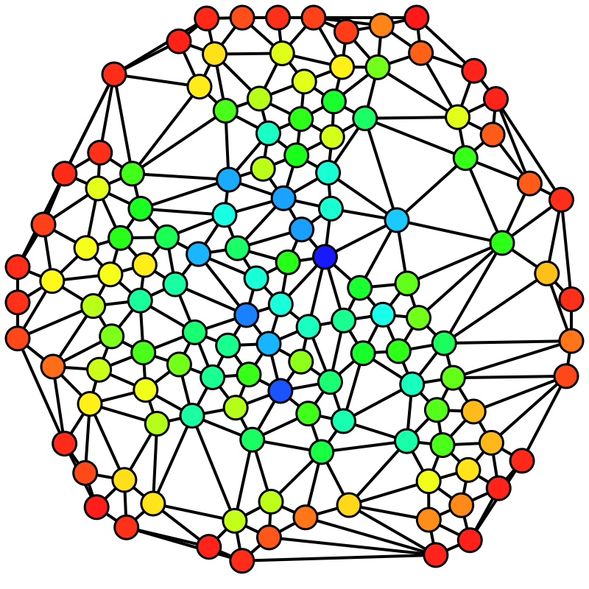
Students talking about the Maths course
What helps them learn link
The teaching link
What they like about maths link

Slide 11
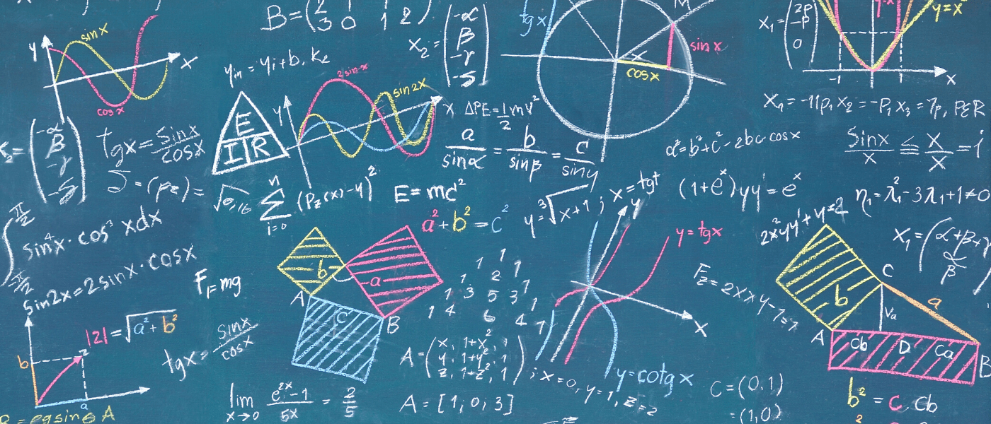
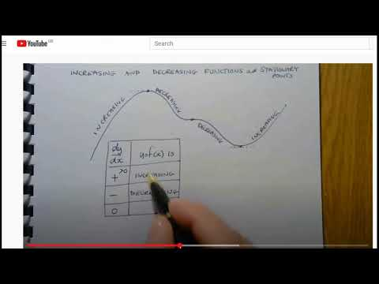
Click the video to find out how we manage to teach maths during COVID-19 disruption.
If the embedded video does not play, try this link

Slide 12

The student experience of distance learning
If the embedded video does not play, try this link

Slide 13


Mr. Saddiq
Introduction to the Course
(Please enable speaker)
10 Maths Dept. teachers
Ongoing support & guidance
Other Maths courses
What's required from you?
(Sound should play automatically.
If not, please click on the sound icon)

Slide 14
Important GCSE Maths topics to revise…
Algebraic Expressions
  Expanding brackets
  Simplifying Surds
Quadratics
  Solving Quadratics
  Completing the square
Equation and Inequalities
  Solve linear Simultaneous equations
  Solve linear Inequalities
(Please click on the sound icon)

Slide 15
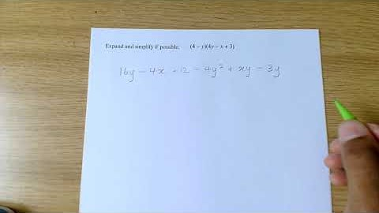
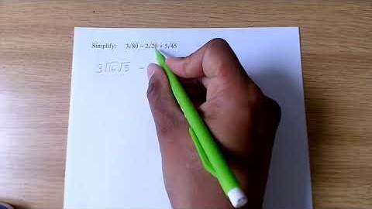
Algebraic Expressions
Expanding Brackets
https://youtu.be/kpCkLWG2YMg
Simplifying Surds
https://youtu.be/0AwWjE7y1JQ

Slide 16
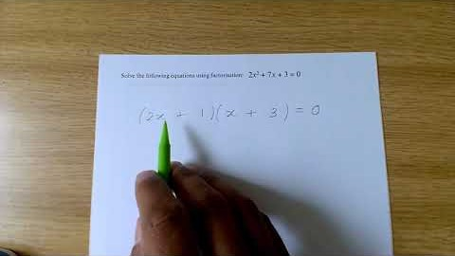
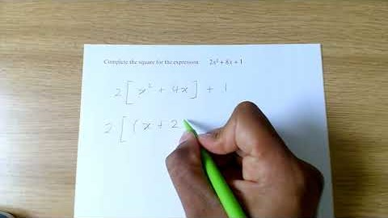
Quadratics
Solving Quadratics
https://youtu.be/4HoKCBQ09Gc
Completing the Square
https://youtu.be/_Qk_rKamWg4

Slide 17
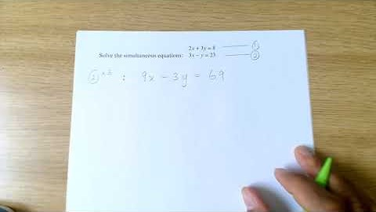
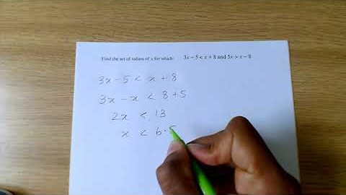
Equations & Inequalities
Solve Linear Simultaneous Eqn.
https://youtu.be/J3fD9xpC8-Q
Solve Linear Inequalities
https://youtu.be/pBPTYUc99c4

Slide 18
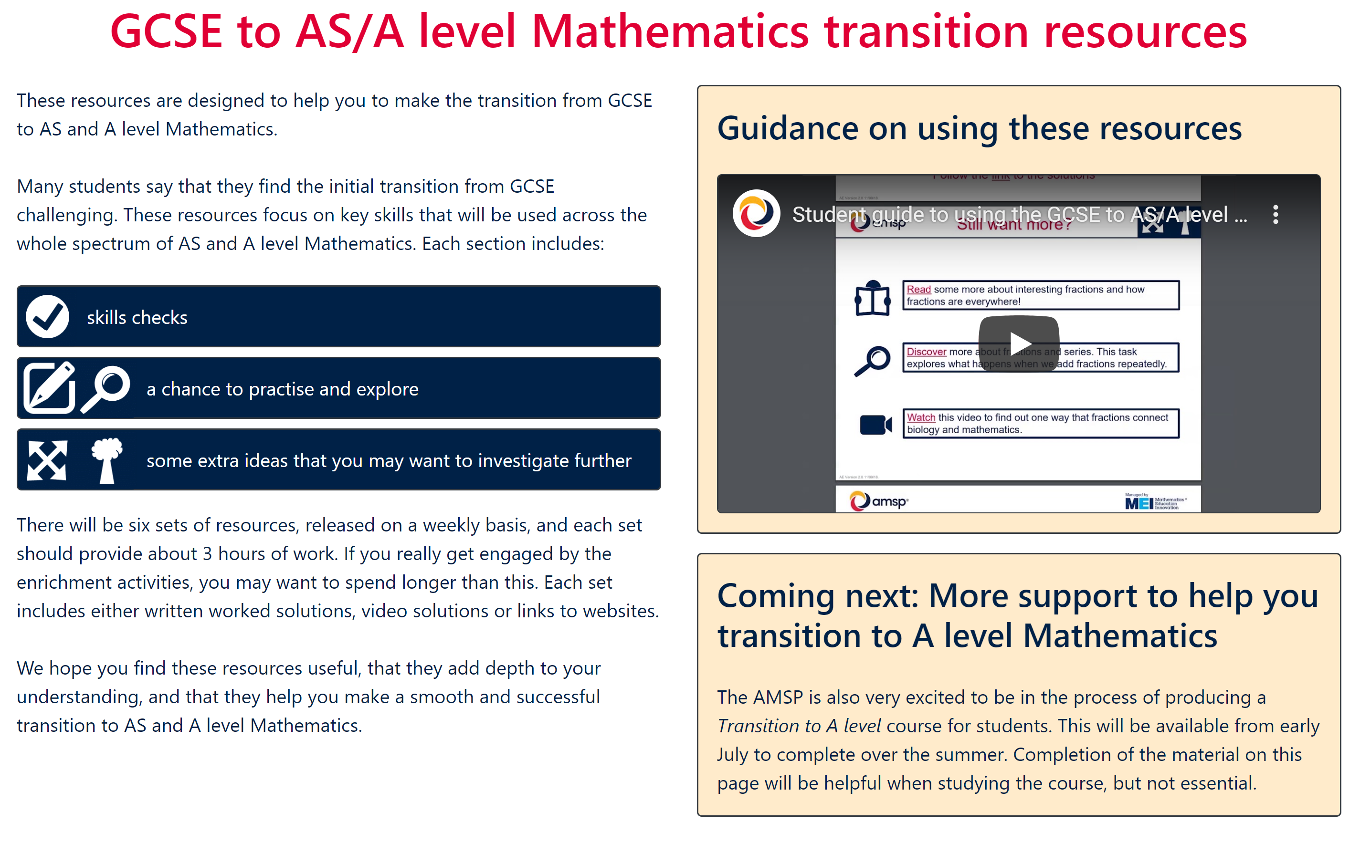
https://amsp.org.uk/resource/gcse-alevel-transition-resources
(Please click on the sound icon)

Slide 19
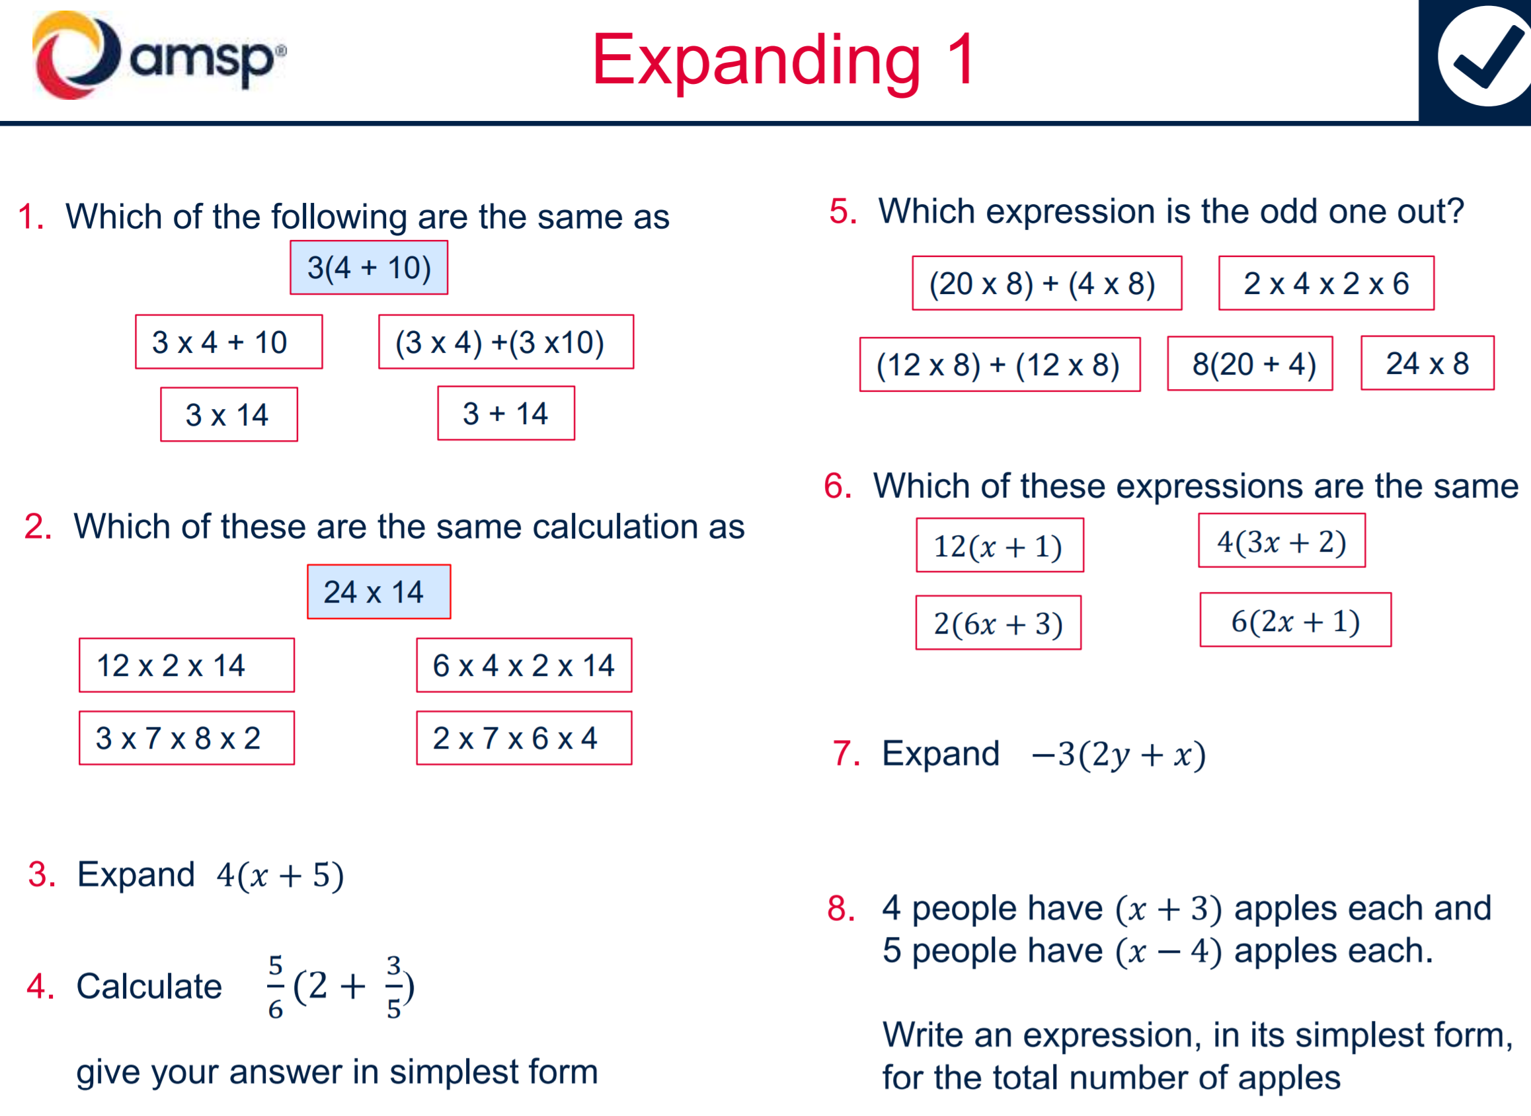
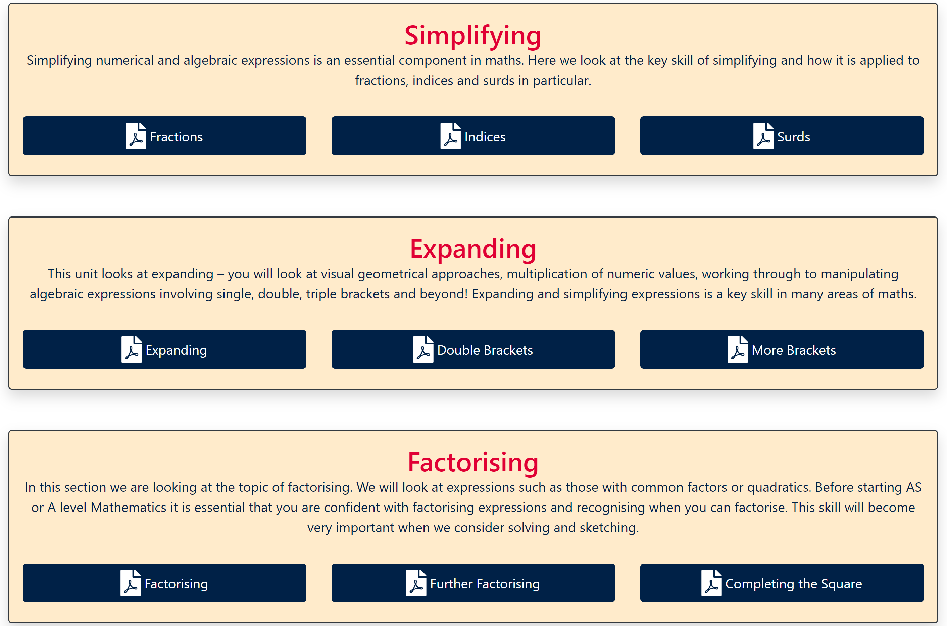
Click on the links…
(Please click on the sound icon)

Slide 20
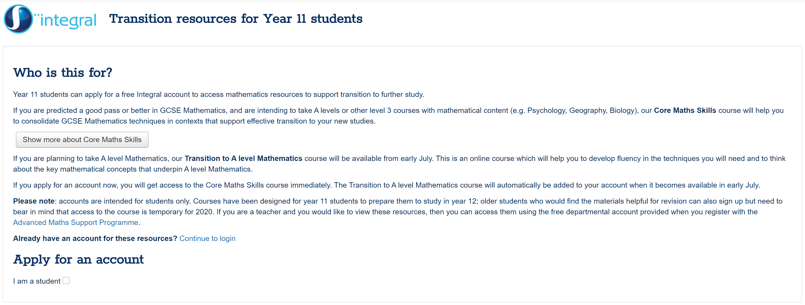
https://2017.integralmaths.org/management/self_reg_students.php
(Please click on the sound icon)

Slide 21

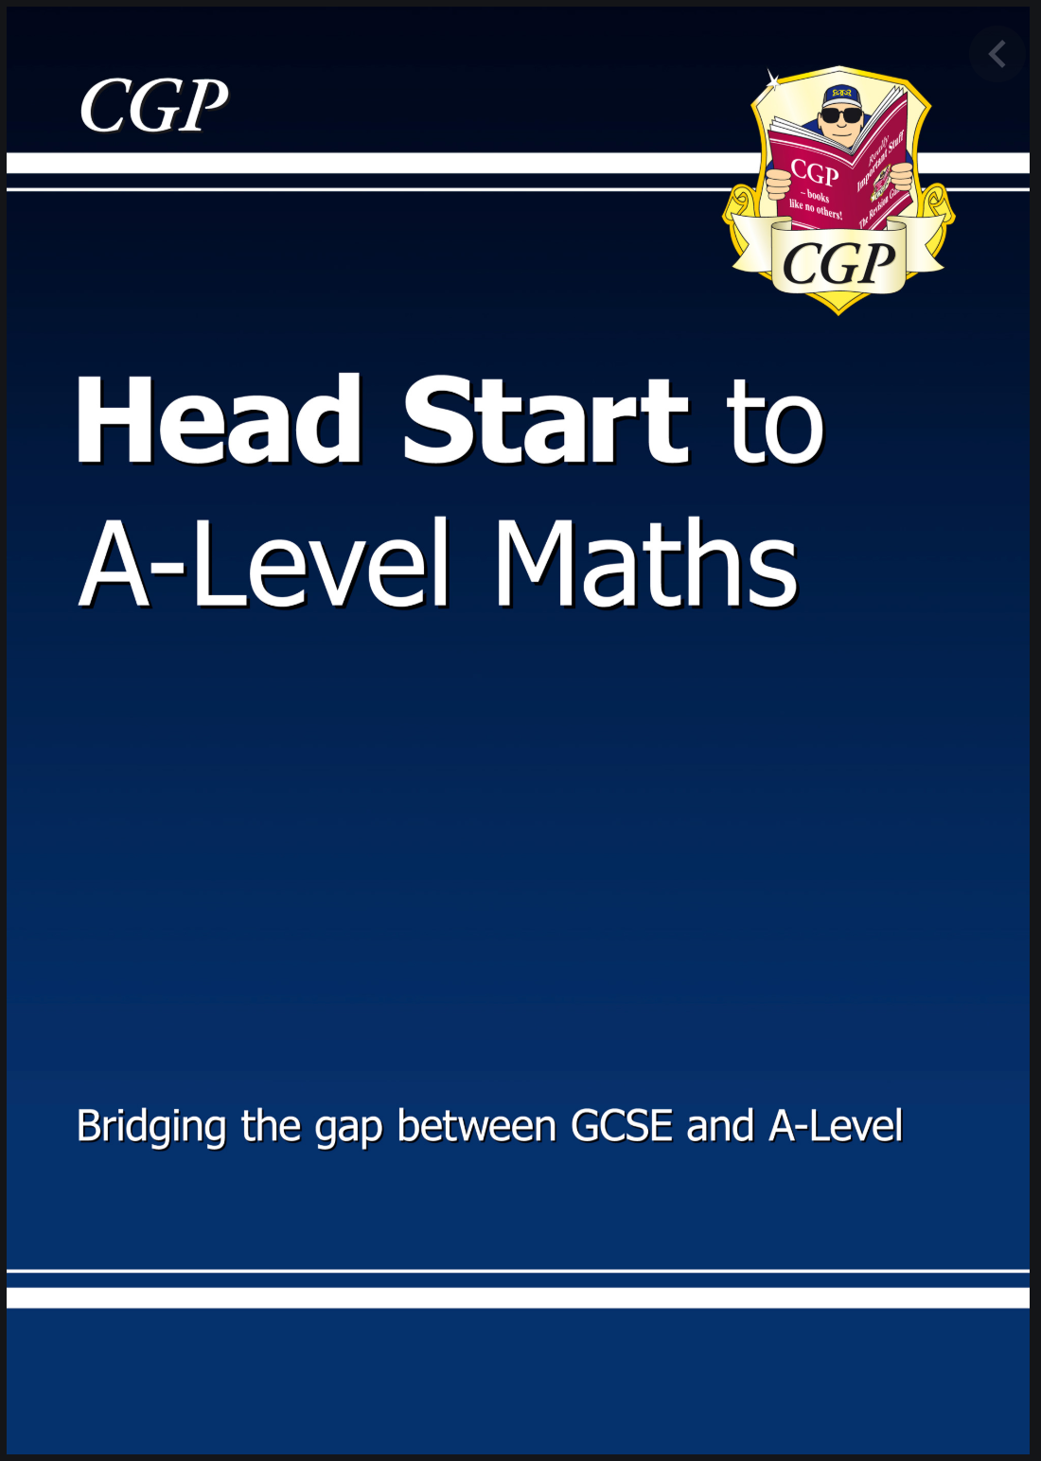
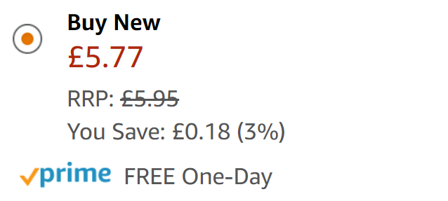



(Please click on the sound icon)

Slide 22
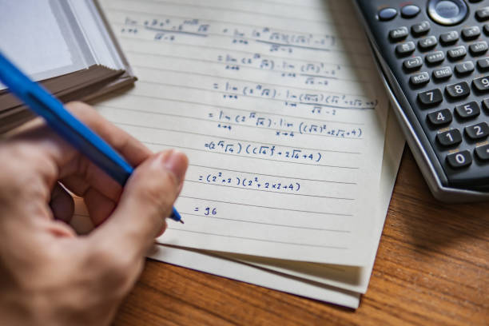

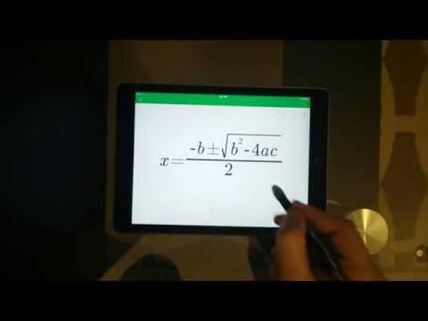
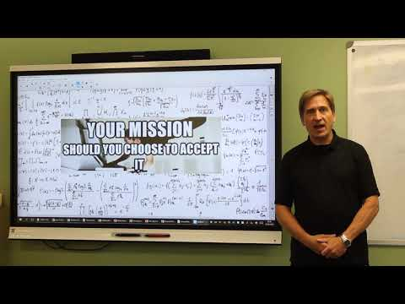
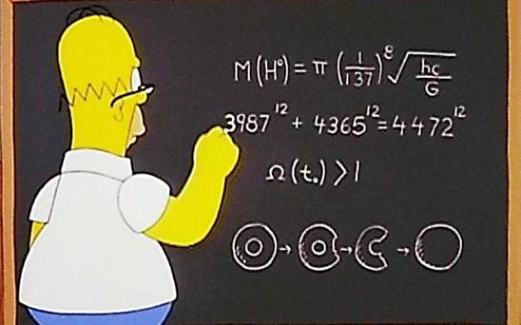



Slide 23
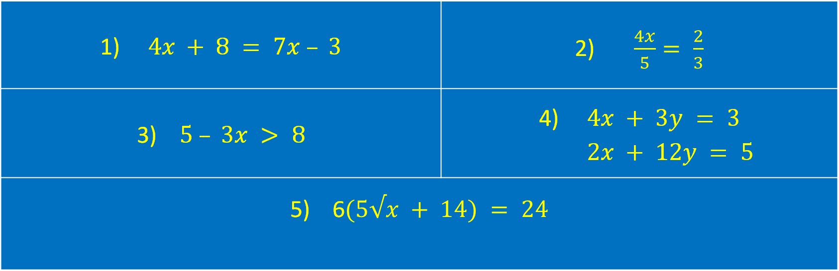

Algebra Challenge Part 1:
Can you find the values of $x$ (and $y$) for which the following are true? Video solutions are here
1) $4x + 8 = 7x – 3$ | 2) $\frac{4x}{5}= \frac{2}{3}$
3) $5 – 3x > 8$ | 4) $4x + 3y = 3$ $2x + 12y = 5$
5) 6$(5√x + 14) = 24$

Slide 24


Algebra Challenge Part 2:
Can you find the values of these (no calculators!)? Video solutions here
6) $8^{−1}$ | 7) ${169}^{\frac{1}{2}}$
Algebra Challenge Part 3:
Can you simplify these? Video solutions here
8) $(2x + 5)(4 – 3x)$ | 9) $xy\left(\frac{x}{y}+\frac{y}{x}\right)$

Slide 25


Algebra Challenge Part 4:
Can you factorise these (no calculators!)? Video solutions here
10) $p^{3}q^{2} + 3pq^{2} – pq$ | 11) $x^{2} + 5x – 14$
Algebra Challenge Part 5:
Can you make $x$ the subject ? Video solutions here
12) $\frac{3(x+5)}{y}=y$ | 13) $ax + bx = c$

Slide 26
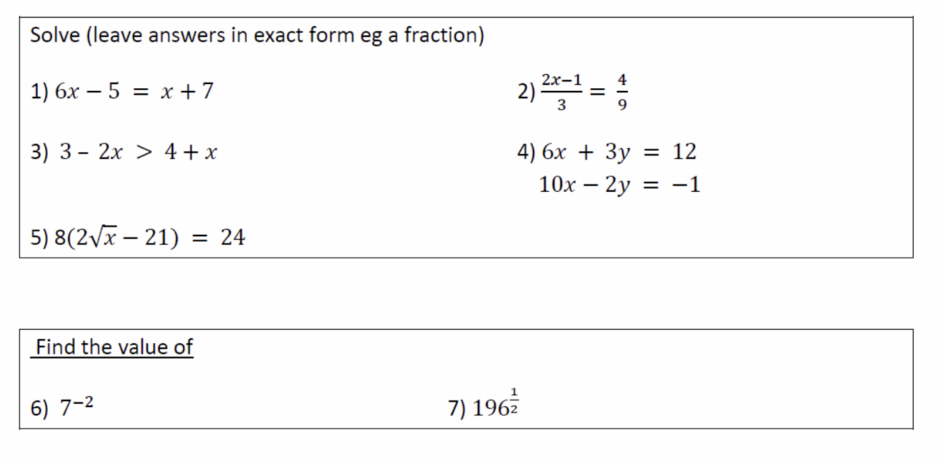
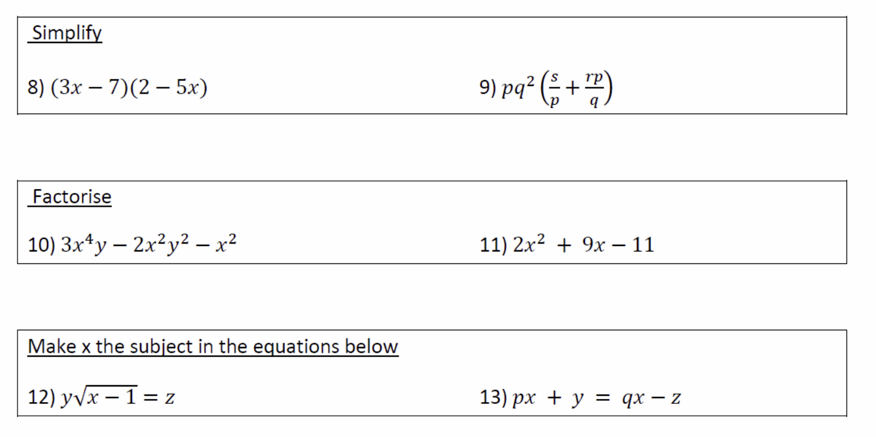
Now you should be able to tackle the questions below. We will tell you the answers in September!

Slide 27
Interested in Further Maths?
Then please also view the Further Maths taster session.

Slide 28

We hope this has given you useful information about Maths, good luck in your GCSEs and we hope to see you in the autumn.

