Slide 1
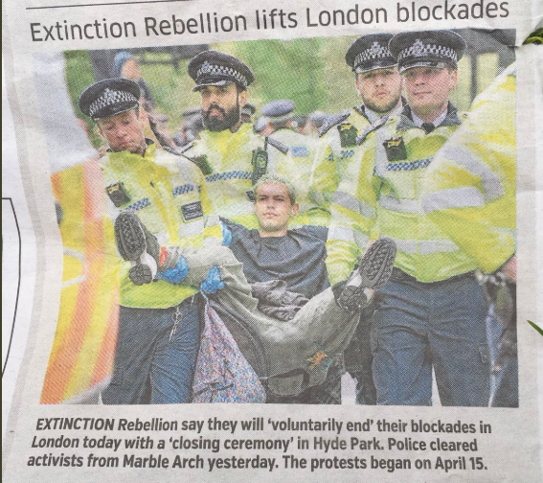
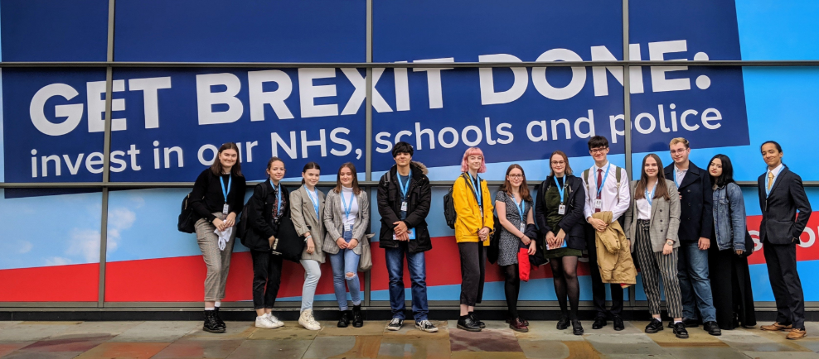
Why Politics?
It broadens horizons
Preparation for adult life
It builds essential university skills
It’s thought-provoking

Slide 2
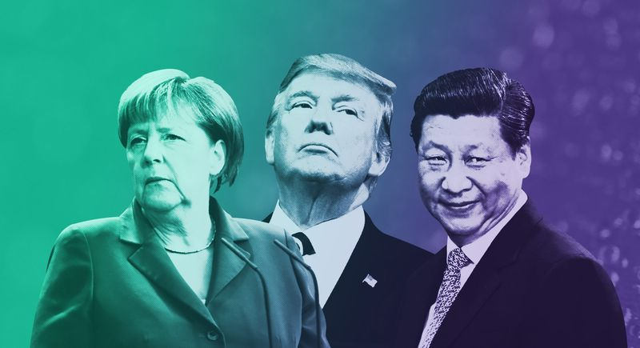
What will I study?
UK Politics
Political Ideas
UK Government
Global Politics

Slide 3
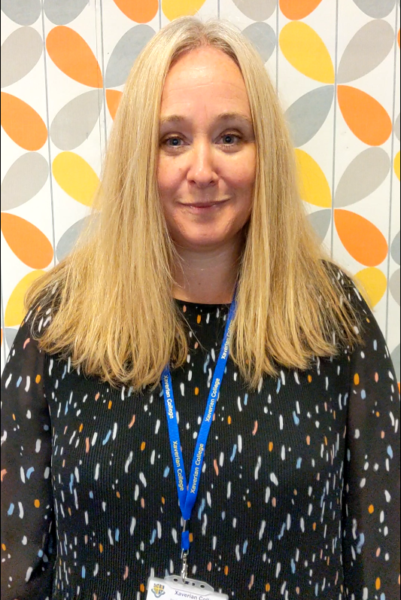
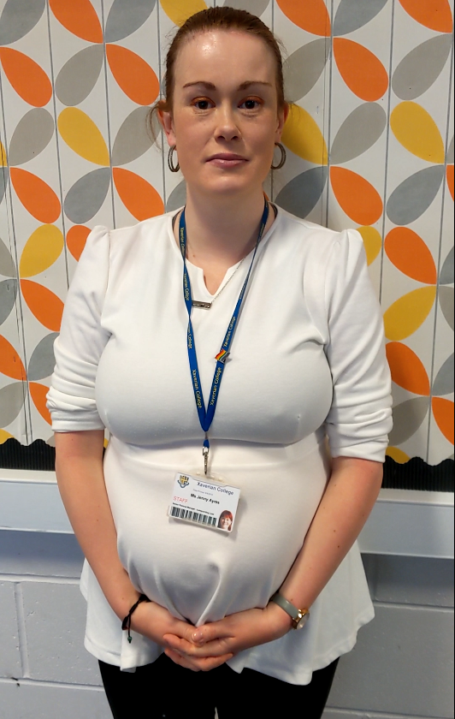
Meet the Politics Dept.
Alison Hall Head of Politics
Jenny Ayres Teacher of Politics
Click images to play on YouTube

Slide 4
Prepare for Politics
The single most effective act you can take to prepare for Politics is to regularly engage in local, national and global news. Examiners look for the use of recent examples to evidence political roles, processes and institutions.
Download a news app on your phone – Guardian, Times, HuffPost, Al Jazeera, CNN, MEN
Watch a quality TV news programme – C4 News, Sky News
Listen to a quality radio news programme – BBC Radio 4 & 5, LBC, coming soon Times Radio
Download politics podcasts

Slide 5
What do current and past students say about A Level Politics & the Dept?

Slide 11
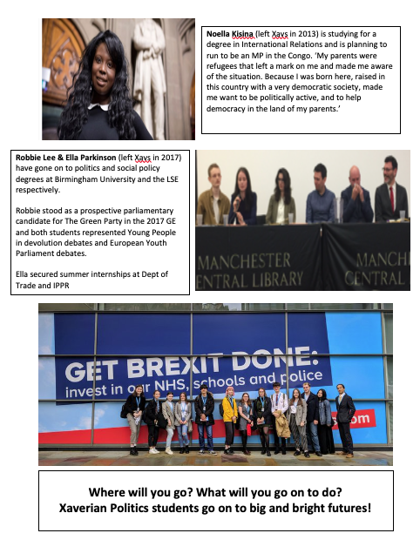

Slide 12
A Level Virtual Lesson
POWER

Slide 13
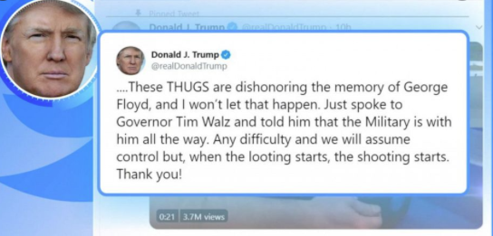
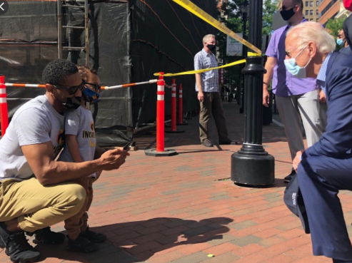
Power
Is a key concept that underpins politics
Is relevant to all areas of the course
Comes in different forms

Slide 14
TASK
You have 10 mins to write down answers to the following Qs – set a timer on your phone!
What is power?
How is power exercised?
Who has it?
What is the impact of who has power in society?
Who needs more power in society?

Slide 15
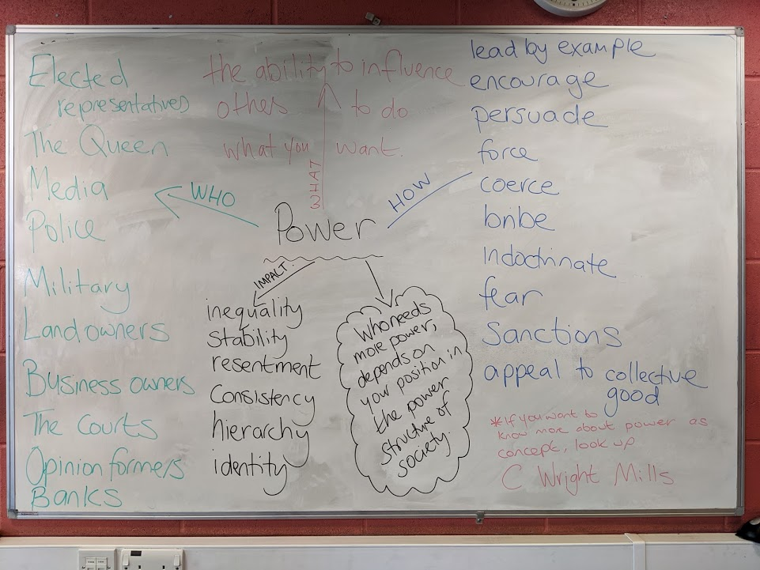
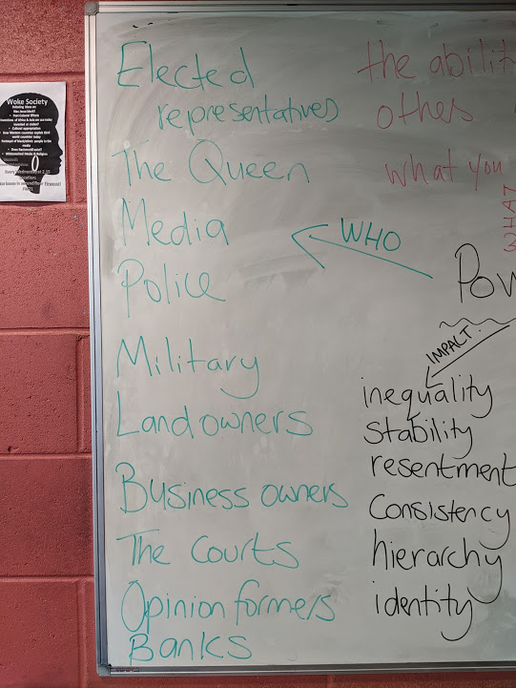
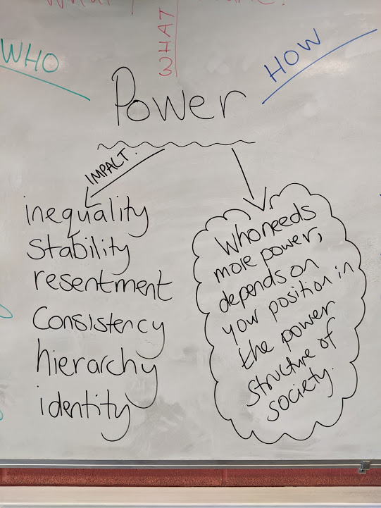
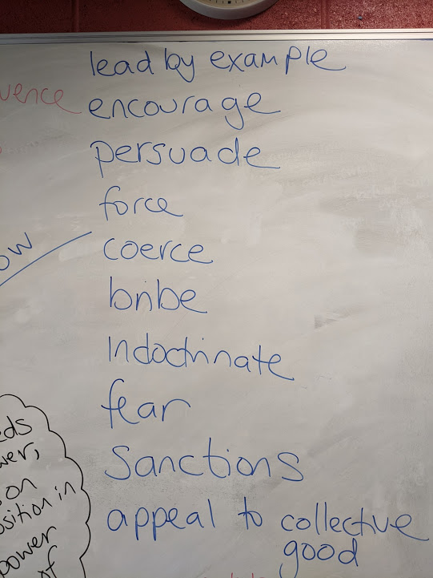
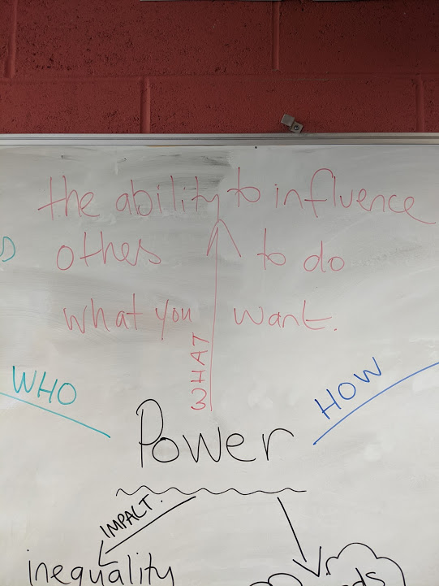

Slide 16
The Prime Minister is the focal point for power in the British political system. TASK 1: Work through the sources on the next 5 slides (graphics, video links, article). TASK 2: Answer the following questions using the source material. What power does a PM have? Where does that power come from? How might a PM’s power be limited by others?

Slide 17
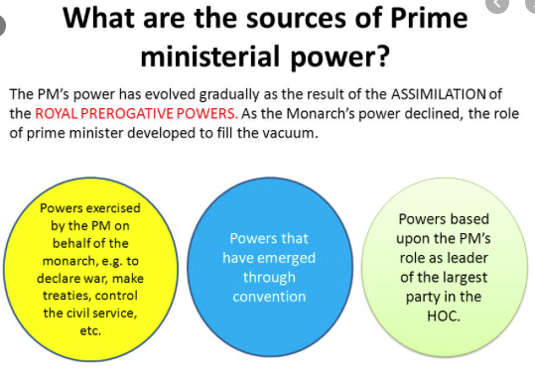

Slide 18
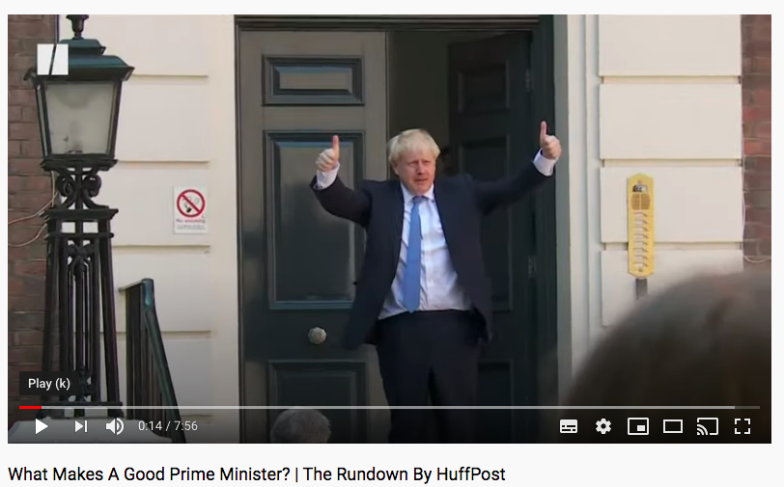
What makes a good Prime Minister

Slide 19
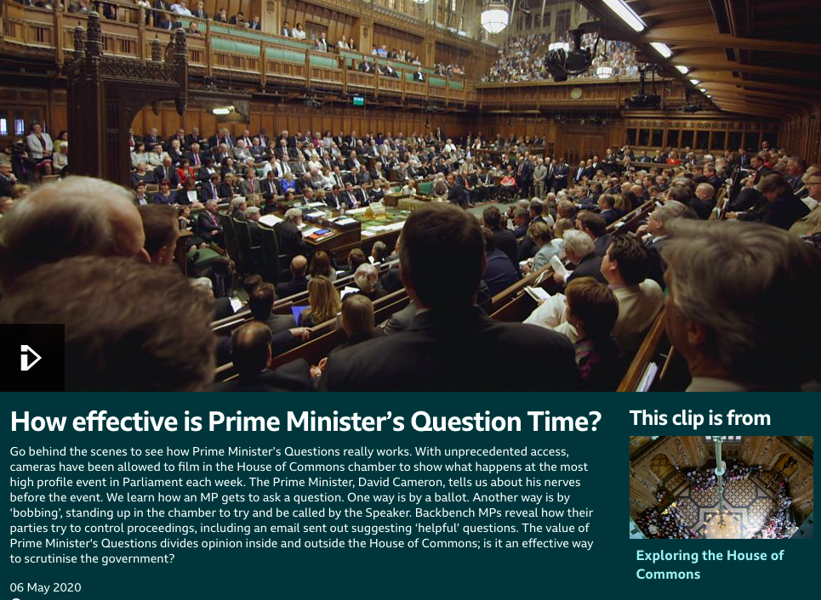
https://www.bbc.co.uk/programmes/p02msv8d

Slide 20
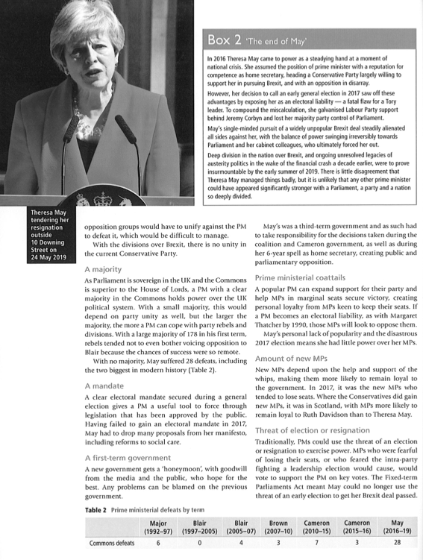

Slide 21
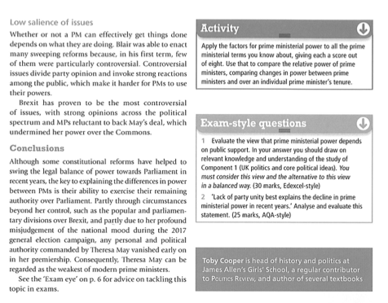

Slide 22
Work through the following test on Seneca on the role and powers of the PM.
(You will need to download Seneca App or access task through the link below on a tablet or PC or phone – We will be able to see how you get on with the task!) Class code: apKv7nihtp

Slide 23
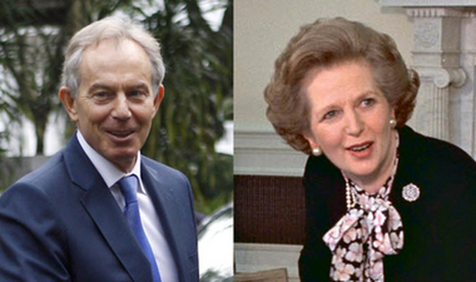
Battle of the PMs Who was the most powerful?

Slide 24
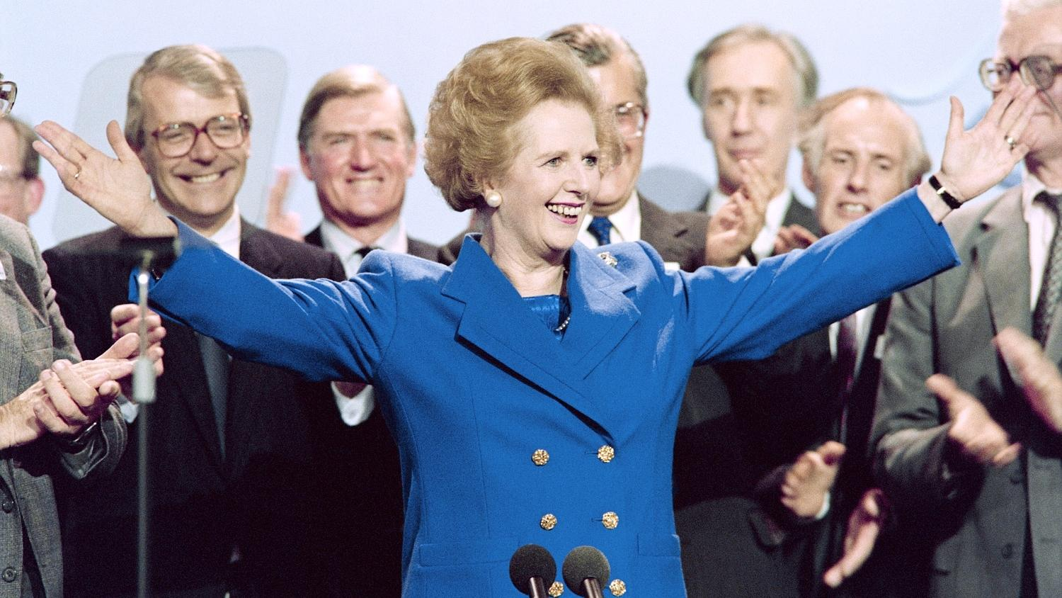
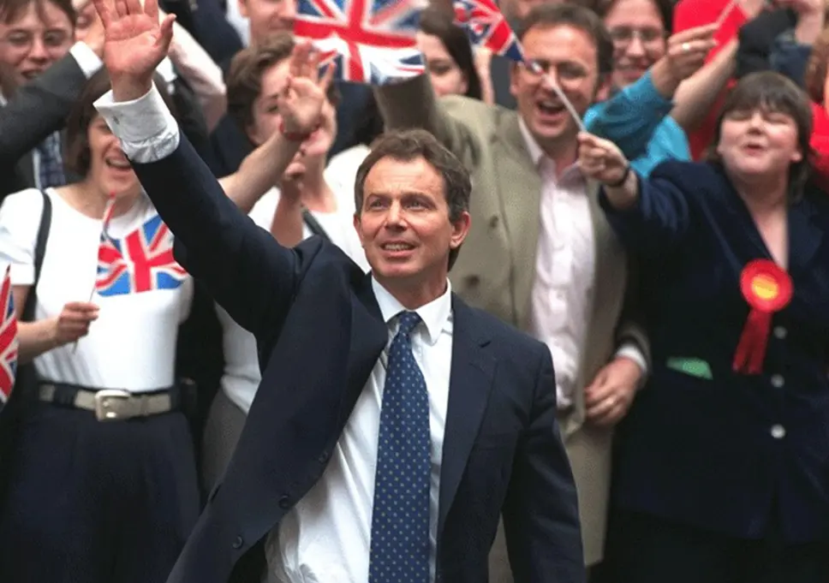
Listen to the audio file and make a list of the arguments that propose why Tony Blair and Margaret Thatcher were each powerful PMs.
Who do you think was the most powerful PM (Blair or Thatcher) and why, what is the strongest argument made to support your view? Both politics teachers have different views and you hear both of ours below.

Slide 25
Thank you for taking part in the lesson. We hope it engaged you and you got a taste for the approaches we use in the classroom. If you want to learn more about ‘Power’ & the A Level Politics Specification, there are a few slides that follow with links to resources to keep you thinking about politics.

Slide 26
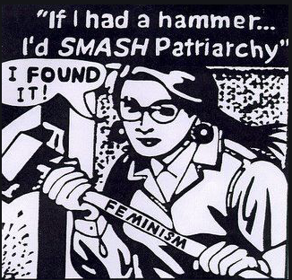
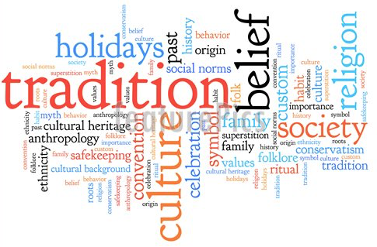
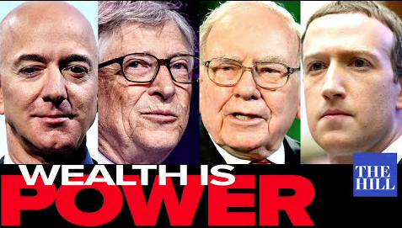
Power & Political Ideologies
Power is a vital concept that we study when exploring political philosophies – click on each bullet point for further resources to explore power
Liberalism: the power of the state should be limited by a constitution
Socialism: the power of wealth accumulation in capitalist societies
Conservatism: the power of traditional norms and values
Feminism: the institutional power of patriarchy

Slide 27
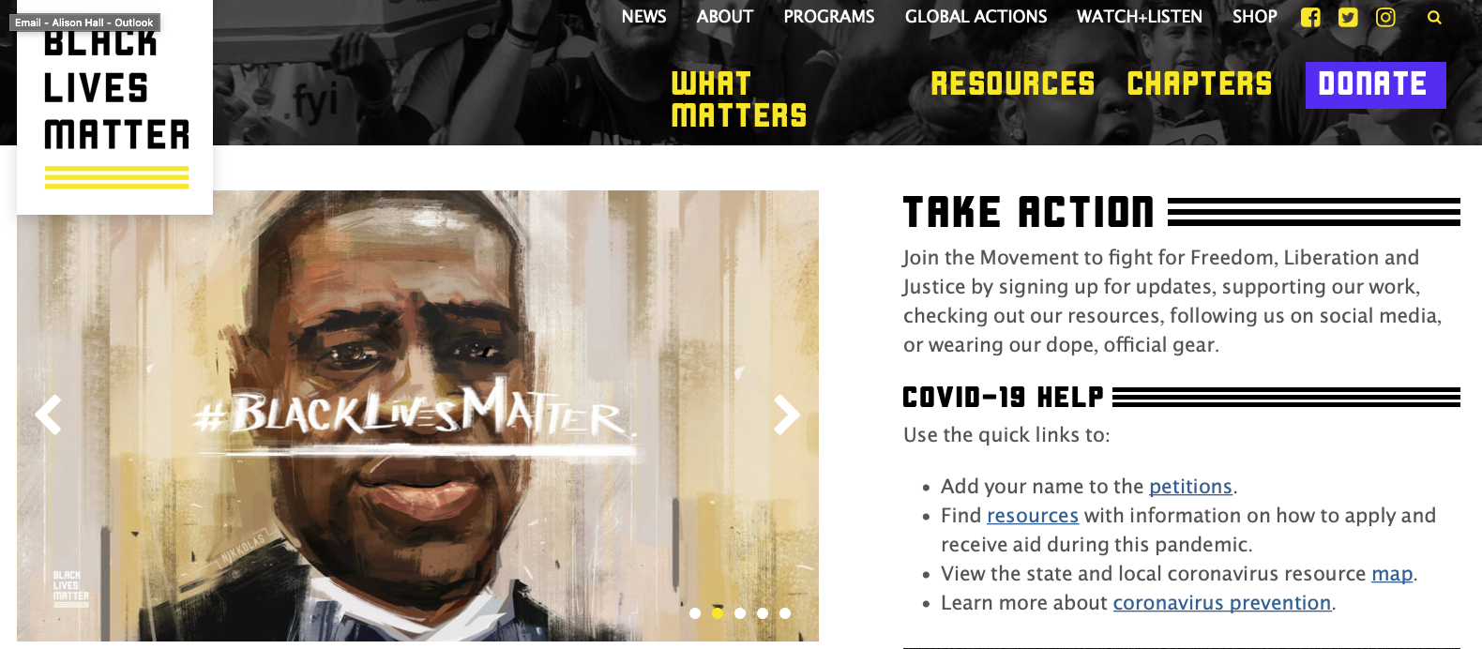
Power in UK Politics
There are many groups in UK society who lack access to power and decision making due to sex, race, class, age, disability, sexuality and religion. The powerless often use legal and illegal campaigning methods to try to pressure and influence the public, media and hopefully the political agenda.

Slide 28
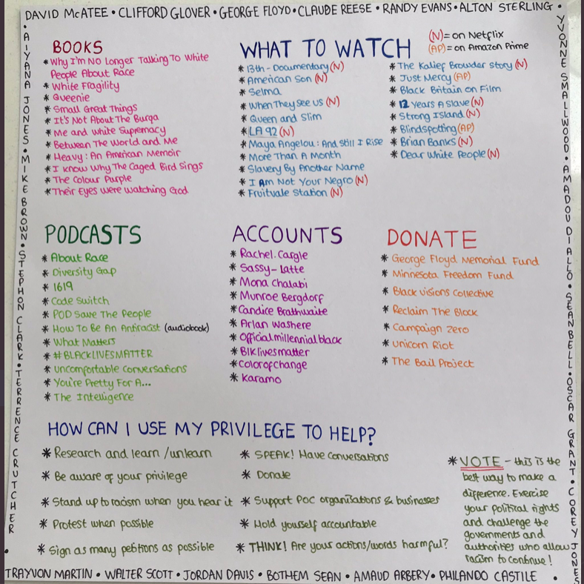
TASK: Access some of these resources to find out more about BLM in the UK and US and more widely about race & power
https://blacklivesmatter.com/about/
https://www.newstatesman.com/politics/uk/2020/06/we-cant-breathe
http://www.theglassbeadgame.co.uk/episode/blacklivesmatter/

Slide 29
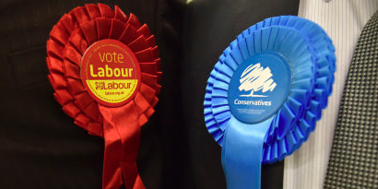
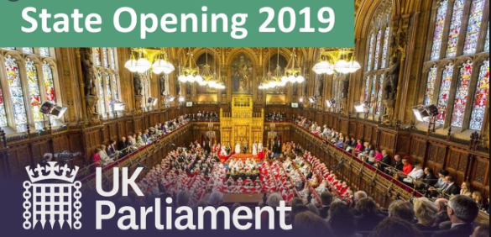
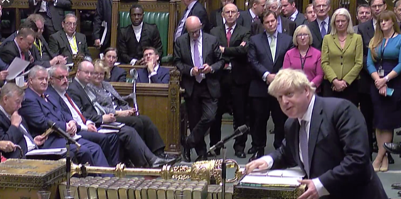
Power & The British Governing System
At the heart of any governing system is the location of power and mechanisms which act to hold the powerful to account.
Most liberal democracies have a written codified constitution, we do not.
Most liberal democracies have a separation of power between their legislative, administrative and judicial arms, we do not.
Most liberal democracies have co-equal powerful governing arms, we do not.
Most liberal democracies have an elected head of state, we do not.
Most liberal democracies have higher constitutional law which protects citizens rights, we do not.
Most liberal democracies use electoral systems which offer broad political party choice, we do not.

Slide 30
A constitution is a system of rules which describes the structure and powers of Government, the relationship between different parts of the Government, and the relationship between the Government and the citizen. The constitution is recognised as a reliable source of guidance and instruction of how a country should be governed.
To have some element of sovereignty
To give a Govt. legitimacy
To maintain stability in governance
To set out clear functions & powers of each branch of govt
To provide accountability through checks & balances
To set out citizens’ rights and duties
To safeguard citizens freedoms
TASK: Watch these two videos to compare and contrast the US https://www.khanacademy.org/humanities/us-history/road-to-revolution/creating-a-nation/v/the-us-constitution
and UK https://www.youtube.com/watch?v=bgib9vrTPTE
constitutions

Slide 31
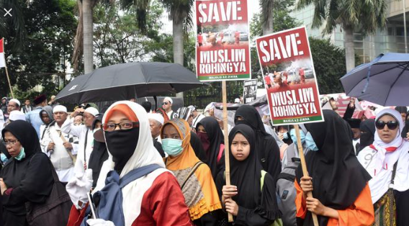
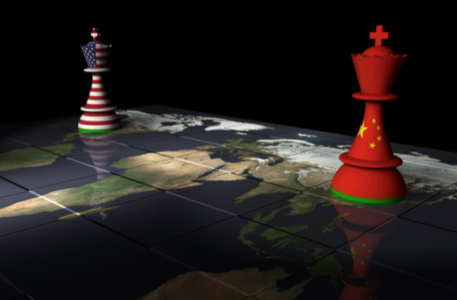
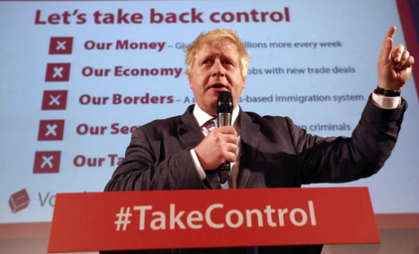
Power in Global Politics
Global politics is ALL about the use of hard & soft power in relations between states. Click on the link above for a documentary on Globalism
The ability of states to strike trade deals which suit themselves rather than other states
States whose actions home and aboard don’t get challenged
States who can put a block on the progress of other states
States who see a benefit in pooling power to tackle common issues
States whose culture shape views, beliefs and actions around the world

Slide 32
Politics Enrichment – student run Feminist, Debate & Model United Nations groups

Slide 33
Good luck with your GCSEs and see you in September in person, hopefully!

