Slide 1
BTEC SPORT
XAVERIAN COLLEGE
Virtual New Students Day 2020

Slide 2
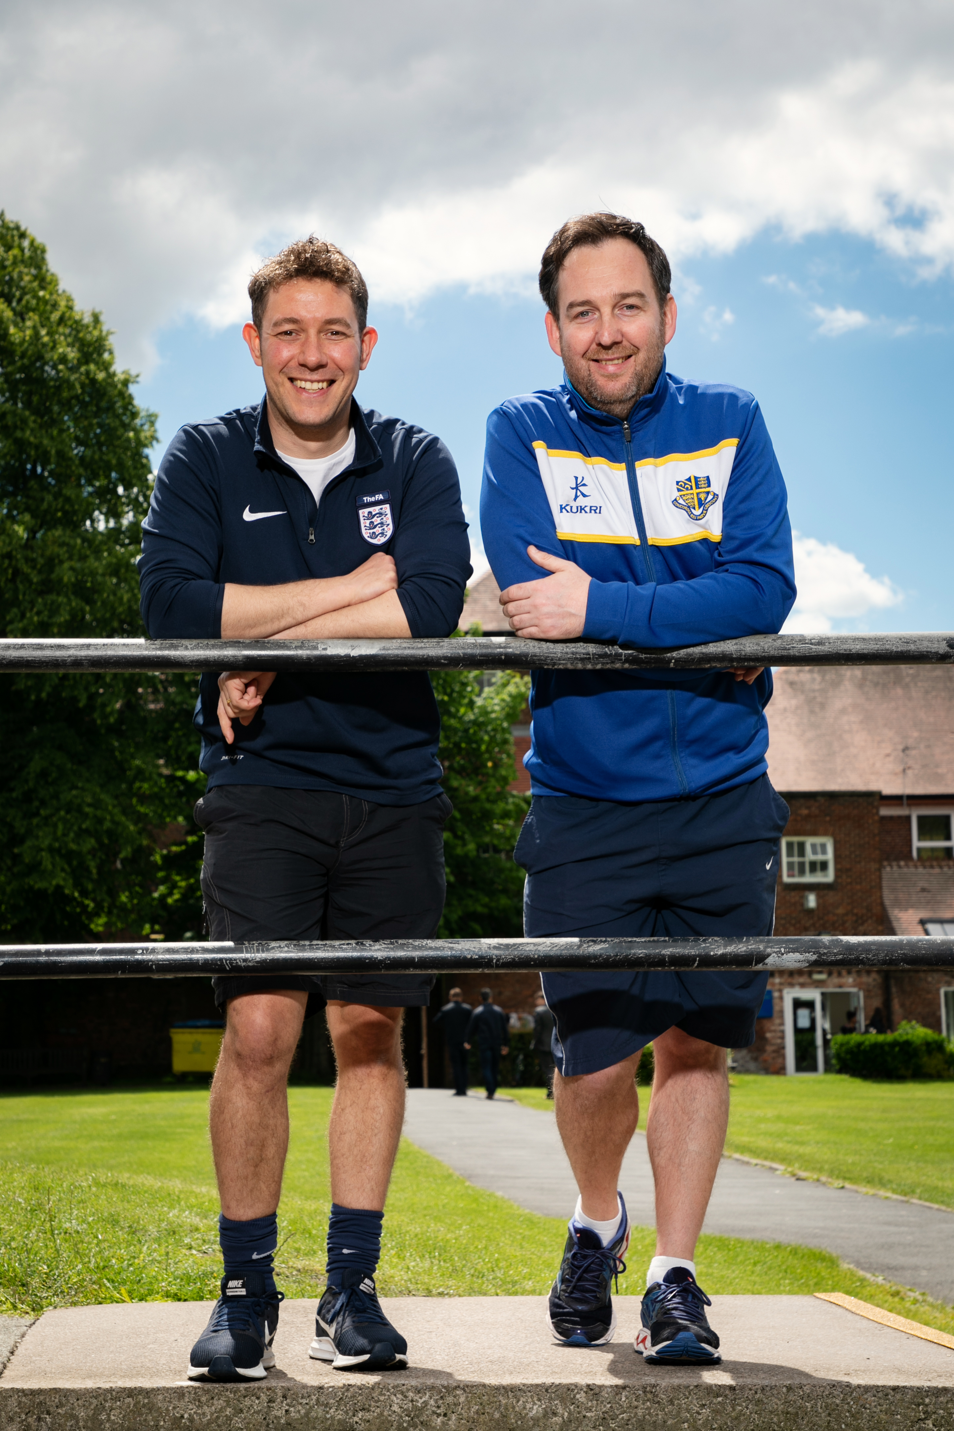
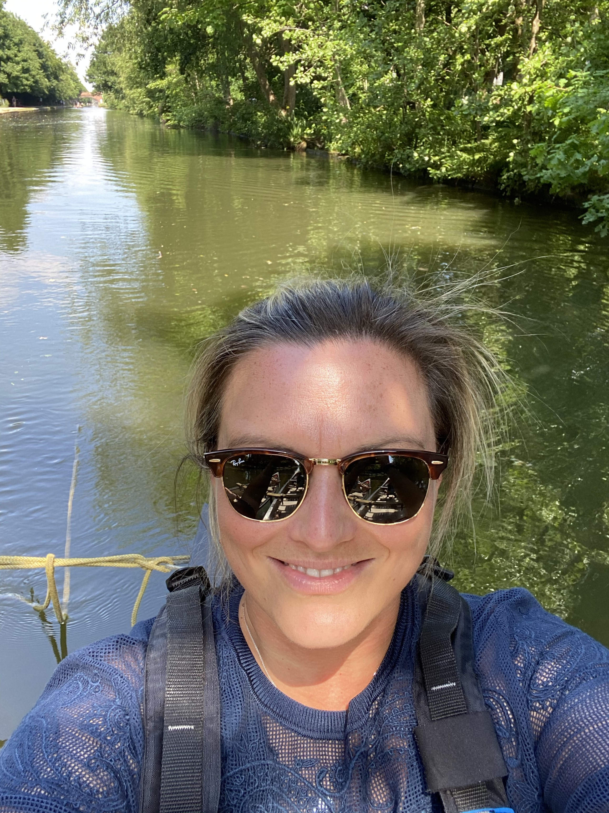
Meet Your teachers in the sports department...
Mr Kilroy - Curriculum Leader and Teacher of BTEC Sport (blue top)
Mr Anthony - Teacher of BTEC Sport (navy top)
Mrs Horner - Teacher of BTEC Sport

Slide 3
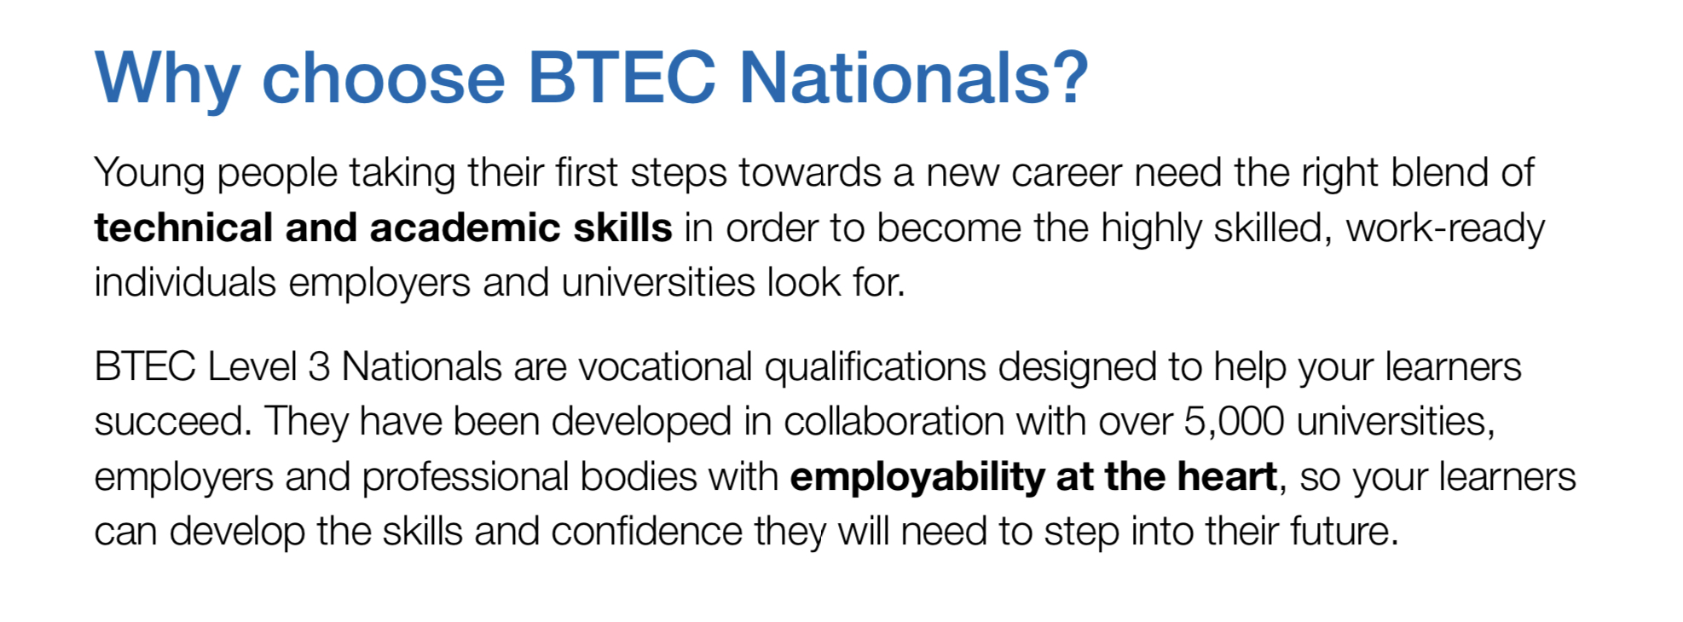

Slide 4
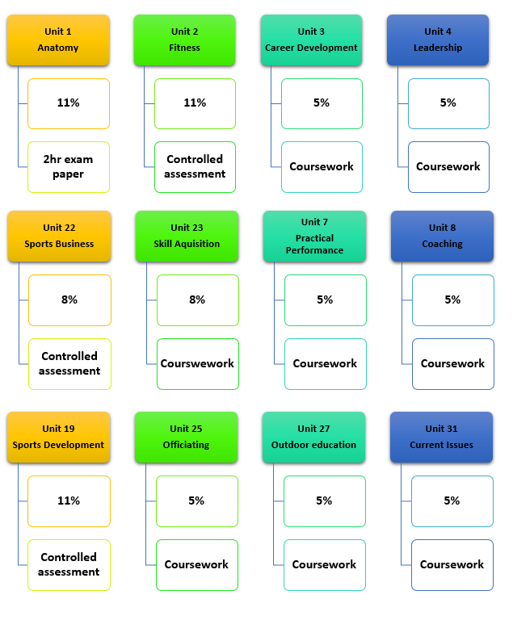
Btec level 3:
national Extended diploma
This BTEC is the equivalent to 3 A Levels and will take up all of your 3 available blocks of study.
You will complete 14 units some of which are coursework based and a smaller amount that are assessed externally through 1 exam and 3 controlled assessments.
You will also complete one further unit (not detailed in the diagram).

Slide 5
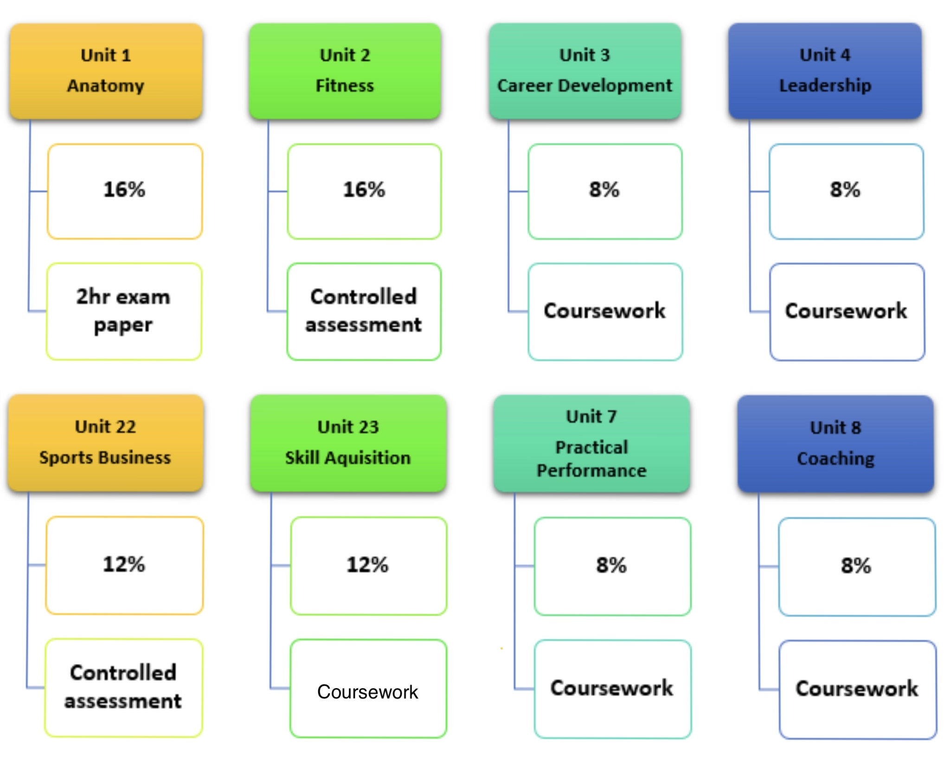
Btec level 3:
national Diploma
This BTEC is the equivalent to 2 A Levels and will take up two blocks of study. This means that you can chose to study it with another subject choice.
You will complete 9 units some of which are coursework based and a smaller amount that are assessed externally through 1 exam and 2 controlled assessments.
You will also complete one further unit (not detailed in the diagram).

Slide 6
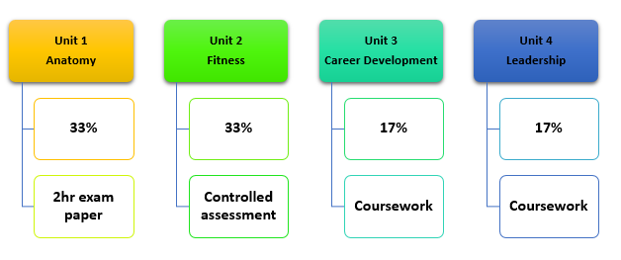
Btec level 3:
National extended certificate
This BTEC is the equivalent to 1 A Level and will take up one block of study. This means that you can chose to study it with two other subject choices.
You will complete 4 units some of which are coursework based and a smaller amount that are assessed externally through 1 exam and 1 controlled assessment.

Slide 7
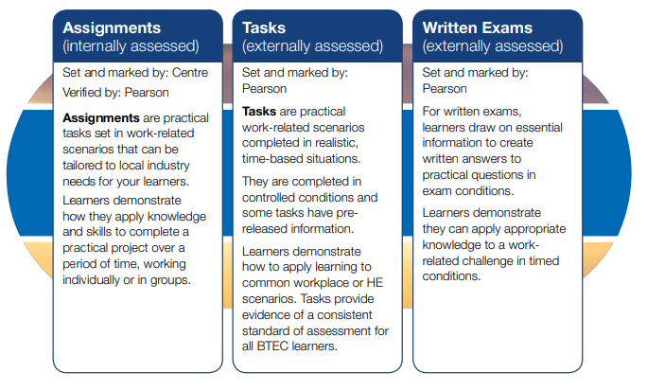
HOW WILL YOU BE ASSESSED AND GRADED?

Slide 8
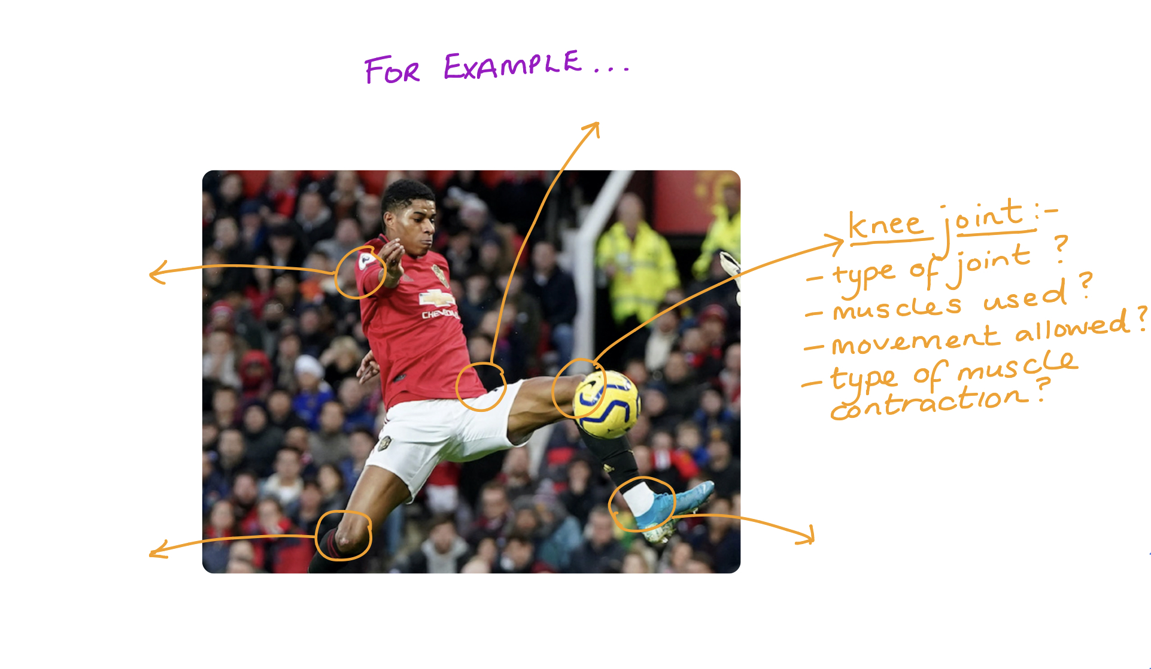
VIRTUAL LESSON CONTENT AND TASTER TASKS....
Fitness Task – Linked to controlled assessment task
Reading the scenario below – State what strategies you would use to help the client achieve their goals.
SCENARIO
Mrs Hall is a 42 year old who works 9 hours a day in a care home. She does not currently take part in any exercise and has two young children to look after when she gets home.
Her friend wants them to both start exercising but they are struggling to find time to do so. They are both attending a wedding in six weeks’ time.
Mrs Hall wants to fit into a smaller dress size for her friend’s wedding.
Mrs Hall has previously completed a PAR-Q form and has indicated that she has no medical conditions and is fit to take part in physical activity.
Occupation:
What is your occupation? Care Assistant
How many hours do you work daily? 8-5 with a 1 hour lunch break
How far do you live from your workplace? 1.5 miles
How do you travel to work? Bus
Current activity levels:
How many times a week do you currently take part in physical activity? Not at all
Physical activity/sporting goals
Become fitter
Wants to lose weight
Test results:
Test Score
Blood Pressure 128/84
Resting Heart Rate 67
Body Mass Index 36
Waist-to-Hip Ratio 0.95
Current Issues Task – Linked to coursework
Complete a report discussing whether the Premier league should have started back on 17/6/20. (As with all discussion work, you need to give positive and negative arguments to the questions)
Anatomy Physiology Task - Linked to the exam
Get a picture of a sports performer of your choice and analyse the joints in the body that are used by this sports performer

Slide 9
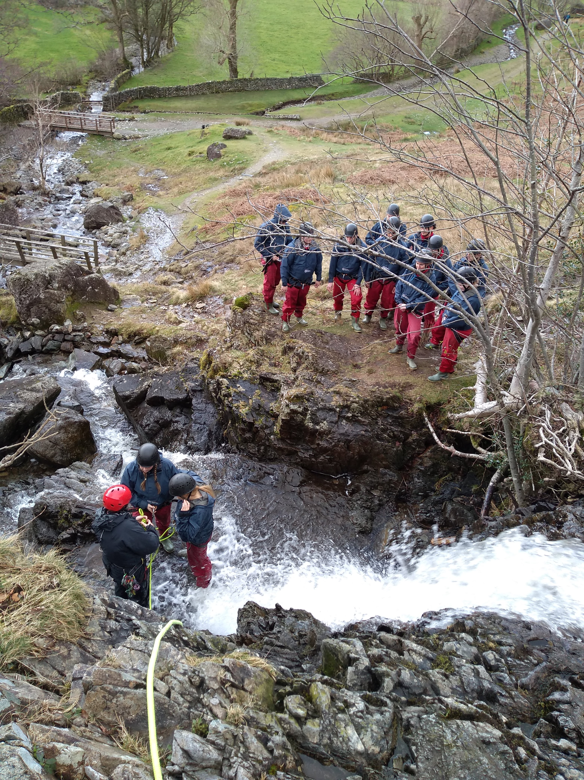
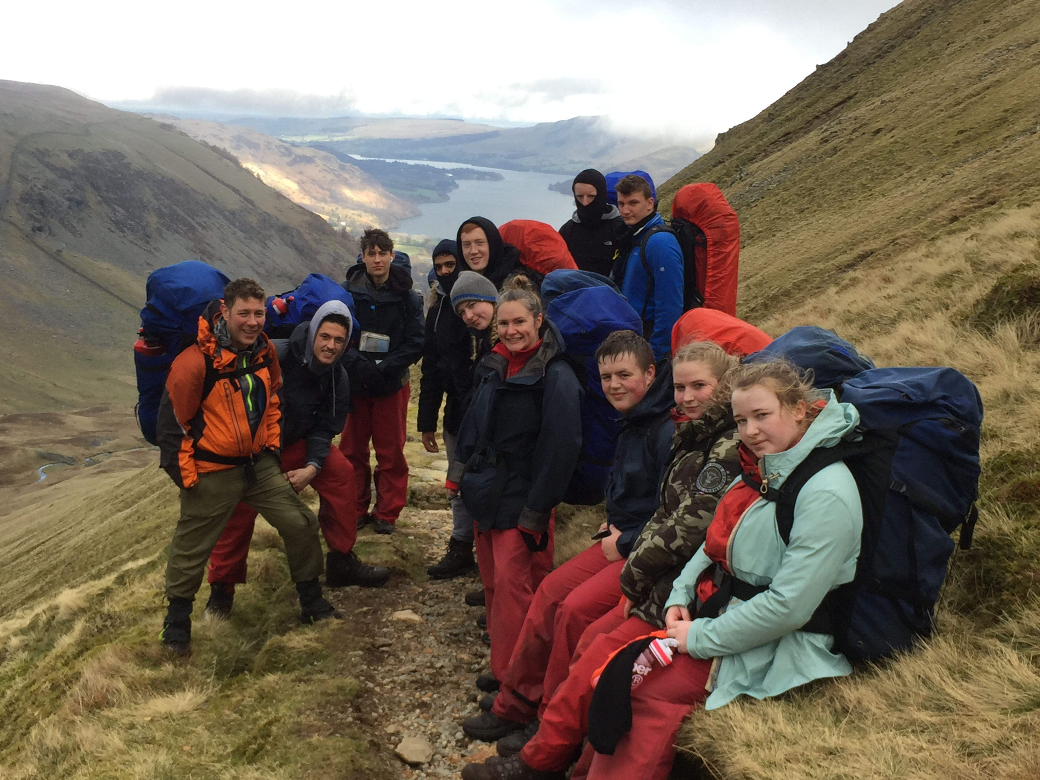
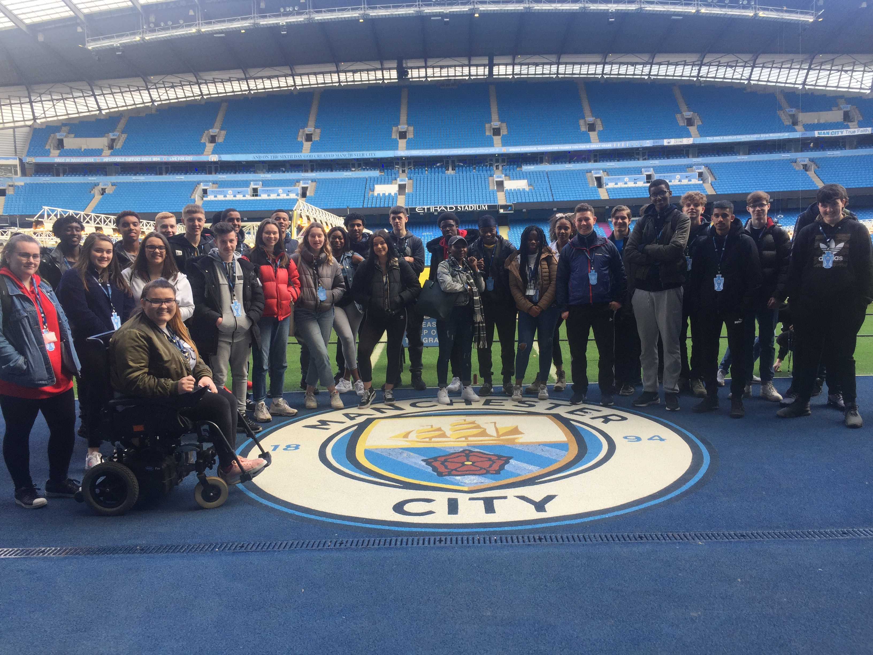
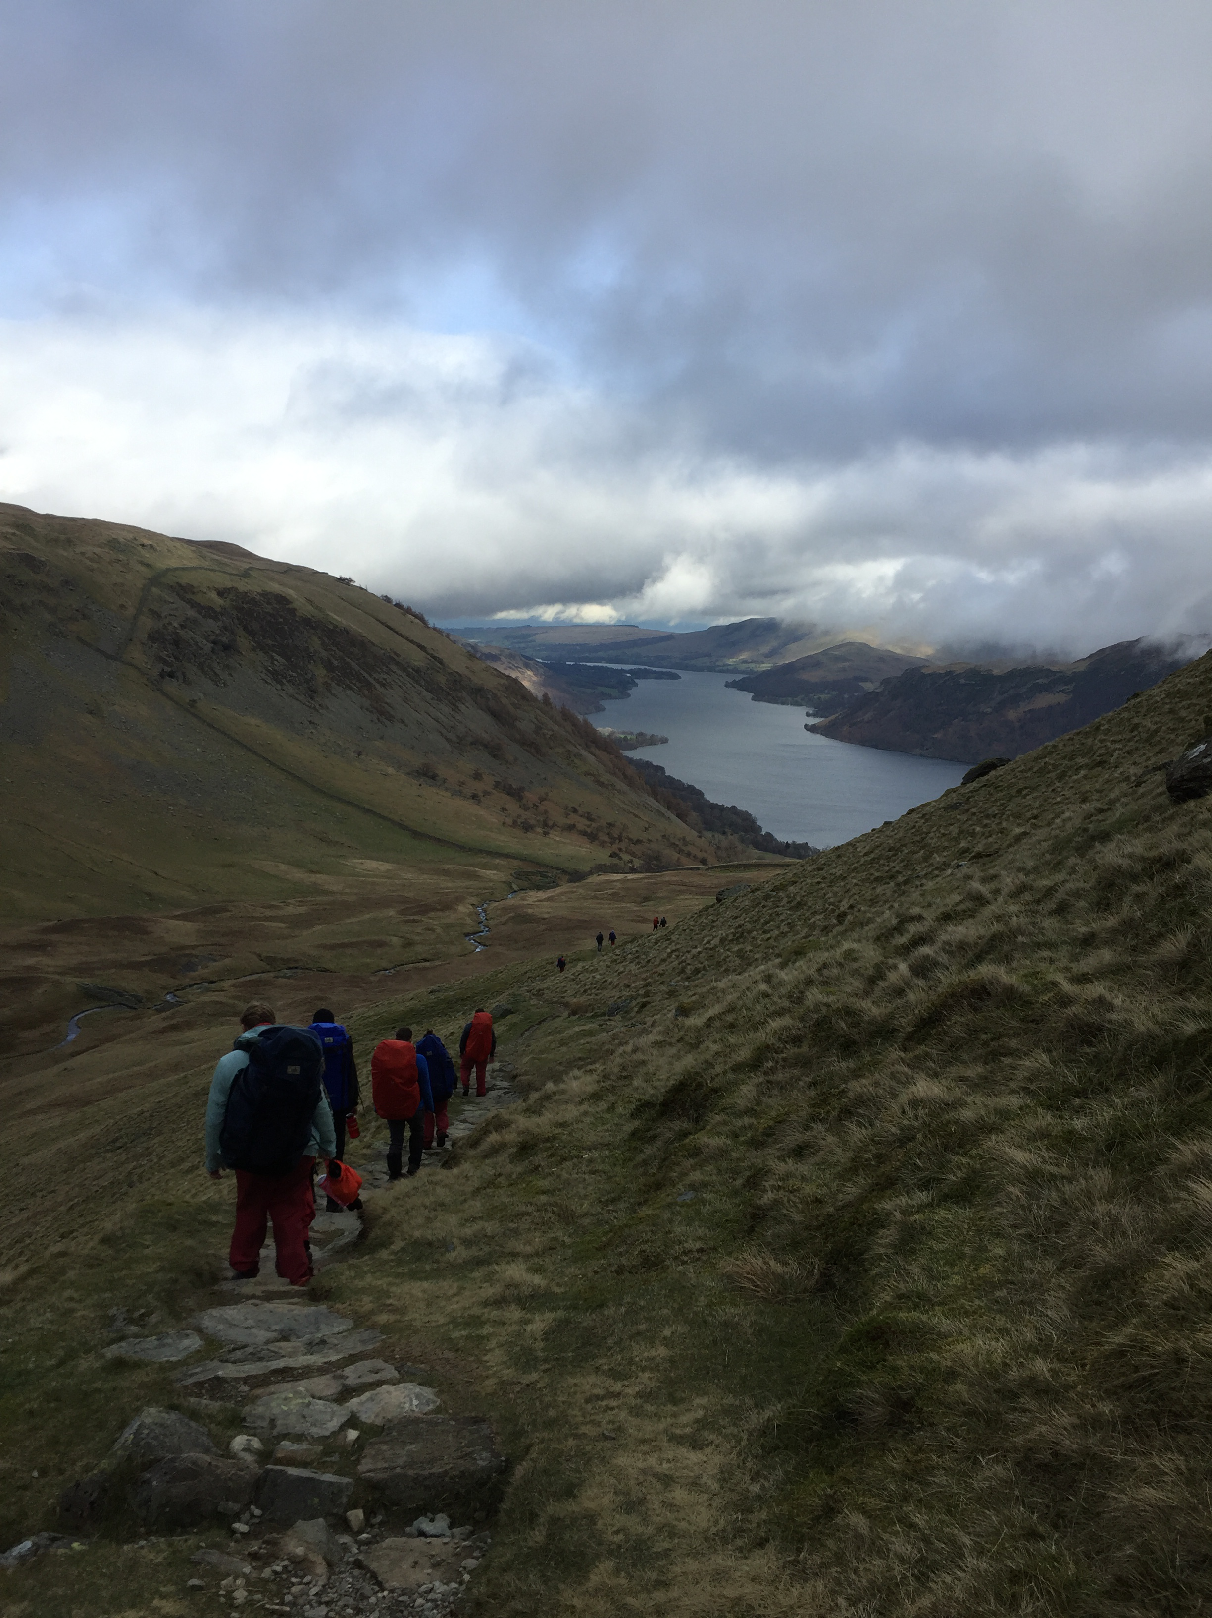
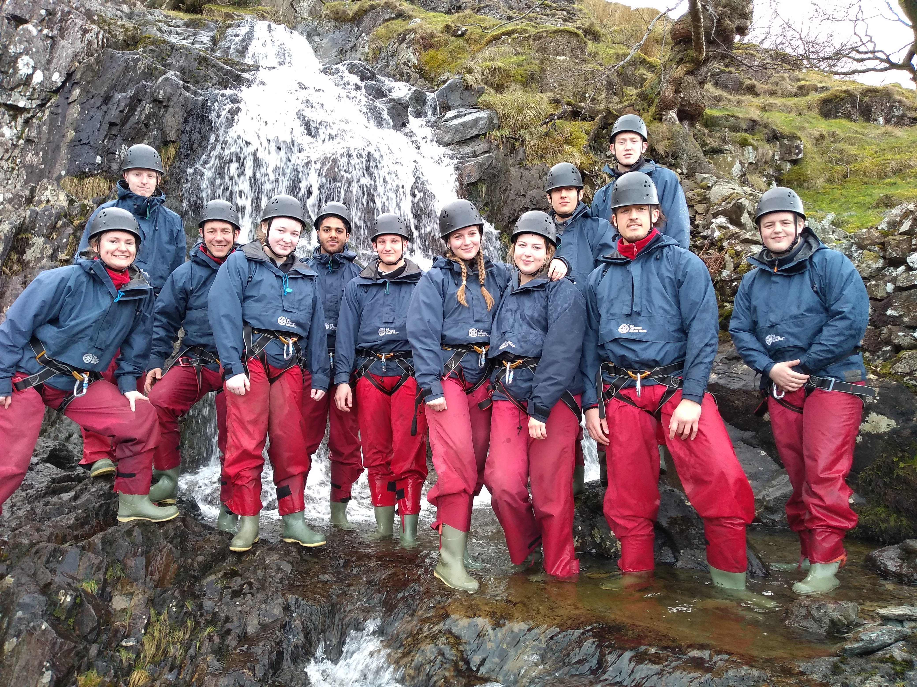
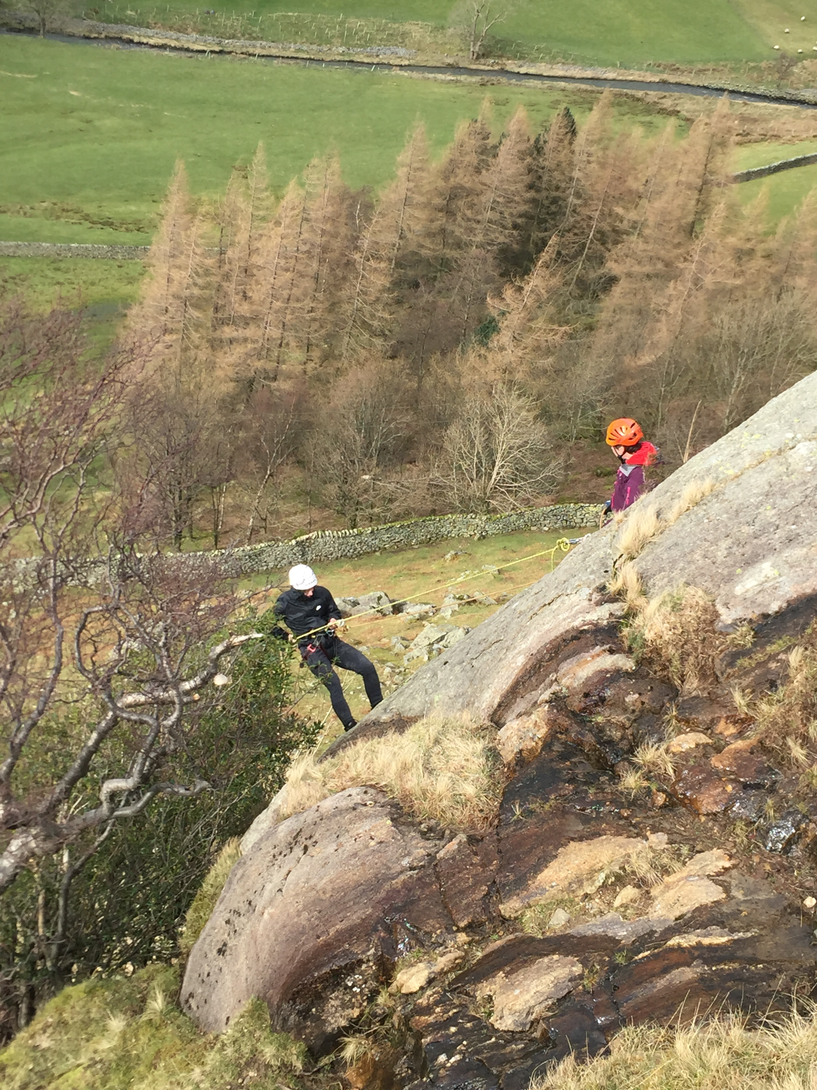
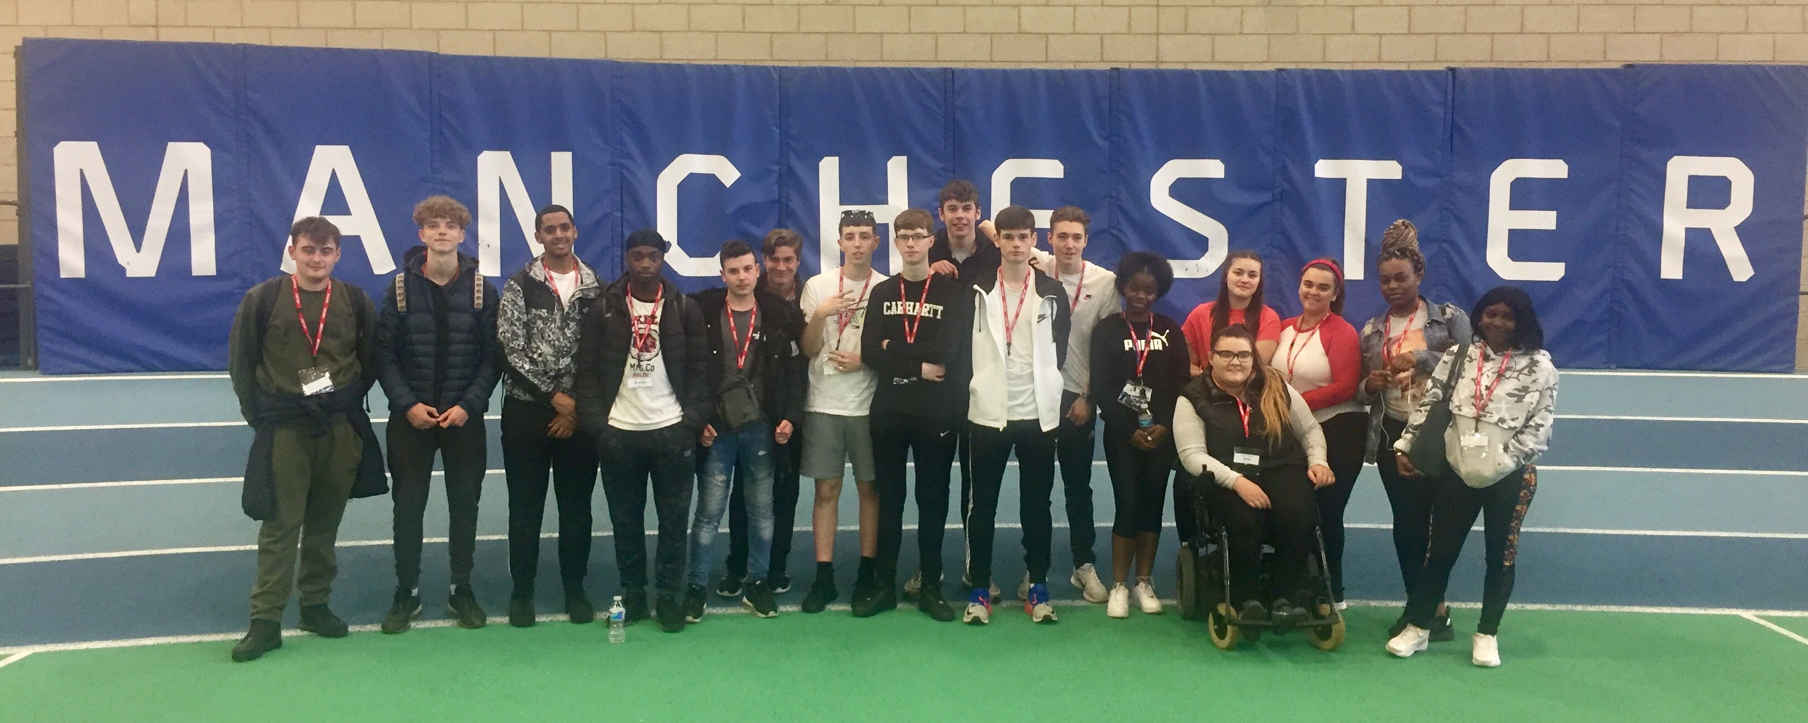
TRIPS AND EXTRA CURRICULAR

