Slide 1
Welcome to Applied Science
A brief introduction to what you can expect when studying applied science.
Ed Hillman – Curriculum Leader for Applied Science
e.Hillman@Xaverian.ac.uk

Slide 2


Slide 3
Course Structure
Two year course with options for the equivalent of 1, 2 or 3 A Levels
BTEC Nationals are offered in different sizes. Be sure to know which size course you are on. At Xaverian College we offer the ones highlighted in yellow below which will take you 2 years to complete.
Full course name | A’ level equivalence
BTEC L3 National Certificate | ½
BTEC L3 National Extended Certificate | 1
BTEC L3 National Foundation Diploma | 1½
BTEC L3 National Diploma | 2
BTEC L3 National Extended Diploma | 3

Slide 4
Course Structure
Two year course with options for the equivalent of 1, 2 or 3 A Levels
In the first year.
 | Teachers LM SUL GWG | Teacher MJH FT NS | Teacher EH LXM
Term 1 September to December (approx) | Unit 2 Practical Scientific Procedures and techniques 90 GLH Mandatory Set assignments Internally marked | Unit 11 Genetics and Genetic Engineering 60 GLH Optional Set assignments Internally marked | Unit 8 Physiology of Human Body Systems 60 GLH Optional Set assignments Internally marked
Term 2 December to February (approx) |  | Unit 3 Science Investigation Skills 120 GLH Mandatory External Written assignment set and marked by exam board | Unit 10 Biological Molecules and Metabolic Pathways 60 GLH Optional Set assignments Internally marked
 | Unit 1 Principals and applications of Science I 90 GLH Mandatory Written exam set and marked by exam board
Term 3 March to May (approx) |  |  | Unit 12 Diseases and Infections 60 GLH Optional Set assignments Internally marked
COURSE ENDING JUNE 2022

Slide 5
Unit 1: Principles and Applications of Science I
External Assessment
Three 40 minute exams
This unit covers some of the key science concepts in biology, chemistry and physics.

Slide 6
Unit 3: Science Investigation Skills
External Assessment
A practical and write up under exam conditions
You will cover the stages involved and the skills required to plan a scientific investigation, record and interpret data, and draw scientific conclusions.

Slide 7
Unit 2: Practical Scientific Procedures and Techniques
Internal Assessment
Coursework
Learners will be introduced to quantitative laboratory techniques, calibration, chromatography, calorimetry and laboratory safety, which are relevant to the chemical and life science industries.

Slide 8
Unit 11: Genetics and Genetic Engineering
Internal Assessment
Coursework
We will gain an understanding of the structure of DNA, cell division and the principles of Mendelian genetics and variation.

Slide 9
Unit 8: Physiology of Human Body Systems
Internal Assessment
Coursework
We will study the physiological make up of three human body systems (musculoskeletal, lymphatic and digestive), how the systems function and what occurs during dysfunction.

Slide 10
Unit 10: Biological Molecules and Metabolic Pathways
Internal Assessment
Coursework
This unit covers biological molecules and the metabolic pathways involved in chemical reactions to enable organisms to function normally.

Slide 11
Unit 12: Diseases and Infection
Internal Assessment
Coursework
We will study five types of diseases, their causes and how humans try to prevent and treat them.

Slide 12
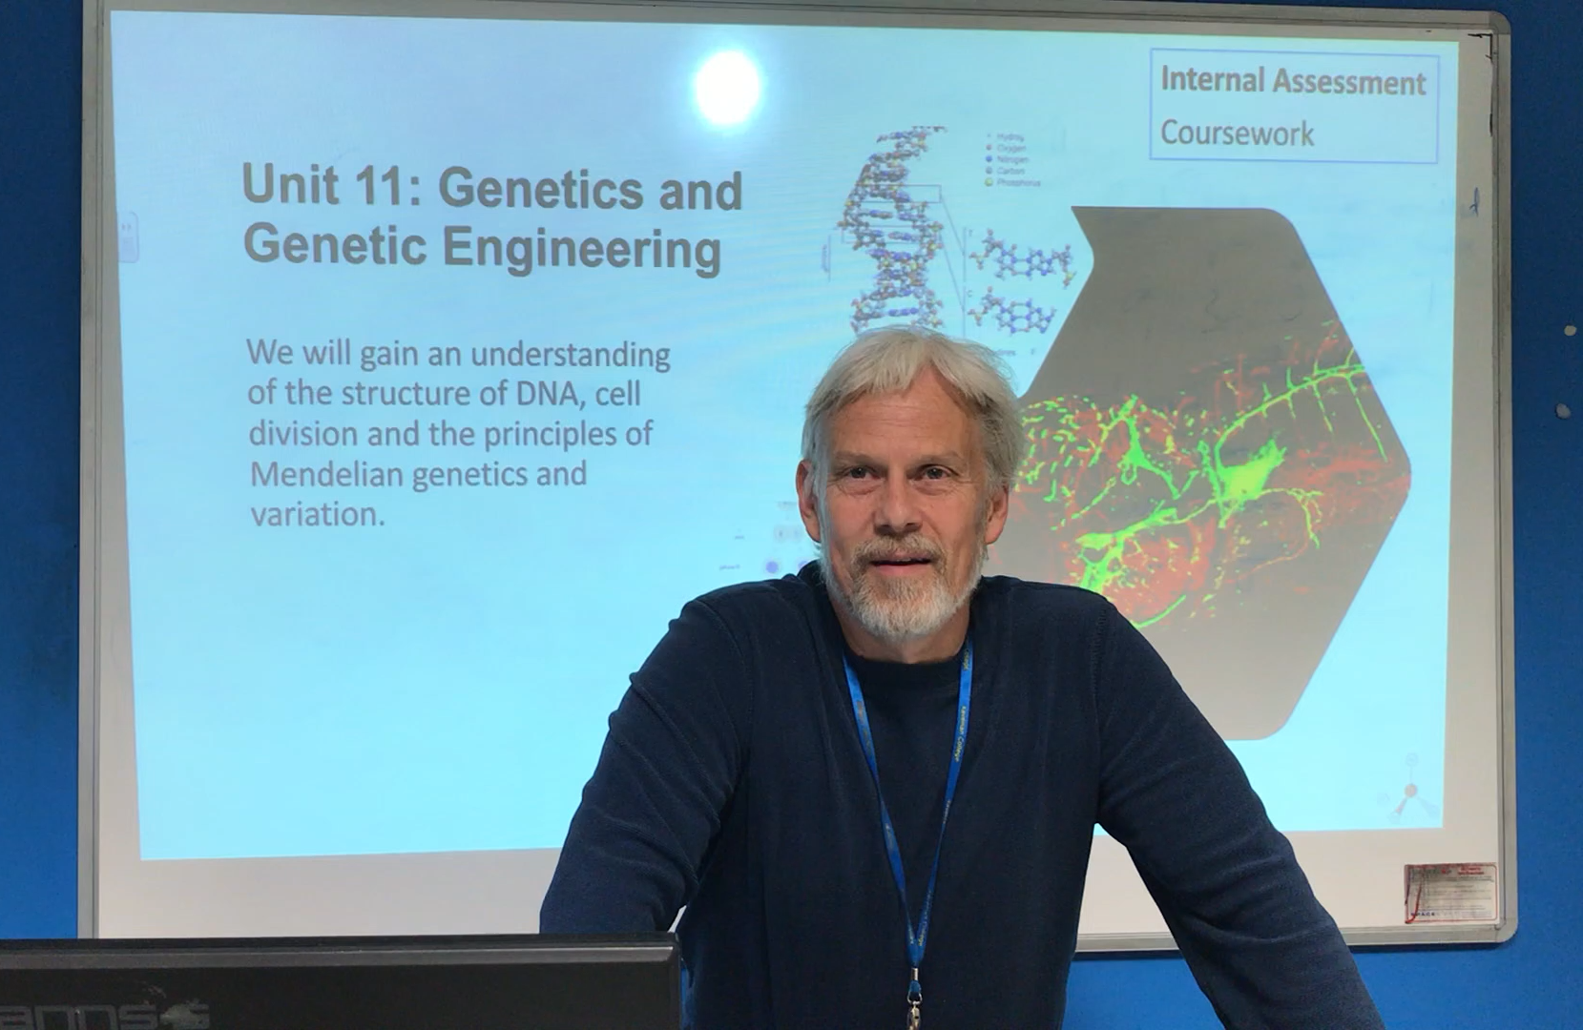


Dr. Hamer
Miss Torkington
Mrs. Andrews
Some of the Applied Science teachers would like to say, “hello!”
Dr. Garnham
Mrs. McMillan

