Slide 1
Drama & Theatre at

Slide 2
Mythbusters
Drama is NOT an ‘easy’ subject. It is an intellectual and physical discipline.
There is written work in Drama.
Employers and universities see Drama as a valued subject and qualification – including Russell Groups.

Slide 3
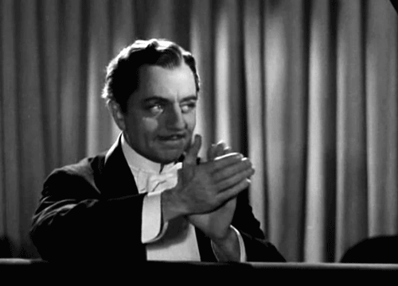
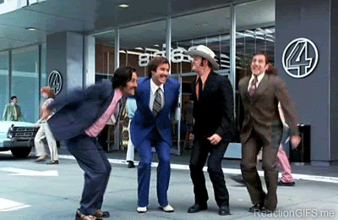
100% PASS RATE. 100% ACHIEVEMENT. 100% RETENTION

Slide 4
YEAR COURSE

Slide 5
Course Information
OVER THE 2 YEARS
COMPONENT 1 | COMPONENT 2 | COMPONENT 3
20%
40%
40%
THEATRE
WORKSHOP
TEXT IN ACTION
TEXT IN PERFORMANCE

Slide 6
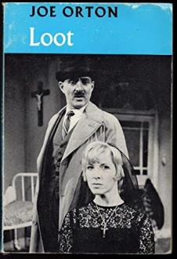
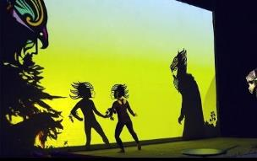
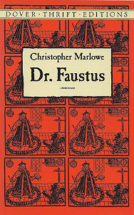
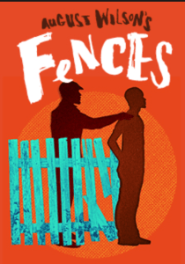
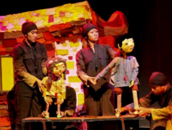
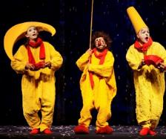
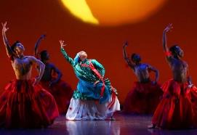
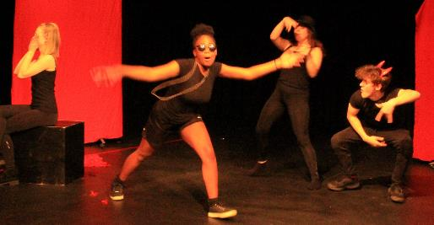
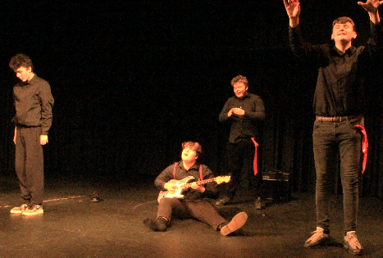
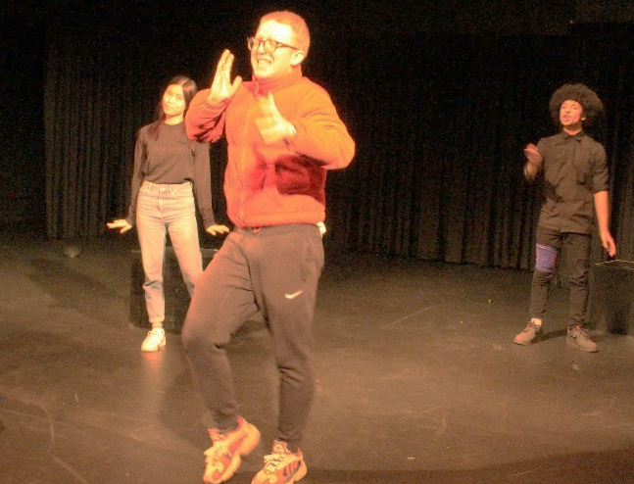
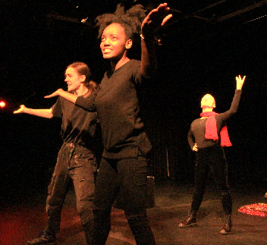
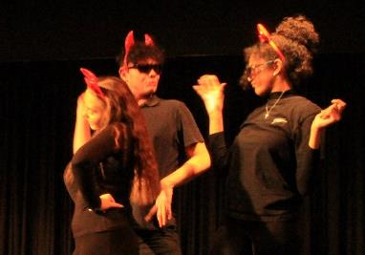
TAKE A PLAY
AND A THEATRE STYLE
COMBINE TO MAKE SOMETHING NEW

Slide 7
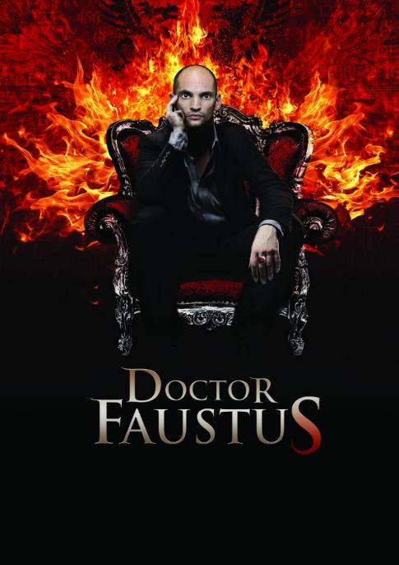
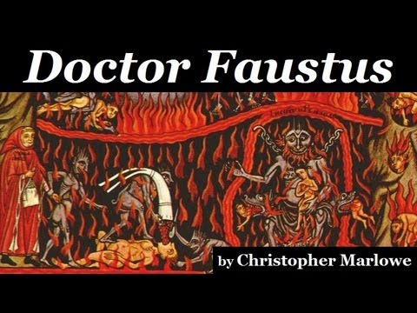
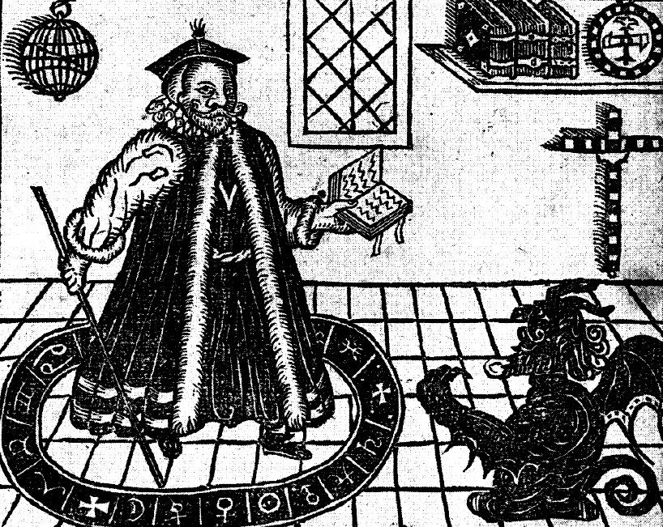
20%

Slide 8
Our lower sixth students’ work from December 2019
Students created their own adaptation of Christopher Marlowe’s Doctor Faustus, performing it using directing techniques developed by Bertolt Brecht; incorporating Narration, Caricature, Comedy, Metatheatre, Distancing Effect, Montage, Dance, Song, Poetry, Social Commentary.

Slide 9
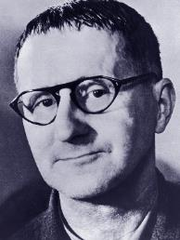
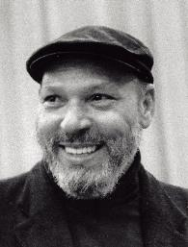
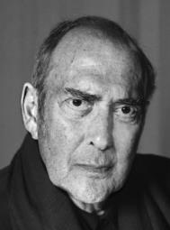
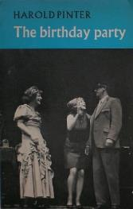
Our lower sixth students’ work from December 2019
Read more about the playwrights we have studied for this Component, and the director whose work we explore in class
Poet, Playwright and Influential Theatre Director Bertolt Brecht
August Wilson, writer of 'Fences'
Harold Pinter, writer of 'The Birthday Party'
Students created their own adaptation of Christopher Marlowe’s Doctor Faustus, performing it using directing techniques developed by Bertolt Brecht; incorporating Narration, Caricature, Comedy, Metatheatre, Distancing Effect, Montage, Dance, Song, Poetry, Social Commentary.

Slide 10
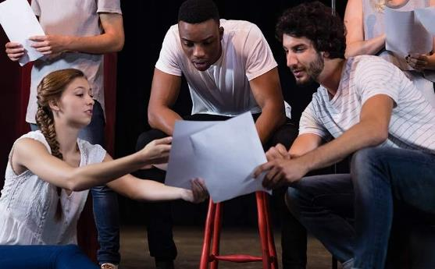
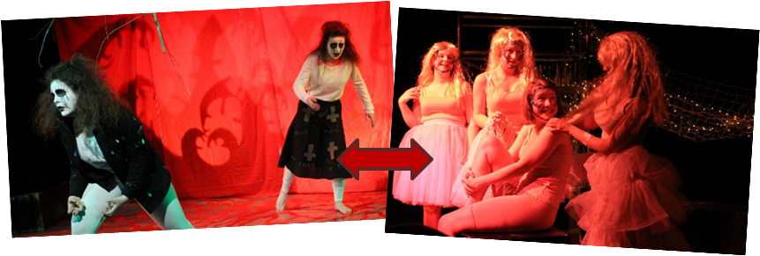
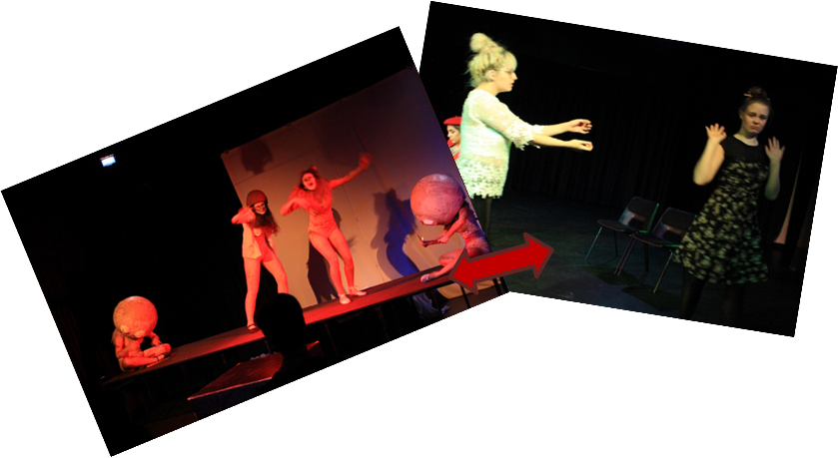
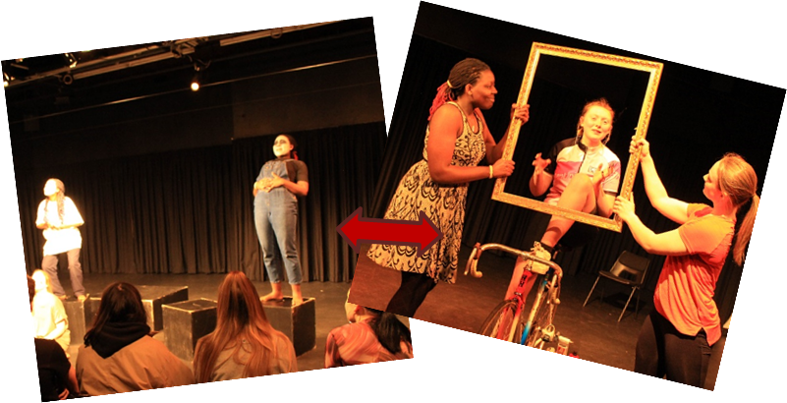
PERFORM A SCRIPT
AND DEVISE A SHOW
CREATE A CONTRAST

Slide 11
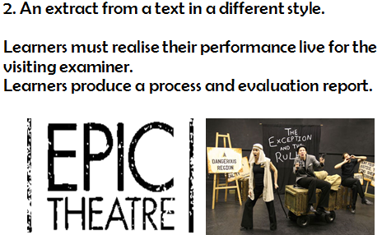
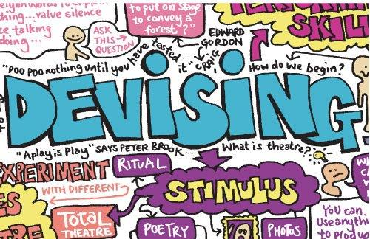
TEXT IN ACTION: 40%

Slide 12
Our upper sixth students’ work from February 2020
Students developed two contrasting performances by using an extract from the German expressionist play “Woyzeck” and writing their own short piece inspired by the image “Seriti” by South African artist Tsoku Maela. These two pieces were developed using a range of theatre styles and inspirations; Berkoff, Artaud, Kneehigh, Rashdash, Frantic Assembly, Splendid Productions.

Slide 13
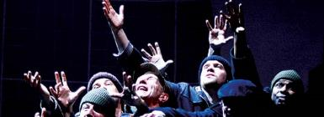
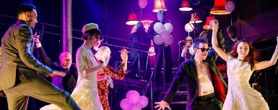
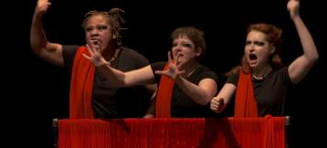
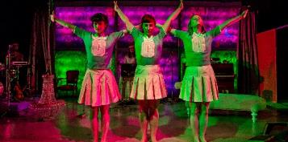
Our upper sixth students’ work from February 2020
Read more about the theatre makers, past and current that our students have taken inspiration from for this year’s Component 2 assessment.
Pioneer of Total Theatre, Steven Berkoff
Creator of Theatre of Cruelty, Antonin Artaud
Irrepressable makers of a Theatre of Humanity, Kneehigh
Punchy and powerful Physical Theatre makers, Rashdash
Developers of an inventive Epic Theatre, Splendid Productions
Choreographers of intense and surreal Dance Theatre, Gecko
Students developed two contrasting performances by using an extract from the German expressionist play “Woyzeck” and writing their own short piece inspired by the image “Seriti” by South African artist Tsoku Maela. These two pieces were developed using a range of theatre styles and inspirations; Berkoff, Artaud, Kneehigh, Rashdash, Frantic Assembly, Splendid Productions.

Slide 14
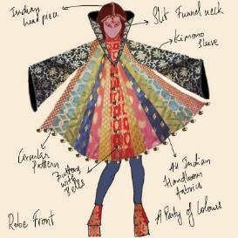
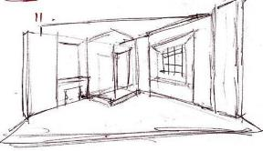
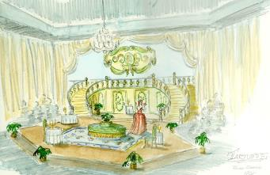
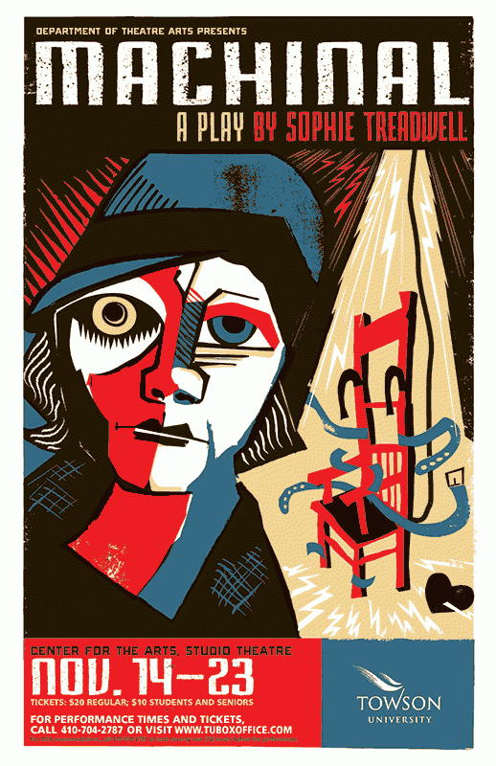
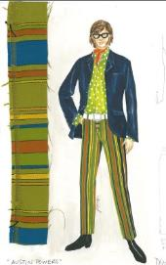
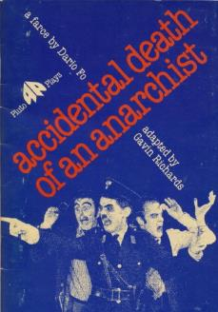
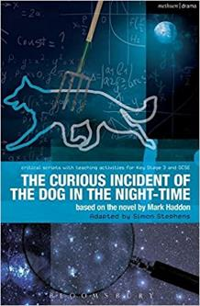
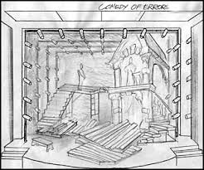
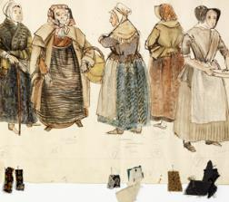
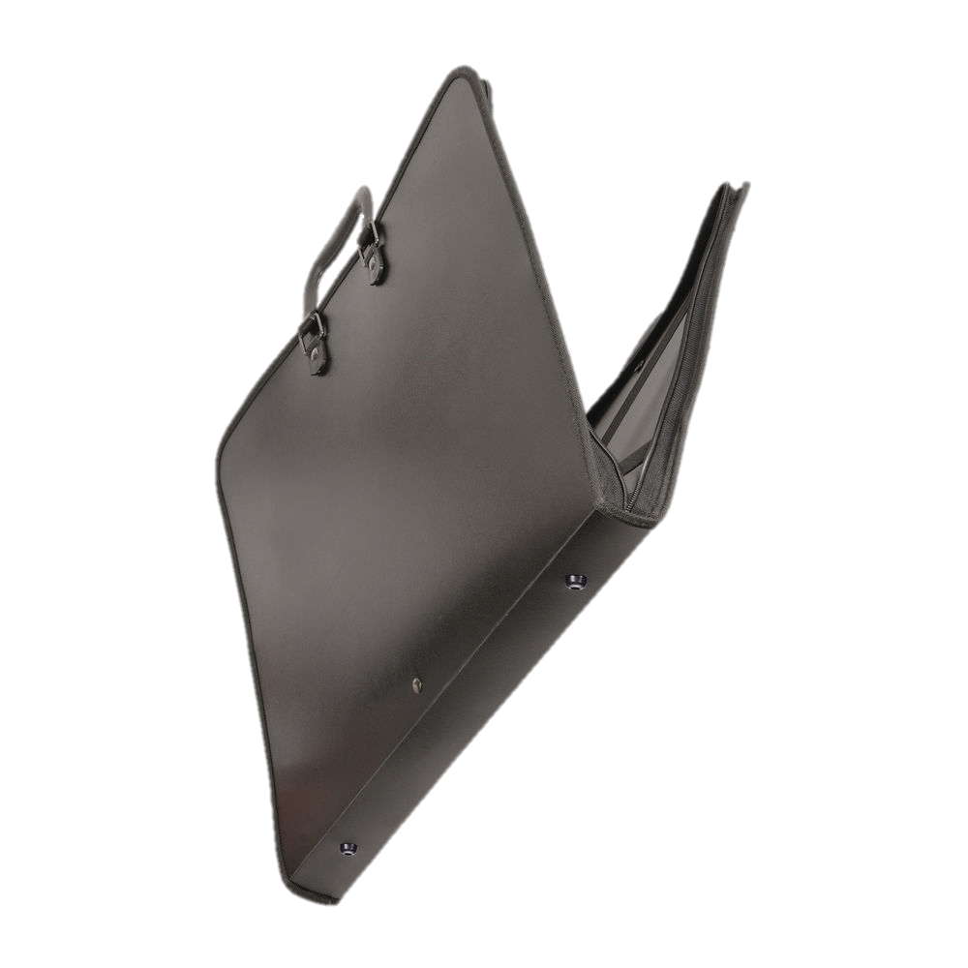
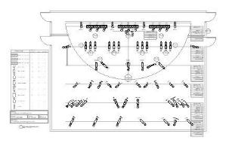
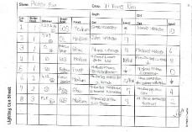
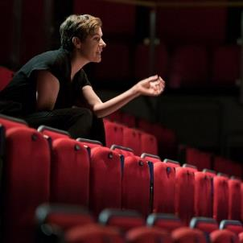
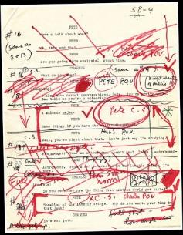
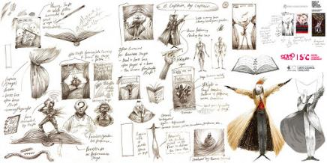
STUDY THREE DIFFERENT PLAYS
CREATE A DESIGN PORTFOLIO
CREATE PRODUCTION
PROPOSALS
WRITE IT UP IN AN EXAM

Slide 15
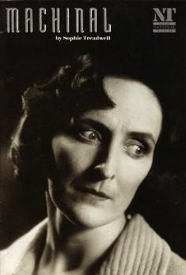
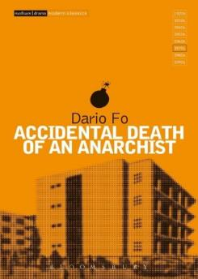
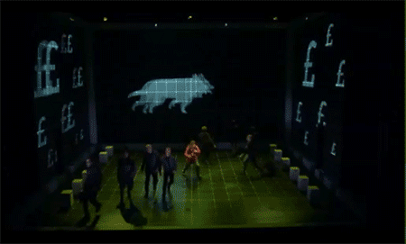
40%

Slide 16
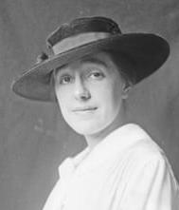
Read more about the plays the exam board set for the written exam, and the Playwrights that wrote them.
Sophie Treadwell, journalist, suffragette and author of expressionist crime drama 'Machinal'
Dario Fo, Italian political activist, clown, national hero and writer of hard-hitting true farce 'Accidental Death of an Anarchist'
Stockport-born-and-bred Simon Stephens, adapter of Mark Haddon's betselling novel 'The Curious Incident of the Dog in the Night-Time'

Slide 18
Experiencing live theatre is a vital part of being a Drama student. Going to see live theatre should be an ongoing experience, in and out of college. If not, it would be like a film studies student who never watched any films!

Slide 19
EXTRA CURRICULAR

Slide 26
PLEASE SEE OUR COURSE VIDEO AND GUIDE FOR MORE DETAILS.
If you have any questions, please email:
drama@xaverian.ac.uk

