Slide 1
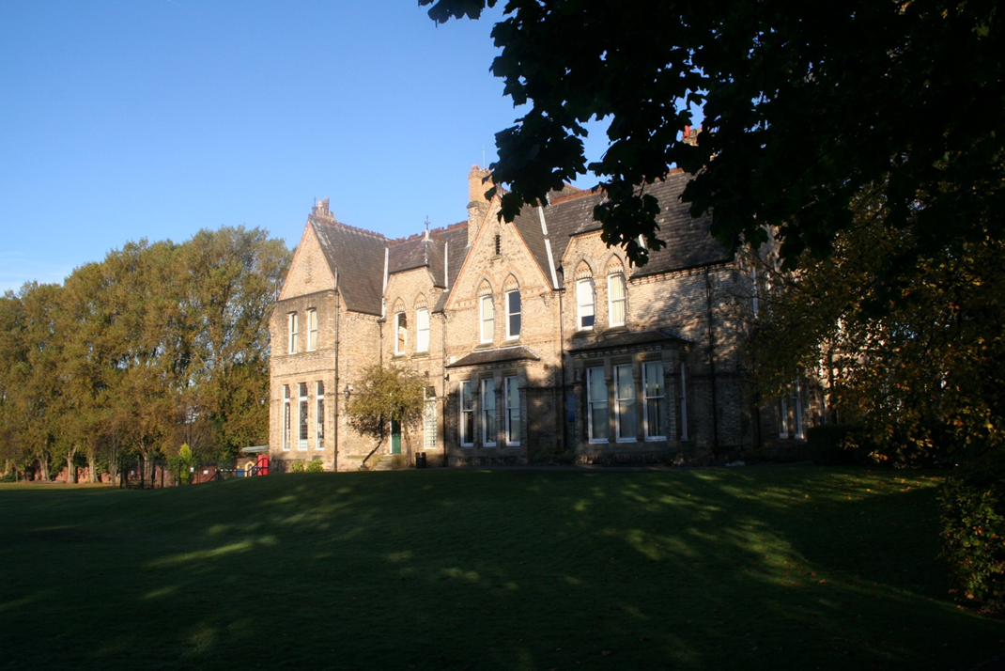
English Language at Xaverian
What’s it all about?

Slide 2
What is English Language as a subject area?
What specific elements of English Language will I study at Xaverian?
Why study English Language at Xaverian at all?

Slide 3
Linguistics – the scientific study of language

Slide 4
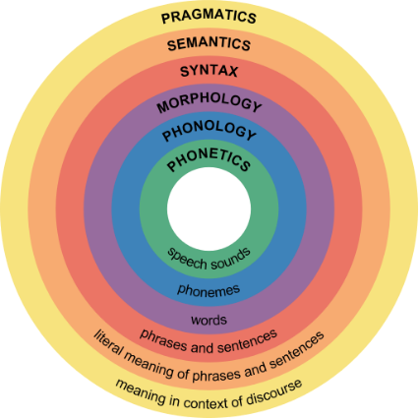
Linguistic Frameworks
Lexis = vocabulary
Grammar = sentences and structures
Semantics and pragmatics = meaning
Phonology and phonetics = sound
Graphology = visual effects
Discourse Structure = structures

Slide 5
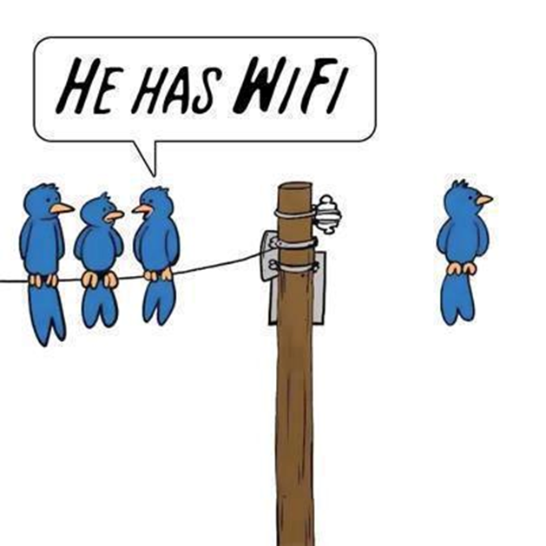

Slide 6
EDEXCEL COURSE COMPONENTS
Language Variation
Child Language Acquisition
Research Practices
Creative Writing

Slide 7
Individual Variation

Slide 10
Variation Over Time

Slide 14
Child Language Acquisition

Slide 17
Investigating Language

Slide 22
Creating Texts

Slide 27
Why study English Language at Xaverian at all?
A course that offers challenge and enjoyment
Some of the best results in the North-West
Extra-curricular opportunities

Slide 30
The Xaverian Experience

