Slide 1
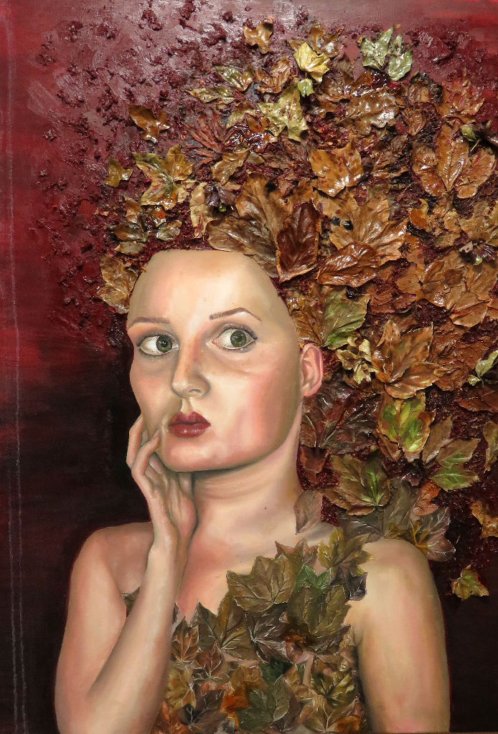
FINE ART
TASTER SESSION
XAVERIAN COLLEGE

Slide 2
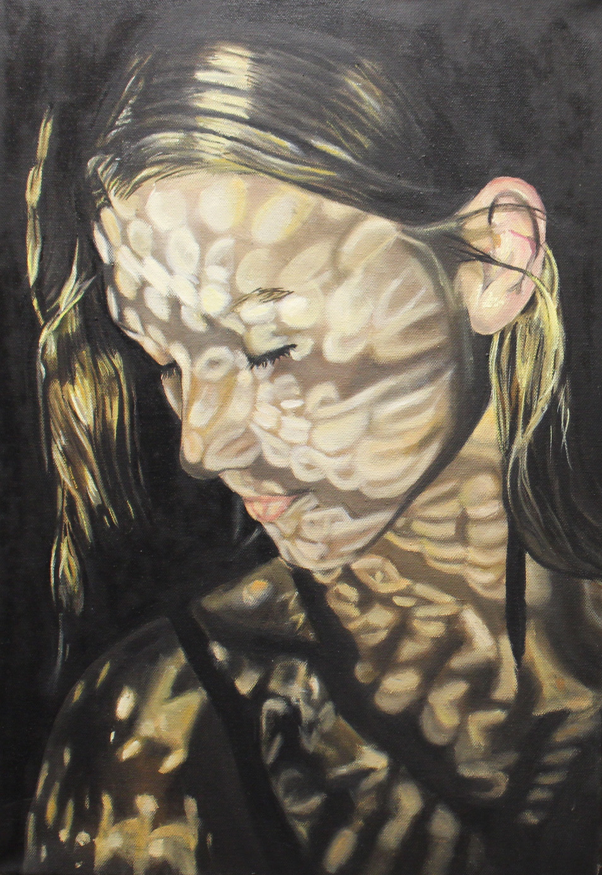
INTRODUCTION
Hello and welcome to A level Fine Art.
In this powerpoint you will see
Our departmental welcome video, in which we try to give you a flavour of how we do things here at Xaverian
Examples of L6 and U6 student sketchbooks
A three week project brief for you to work on if you are feeling creative.
A Gallery of student work

Slide 3
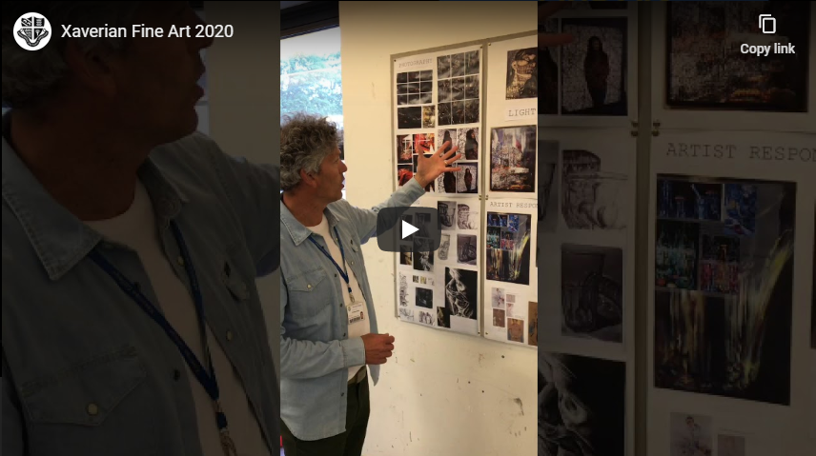

Slide 4
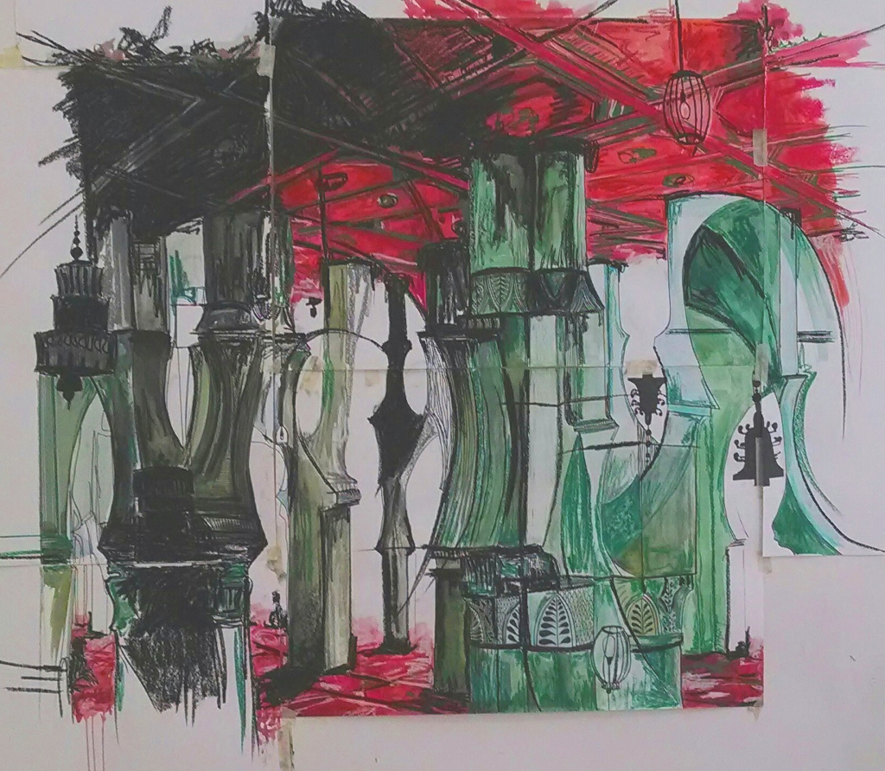
L6 STUDENT SKETCHBOOKS
Please use CTRL and click to open the link to 2 lower sixth sketchbooks. You will see the process of Observational recording, development of ideas through exploring materials and responding to artists, leading to final pieces
High Grades in Art

Slide 5
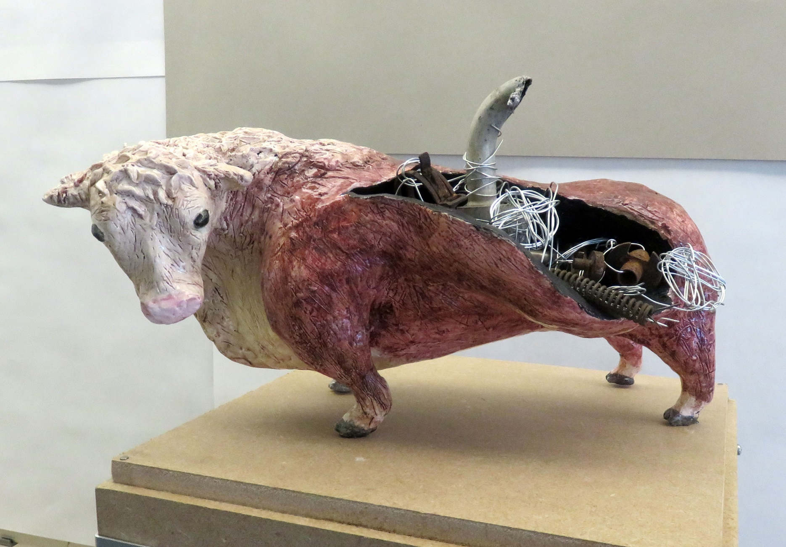
U6 Student Sketchbooks
Please use CTRL and click to open the link to 2 second year sketchbooks. You will see high quality skills, techniques and explorations of media, combined with very creative and imaginative thought processes
Niamh Fenton Comp 1
Kevin Ge

Slide 6
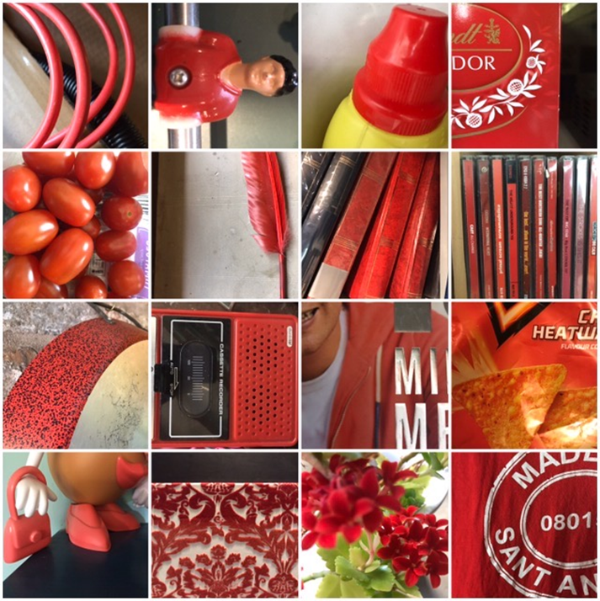
PRACTICAL WORK
If you would like to get stuck into some practical art work over the summer, please open the link (CTRL and click) and be creative….
Isolation Diary 2

Slide 7
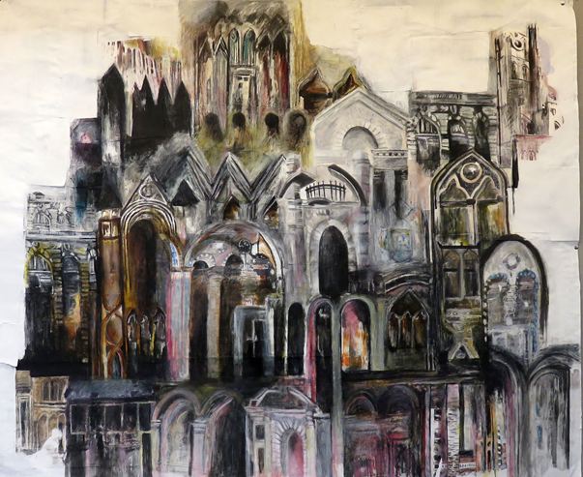
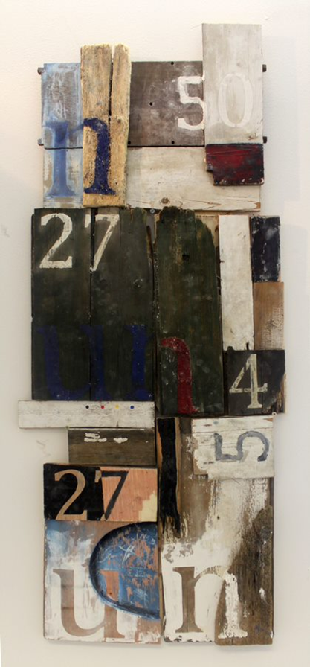
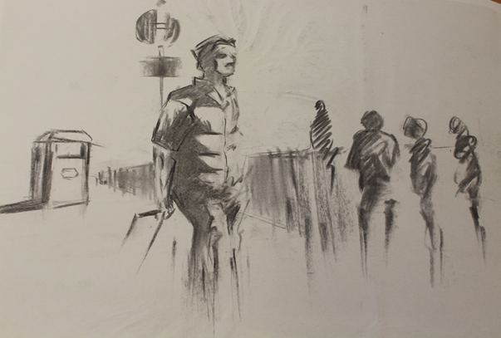
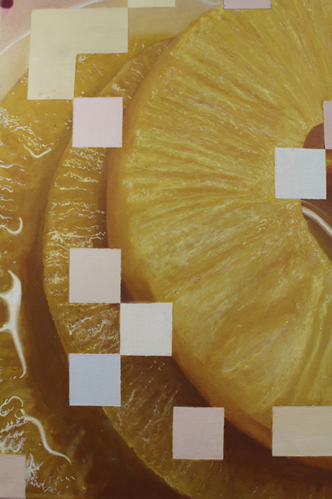
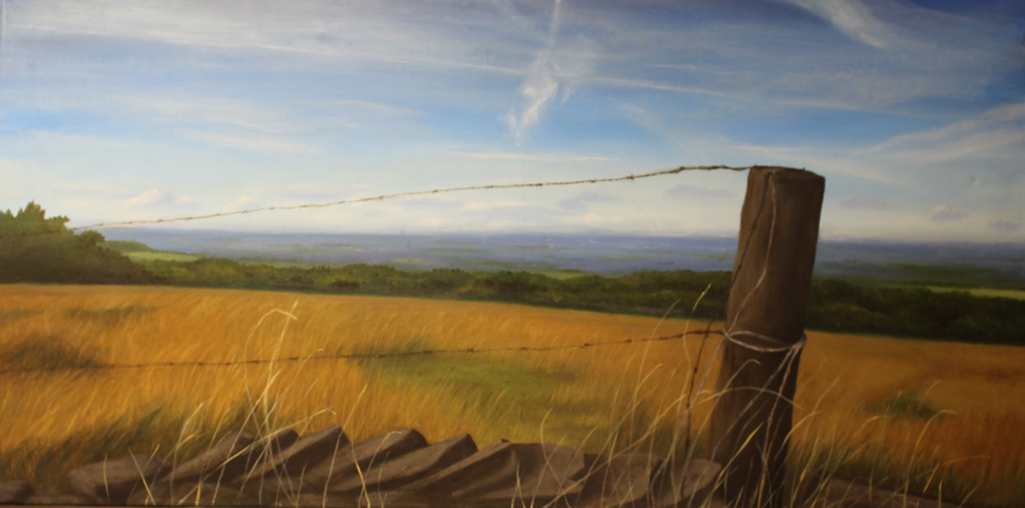

Slide 8
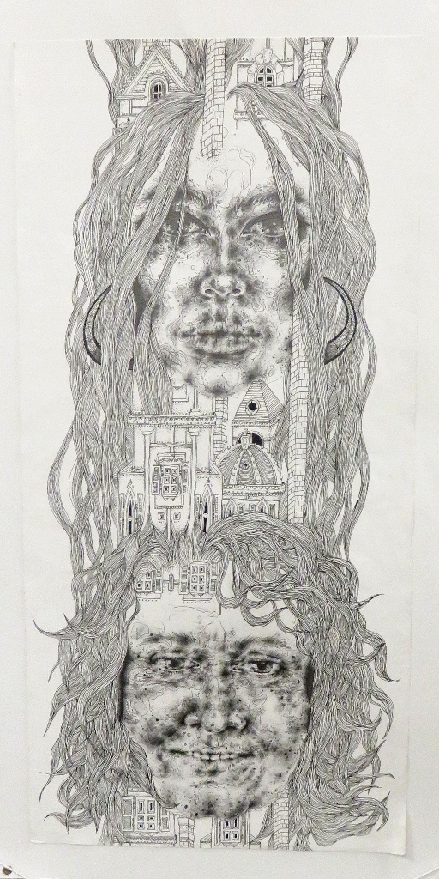

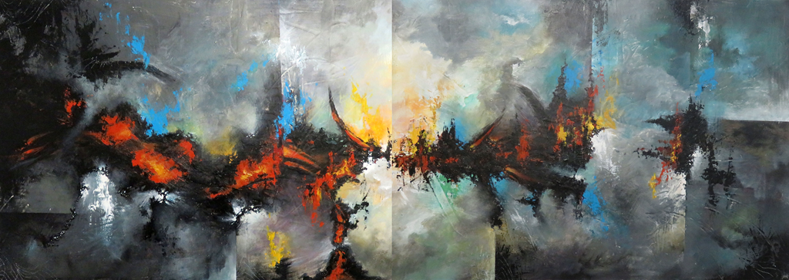
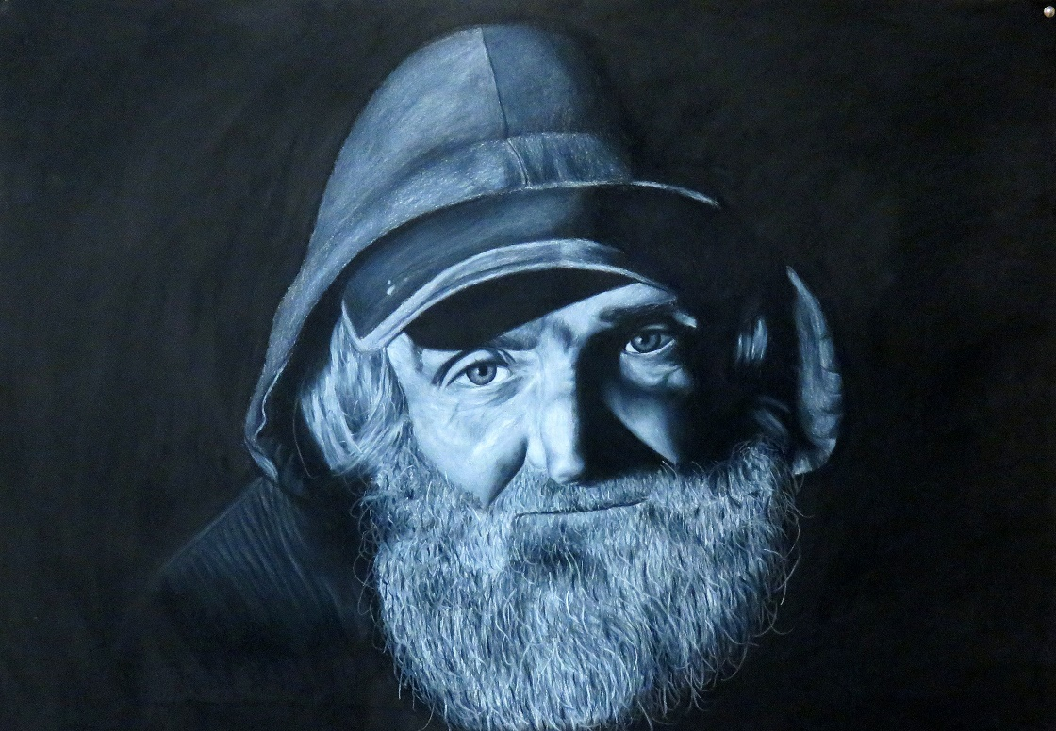

Slide 9
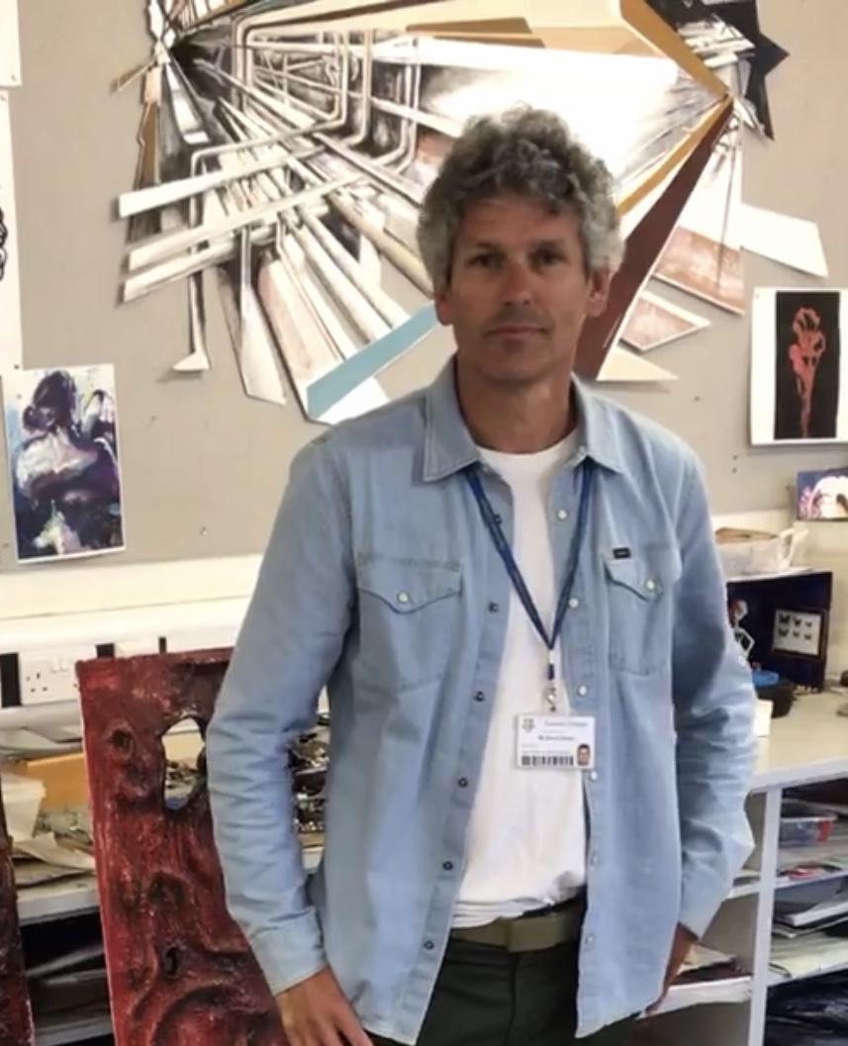
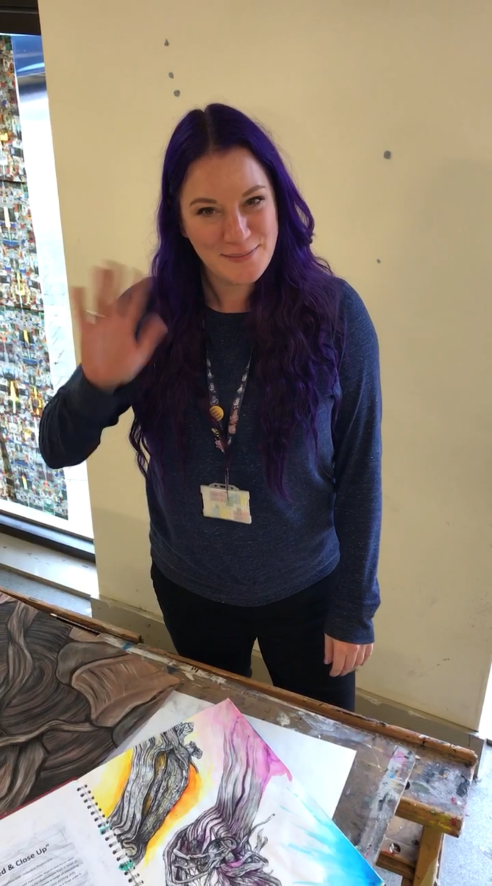
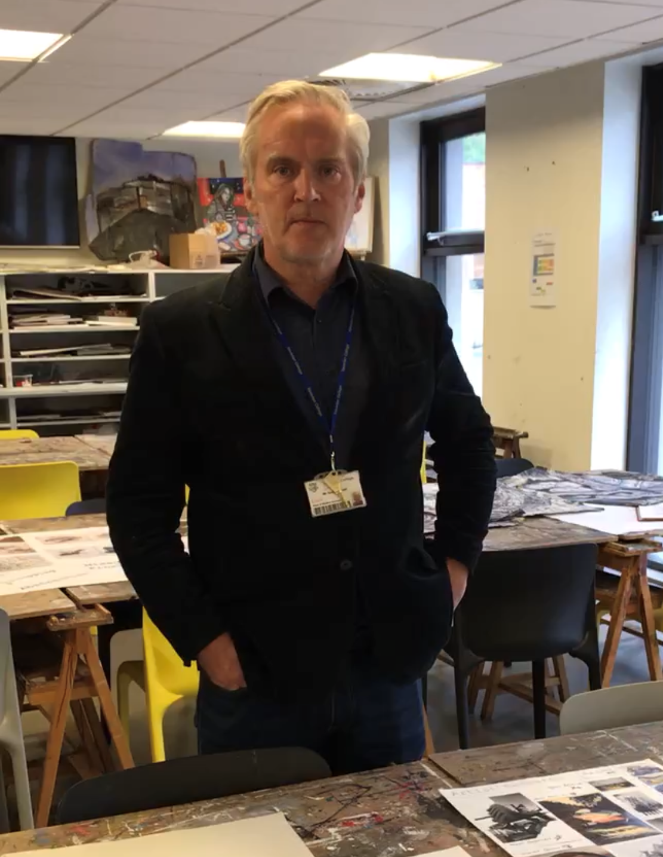
GOOD LUCK & THANKYOU- we’re really looking forward to meeting you in September
Shaun Steele s.steele@xaverian.ac.uk if you would like to get in touch

