Slide 1




Further Maths

Slide 2



There are three ways that you can study Further Maths at Xaverian
For one year
For two years:
Studying three A levels and an AS
Studying three A levels
Studying four A levels
e.g.
A level Maths
A level Chemistry
A level Art
AS level Further Maths
e.g.
A level Maths
A level History
A level Further Maths
e.g.
A level Maths
A level Further Maths
A level French
A level Biology
You must study A level Maths alongside Further Maths so please make sure that you view the Maths taster materials as well

Slide 3
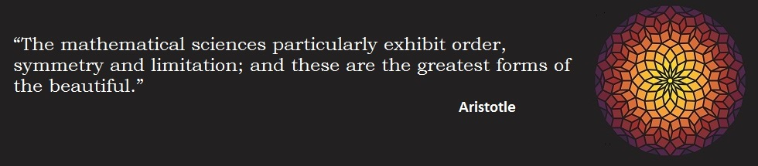
AS – end of lower sixth
Pure Mathematics - 50%
Complex numbers
Matrices
Vectors
Roots of Polynomials
Further Algebra
Calculus
Proof
Decision – 25%
Algorithms
Graph Theory
Critical Path Analysis
Linear Programming
Statistics – 25%
Discrete probability distributions
Poisson distribution
Chi-squared tests
Paper 2
Paper 1

Slide 4

A level – end of upper sixth
Paper 3 Paper 4
- Choose two of these
Pure Mathematics - 50%
Complex numbers
Matrices
Vectors
Roots of Polynomials
Further Algebra
Calculus
Proof
Polar Coordinates
Hyperbolic Functions
Decision – 25%
Algorithms
Graph Theory
Critical Path Analysis
Linear Programming
Statistics – 25%
Discrete probability distributions
Poisson distribution
Chi-squared tests
Hypothesis testing
Central limit theorem
Mechanics – 25%
Momentum and impulse
Work energy and power
Elastic springs
Elastic collisions
Paper 1 Paper 2

Slide 5

You will study some familiar topics further such as delving deeper into algebra…

Slide 6
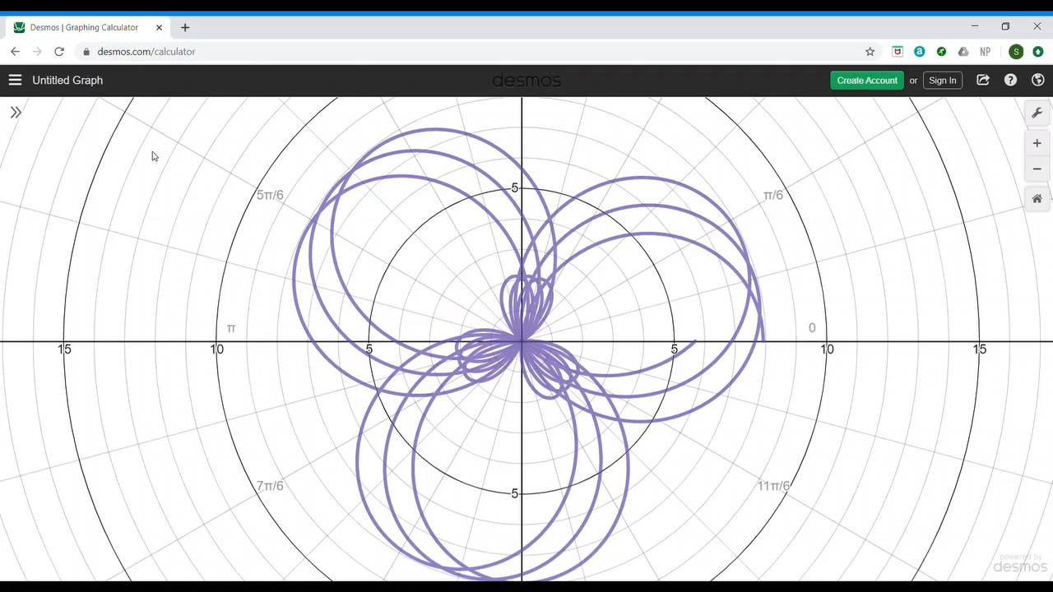
And meet new concepts such as polar curves

Slide 7
Enjoyable
Rewarding
Students find Further Maths to be …….
Stimulating
Empowering

Slide 8
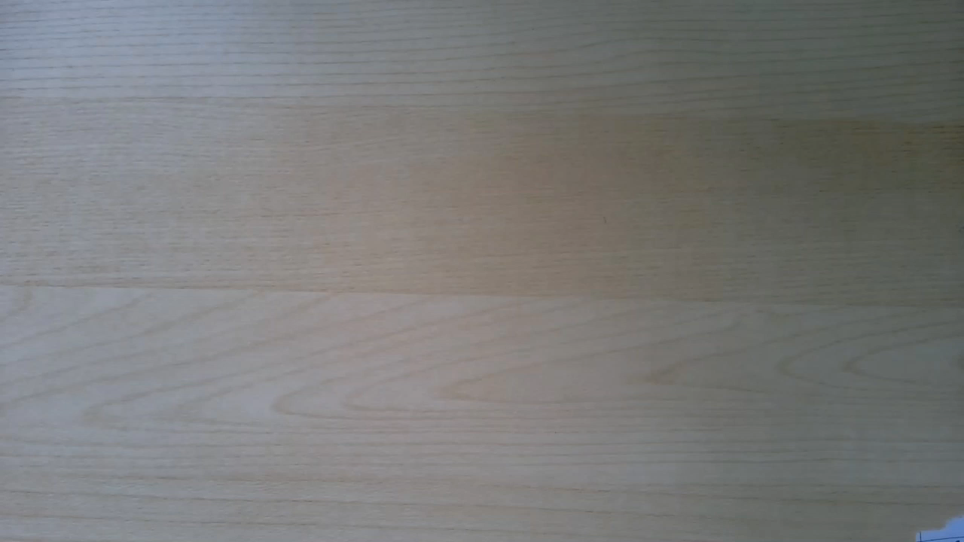
We asked some of our current students about their experiences of Further Maths.
Here’s what they had to say:
(if video does not start automatically,click the graphic and keep watching to see comments from seven of our students)

Slide 9
I’m really interested in Further Maths.
What can I do over the summer to prepare myself for the course?
You will need to be strong in your algebra skills in particular.
You can use the ‘Transition to A level’* course from the AMSP to help you prepare.
*available from early July.
Transition to A level
Link here

Slide 10
We’d like to give you a little taster of some of the maths you will encounter in Further Maths
Please make sure that your sound is turned on.
Sound clips should play automatically but for older versions of powerpoint, you may need to click the sound icon to hear them.

Slide 11

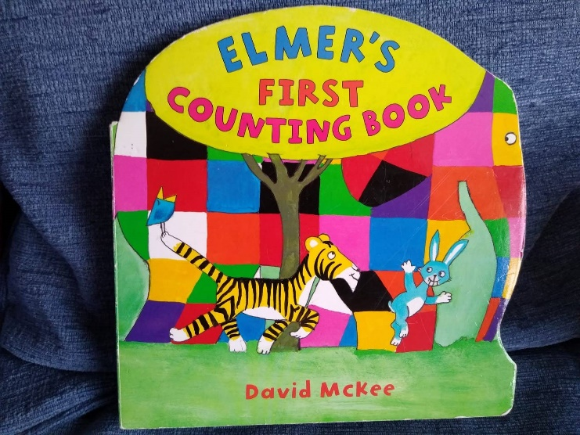

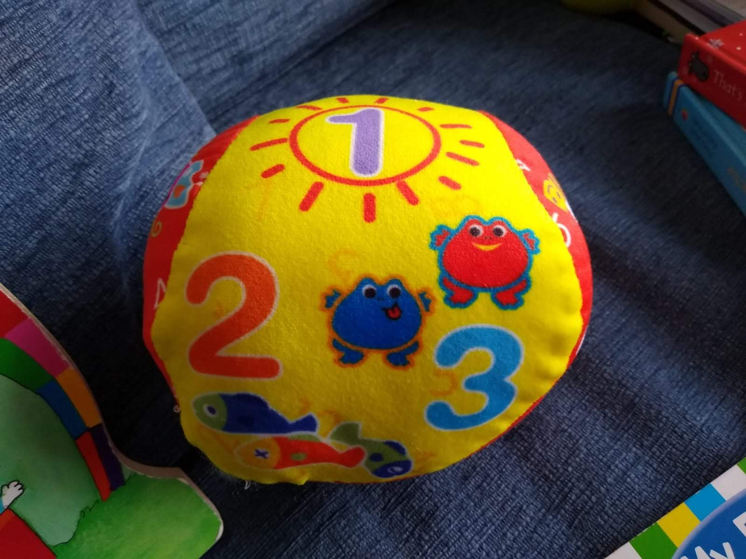

Slide 12
Natural Numbers,
ℕ
1, 2, 3, 4, ……..

Slide 13


Slide 14

Integers,
……, -3, -2, -1, 0, 1, 2, 3, ……
Natural Numbers,
ℕ
1, 2, 3, 4, ……..

Slide 15

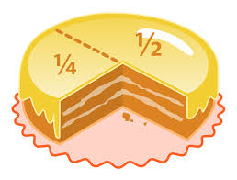

Slide 16

Rational Numbers,
$$\frac{1}{3}$$
$$\frac{a}{b}$$
Integers,
……, -3, -2, -1, 0, 1, 2, 3, ……
ℕ
Natural Numbers,
1, 2, 3, 4, ……..

Slide 17
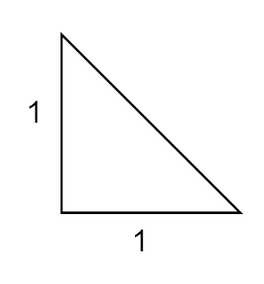

?
$$\sqrt{2}$$

Slide 18

Rational Numbers,
$$\frac{1}{3}$$
$$\frac{a}{b}$$
Irrational Numbers
Integers,
π
$$\sqrt{2}$$
……, -3, -2, -1, 0, 1, 2, 3, ……
Natural Numbers,
ℕ
1, 2, 3, 4, ……..

Slide 19

Real Numbers,
Rational Numbers,
$$\frac{1}{3}$$
$$\frac{a}{b}$$
Irrational Numbers
Integers,
π
$$\sqrt{2}$$
……, -3, -2, -1, 0, 1, 2, 3, ……
ℕ
Natural Numbers,
1, 2, 3, 4, ……..

Slide 20
Find two numbers, a and b, whose sum is 10 and product is 40.

Slide 21
Hints:
Think beyond integers
Try forming two equations and solving them

Slide 23

$$a^{2}=−1$$

Slide 24
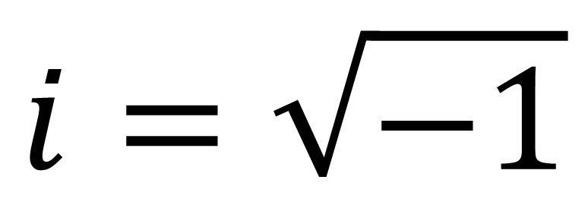
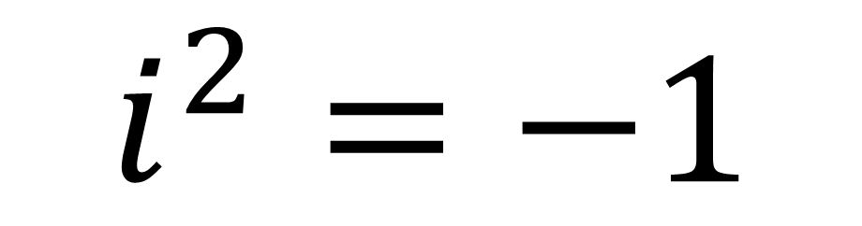
$$i=\sqrt{−1}$$
$$i^{2}=−1$$

Slide 25
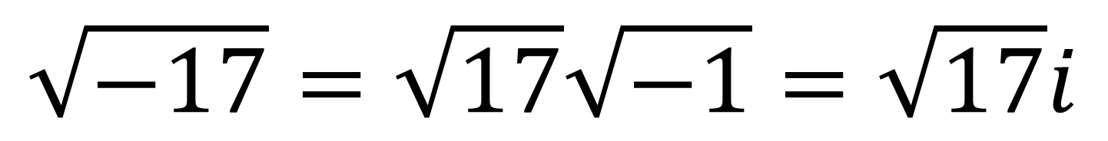
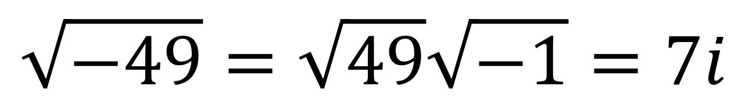
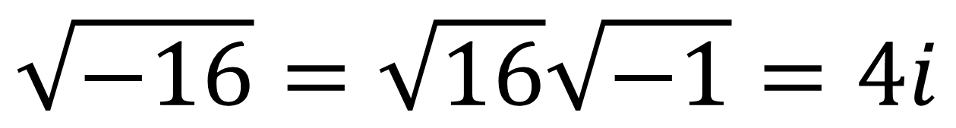
$$\sqrt{−16}=\sqrt{16}\sqrt{−1}=4i$$
$$\sqrt{−49}=\sqrt{49}\sqrt{−1}=7i$$
$$\sqrt{−17}=\sqrt{17}\sqrt{−1}=\sqrt{17}i$$

Slide 26



Real Numbers,
Rational Numbers,
Imaginary Numbers
$$\frac{1}{3}$$
$$\frac{a}{b}$$
$$i$$
$$3i$$
Irrational Numbers
Integers,
π
$$\sqrt{2}$$
……, -3, -2, -1, 0, 1, 2, 3, ……
$$−5i$$
Natural Numbers,
ℕ
1, 2, 3, 4, ……..

Slide 27



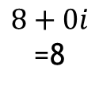
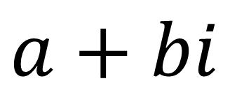
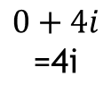

Complex Numbers
$$a+bi$$
Real part
Imaginary part
Examples
$$3+5i$$
$$−2+11i$$
$$1−7i$$
Imaginary number
$$−3+\sqrt{17}i$$
$$0+4i$$
=4i
$$8+0i$$
=8
Real number

Slide 28



Complex Numbers,
$$−2−7i$$
$$1+3i$$
Real Numbers,
Rational Numbers,
Imaginary Numbers
$$\frac{1}{3}$$
$$\frac{a}{b}$$
$$i$$
$$3i$$
Irrational Numbers
Integers,
π
$$\sqrt{2}$$
……, -3, -2, -1, 0, 1, 2, 3, ……
$$−5i$$
ℕ
Natural Numbers,
1, 2, 3, 4, ……..

Slide 30






Solve these equations
$$x^{2}−2x+5=0$$
$$x=1±2i$$
$$x^{2}−6x+18=0$$
$$x=3±3i$$
$$x^{2}−4x+29=0$$
$$x=2±5i$$

Slide 31
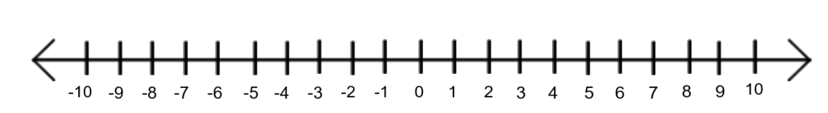




$$−7$$
$$π$$
$$1+2i$$
?
$$\frac{2}{3}$$

Slide 32

Argand Diagram
Im
Re
$$1+2i$$

Slide 33




Where would these numbers go on an Argand diagram?
Im
Click to move.
3
2
1
-1
-2
-3
$$1+i$$
$$2−3i$$
-3 -2 -1 1 2 3
Re
$$−3+2i$$
$$−2i$$

Slide 34

This Photo by Unknown Author is licensed under CC BY-SA

Slide 35
