Slide 1
Xaverian college NEW STUDENTS DAY 2020
VIRTUAL LESSON
An introduction to History at Xaverian
The American Dream in 1945: reality or illusion?

Slide 2
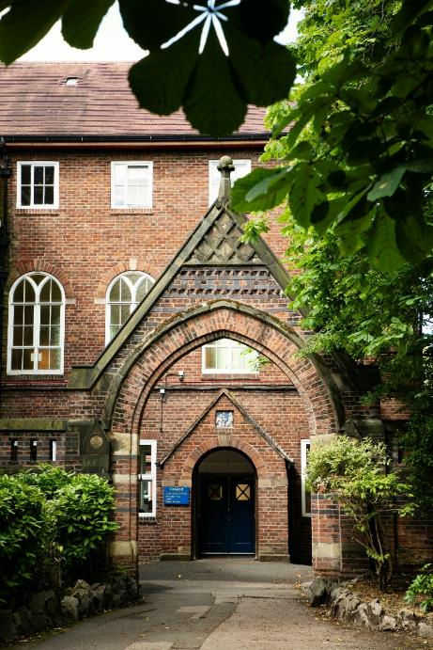
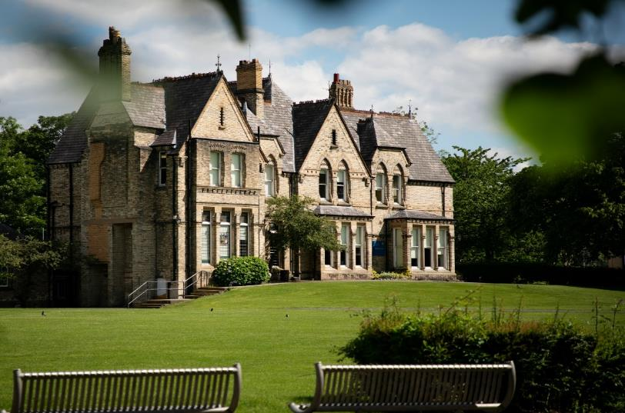
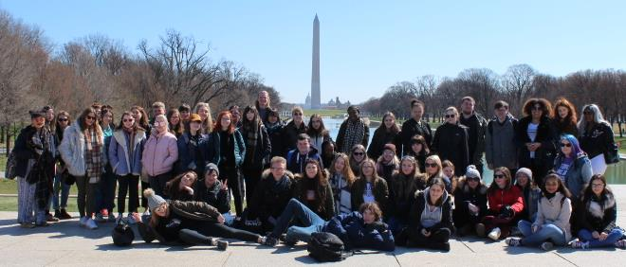
Why study History and why study History at Xaverian?

Slide 3
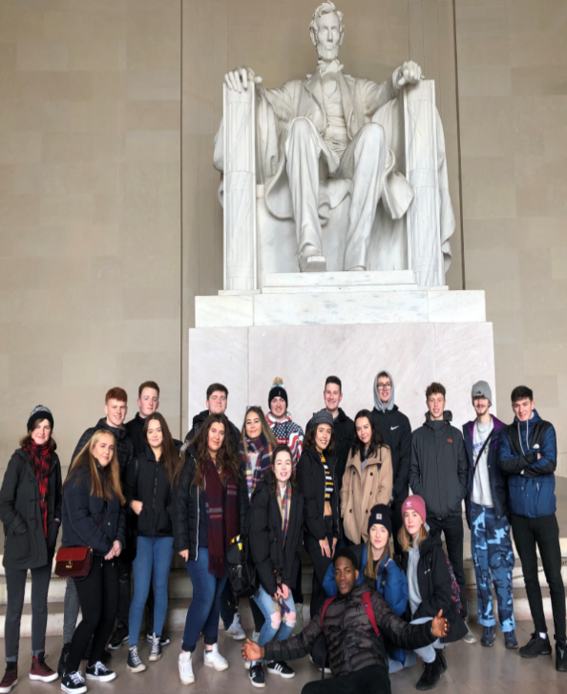
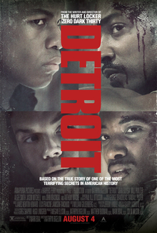
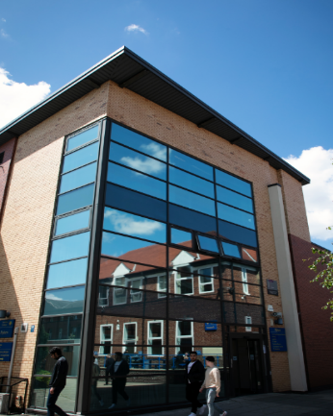
Why Study History at Xaverian?
Studying for your A Levels is not just about getting good grades. It is also about getting opportunities that will help you later on in life. At Xaverian we pride ourselves in providing more than just an academic education.
Be challenged
Improve your future prospects…
Be supported…
Go beyond the classroom…
Enjoy learning

Slide 4
What do our students say about History at Xaverian?
“Teachers go above and beyond to make sure we do well!”
“I’m always pushed to do the best I can and I know my teacher will support me”
“The teachers really know what they are doing”
Beth talks about History at Xaverian – Click to play:
“The booklets that are used really help you to push yourself!”
“the lessons are varied and
interesting!”
Noor talks about History at Xaverian – Click to play:
“I feel really well prepared for University”

Slide 5
What qualifications do I need to enrol on the History course?
If you are studying GCSE History you need at least a grade 5. If you are not studying History you need at least a grade 5 in your GCSE English Language.

Slide 6
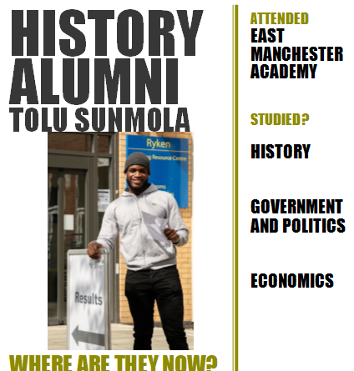
How well do our students do?

Slide 7
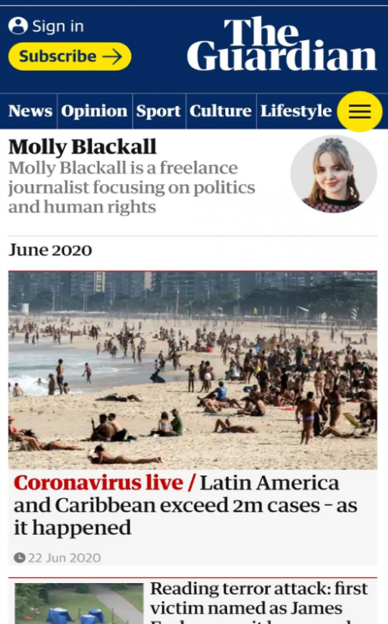
What do our ex students say…

Slide 8
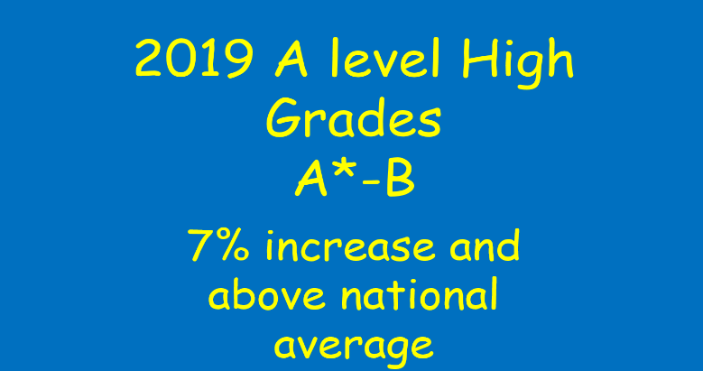
HOW WELL DO OUR STUDENTS DO?
2019 A level
A*s – Xaverian 7% of all students
National average – 5%
Similar centres – only 3%

Slide 9
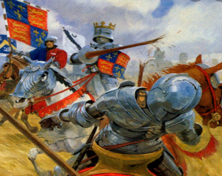
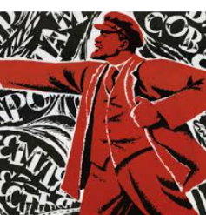
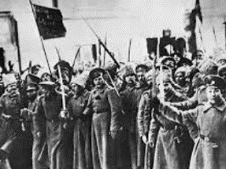
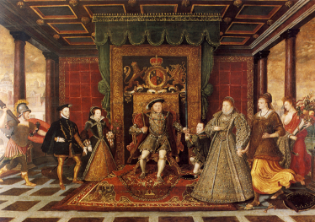
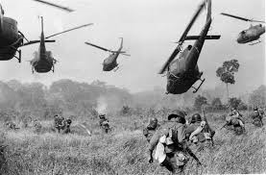
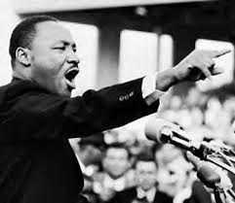
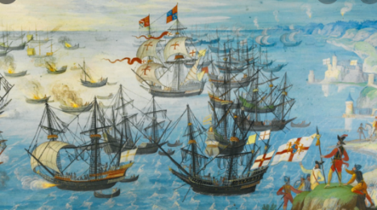
What do we study?
The Tudors: England 1485-1603 Breadth Study worth 40% of A Level | USA: The American Dream: Reality and Illusion 1945-1980 Depth study worth 40% of A Level | Component 3: Historical Investigation/ Personal study c4000 word essay 20% of A Level
Year 1
Henry VII and Henry VIII
Year 1
Presidents Truman, Eisenhower and JFK
Year 2
Johnson, Nixon, Ford, Carter and Reagan
Year 2
Edward, Mary and Elizabeth
Independent work completed by students at the end of year 1 and beginning of year 2.

Slide 10
Taster lesson
The American Dream in 1945: Reality or illusion?

Slide 11
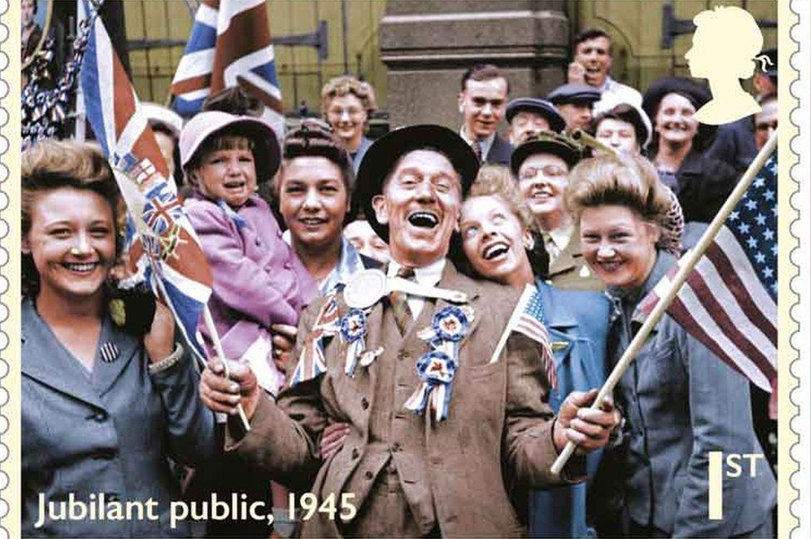
Lesson aims
Our big question for this session is
The American Dream 1945: reality or illusion?
Today you will be using your investigation skills to build up a picture of society in America in 1945

Slide 12
The American Dream 1945: reality or illusion? What exactly is the American dream?

Slide 13
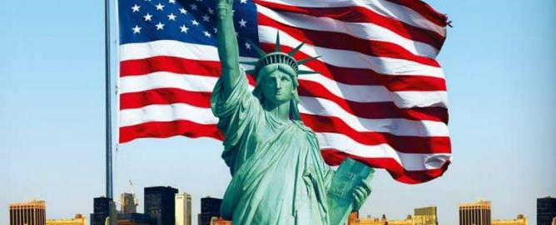
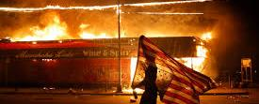
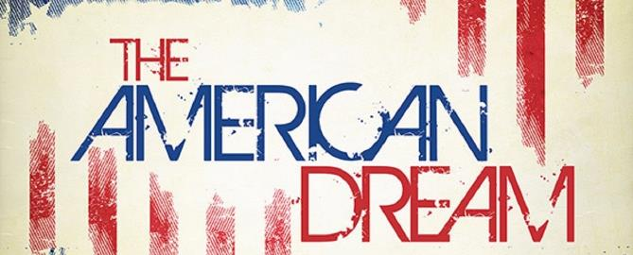
The American Dream 1945 : reality or illusion?
The idea of the American Dream is a controversial topic – at its very base the American dream can be summed up as…
Americans …“dream of a land in which life should be better and richer and fuller for every man, with opportunity for each according to his ability or achievement”
James Truslow Adams 1931
Our aim today is to investigate whether the American Dream was a reality in 1945

Slide 14
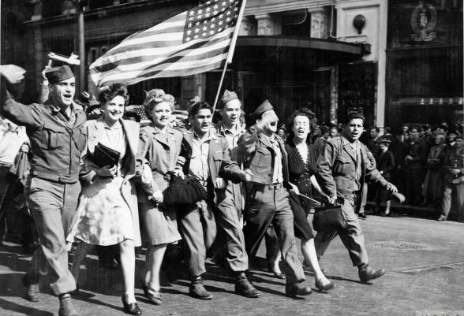
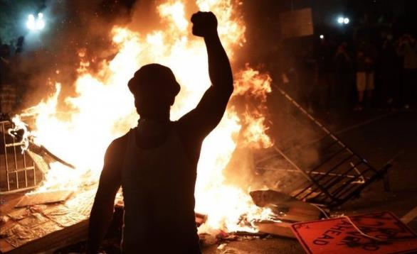
Why this topic for virtual students day?
This topic is particularly important for our USA side of the course
In September we will start the unit by looking in more detail at the World and The USA in 1945 but this activity will give you the opportunity to push your own knowledge and prepare yourself for this unit.
Also given the recent developments in America we also thought it would be relevant to engage with the on going debate of the American Dream.

Slide 15
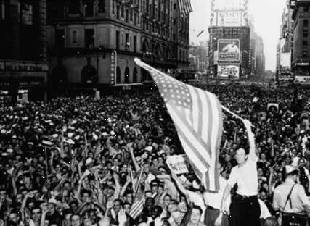
The situation for the usa in 1945?
In May 1945 WW2 in Europe ended. In August 1946 WW2 in Japan ended after the dropping of atomic weapons on Hiroshima and Nagasaki.
The USA emerged from WW2 in a unique position in the fact it actually strengthened the country
World War 2 was seen as a good war for the USA – in comparison to other countries their economy was booming, they have limited fatalities and they have military superiority being the only country to have an atomic weapon
This feeling of superiority is often referred to as ‘American exceptionalism’ – unifying the nation in the idea that America is the greatest in the world
But what was the society of 1945 like and how did this idea of exceptionalism impact on people's lives?
Picture of crowds on VE day in 1945.

Slide 16
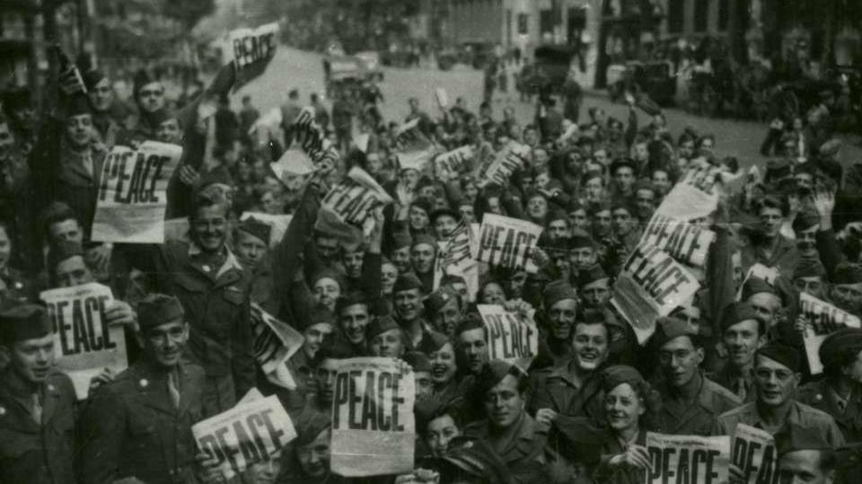
TASK INFORMATION
Today we are going to investigate and evaluate the situation for four groups from American society
You will be given information on the slides and we have also included additional reading and watching to help you develop your understanding further
We have suggested that you might want to note your ideas down on a mind map as presented on the next slide
If you complete your mind map and would like us to have a look you can email to History@xaverian.ac.uk

Slide 17
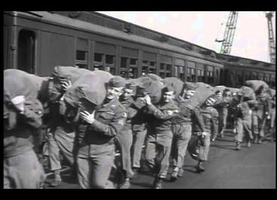
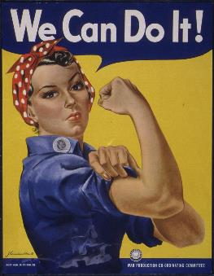
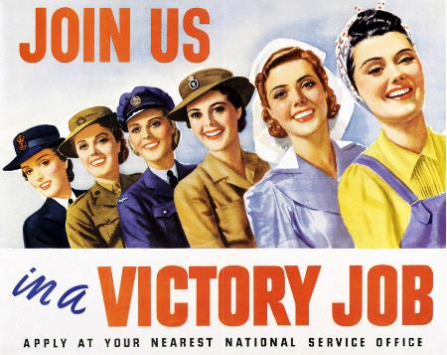
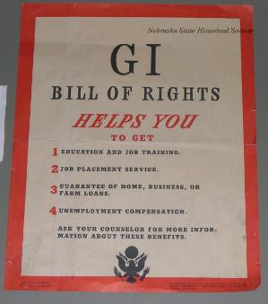
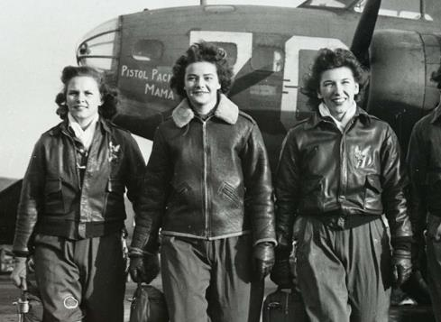
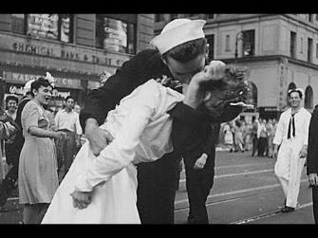
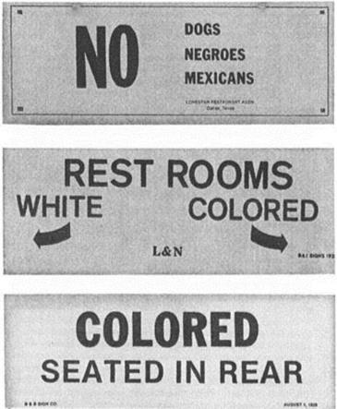
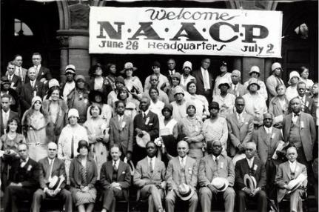
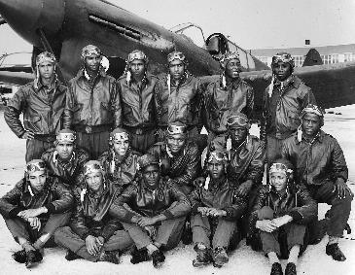
THE AMERICAN DREAM IN 1945 – REALITY OR ILLUSION?
Returning soldiers
Women
African Americans
The Rich

Slide 18
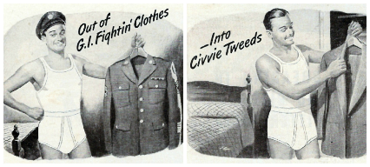
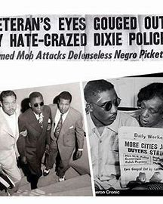
1945 – the American dream a reality or illusion – returning soldiers
By 1945, out of the 140 million population of the United States: one in every nine had left their homes for training camps and three-quarters of them served overseas. Those who returned from war were promised a college education and loans for business and housing: The American Dream?
The GI Bill of Rights: The G.I. Bill of Rights, also called Servicemen’s Readjustment Act, (1944) provided various benefits to veterans of World War II. The act enabled veterans to obtain grants for school and college tuition, low-interest mortgages and small-business loans, job training and unemployment benefits.
Experience of African-American returning soldiers: The experience of African-American US soldiers returning home after the war was often very negative. There were multiple veterans who were attacked, often by drivers or fellow-passengers on the buses and trains transporting them back to their homes. Many more soon realised that the G.I. Bill had been constructed in such a way that most of its benefits including mortgage support, college tuition, and business loans could be denied to them. On February 12, 1946, hours after being honorably discharged from the United States Army, US soldier Issac Woodard was attacked while still in uniform by South Carolina police as he was taking a bus home. The attack and his injuries sparked national outrage and prompted the beginnings of the civil rights movement in the United States. The attack left Woodard completely and permanently blind. Due to South Carolina's reluctance to pursue the case, President Harry S. Truman ordered a federal investigation. The sheriff, Lynwood Shull, was indicted and went to trial in federal court in South Carolina, where he was acquitted by an all-white jury.
Impact of returning soldiers on US education system: The groundbreaking GI Bill of Rights guaranteed an education to all returning veterans. This ‘opened up’ the exclusive campuses for the masses and the once unreachable dream of a college education became attainable for all. Financial assistance from the US government brought a college education to within reach of millions of returning soldiers who would otherwise have gone directly into trades or blue-collar jobs. In addition, the Veterans Administration paid the university up to $500 a year for tuition, books and other training costs.
Further reading/viewing:
https://www.youtube.com/watch?v=66EOCMdEqCI VJ day celebrations
https://www.history.com/news/gi-bill-black-wwii-veterans-benefits Impact of GI Bill of Rights in African-American returning soldiers.
https://www.khanacademy.org/humanities/us-history/postwarera/postwar-era/a/the-gi-bill Article on the impact of GI Bill of Rights.

Slide 19
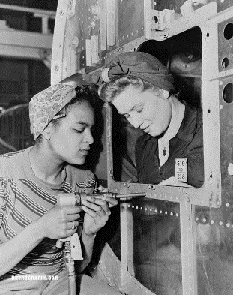
1945 – the American dream a reality or illusion – women
Some 350,000 women served in the U.S. Armed Forces in World War II, both at home and abroad. They included the Women’s Airforce Service Pilots, who on March 10, 2010, were awarded the prestigious Congressional Gold Medal. Meanwhile, widespread male enlistment left gaping holes in the industrial labor force and defense industry. Women were critical to the war effort: Between 1940 and 1945, the age of “Rosie the Riveter,” the female percentage of the U.S. workforce increased from 27 percent to nearly 37 percent, and by 1945, nearly one out of every four married women worked outside the home. World War II opened the door for women to work in more types of jobs than ever before, but with the return of male soldiers at war’s end, women, especially married women, were once again pressured to return to a life at home, a prospect that, for thousands of American women, had shifted thanks to their wartime service.
Research sources to further understanding
https://www.khanacademy.org/humanities/us-history/rise-to-world-power/us-wwii/a/american-women-and-world-war-ii
https://www.nationalww2museum.org/war/articles/gender-home-front
https://www.pbs.org/wgbh/americanexperience/features/tupperware-work/
Women at War 1939-1945 -Netflix documentary
https://www.history.com/news/black-woman-army-unit-mail-world-war-ii
https://www.vox.com/21264250/rosie-the-riveter-labor-wwii
Working Conditions For Women in World War II​
With many fathers off fighting, mothers were faced with the burden of balancing childcare and work, and absenteeism became the symptom that caused factory owners—and the United States government—to finally acknowledge the issue. The Lanham Act of 1940 gave war-related government grants for childcare services in communities where defense production was a major industry. In 1942, Eleanor Roosevelt stepped in, encouraging her husband, Franklin D. Roosevelt, to pass the Community Facilities Act, which led to the creation of the first U.S. government-sponsored childcare center. Roosevelt also urged for reforms like staggered working hours at factories to allow working mothers to go to grocery stores—stores that were often either closed or out of stock by the time women clocked out of work. ​
Not all women were treated equally in the workplace. African American women found that white women were not always welcoming at work—if they were even granted the same job opportunities in the first place—and were paid less than their white peers. Japanese American women fared even worse, as they were sent off to Japanese Internment Camps under Executive Order 9066.​

Slide 20
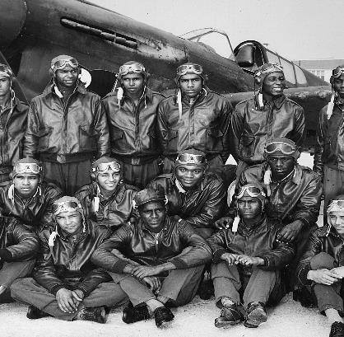
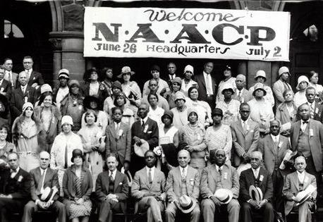
1945 – the American dream a reality or illusion – African Americans
Life for African Americans in 1945 was particularly difficult – for those living in the South they live in De jure Segregation. This meant their lives were dictated by the Jim Crow Laws. This meant complete and utter segregation. Slaves had been freed in 1863 however in many of the plantations the owners had merely changed the status of their slaves to that of Share Croppers – this meant the former slaves now worked the land for low pay and cheaper rent. For a lot of African Americans life was very similar to what it had been during slavery.
After Emancipation some African Americans were able to leave the south and head North for better work and social conditions – this was referred to as the Great Migration (1916-1970). During the Great migration over 6 million African Americans moved to the North. Life in the North gave more employment opportunity but still life was segregated – this type of segregation was not through law but through the way society treated African Americans. This is called De Facto segregation – through this segregation African Americans had limited social and economic opportunities.
World War 2 brought more opportunities for African Americans – as trade and industry prepared for war many African Americans were able to gain employment in factories to help with the War effort. Many African Americans joined the army to fight in the war. African American soldiers were kept separate to white soldiers. However, some African American units gained a reputation for their bravery (this included the Tuskegee Airmen). When soldiers returned they were still met with resentment and racism in some cases soldiers were killed by mobs (see Harlem riot of 1943)
With the end of the war many of the factory workers lost their jobs, African American soldiers were met with violence and segregation and racism were still embedded in USA society - as a response many African Americans used the momentum of unity after the war to join Civil rights groups – membership to these groups grew significantly (The National Association for the Advancement of Colored People went from 50,000 to 450,000 after the war)
Additional reading and recommended viewing
13^{th -} documentary (mature content warning) available Netflix and Youtube
https://www.history.com/topics/civil-rights-movement/naacp
https://www.history.com/news/did-world-war-ii-launch-the-civil-rights-movement
Some key figures you may want to research – Phillip A Randolph, Thurgood Marshall, Barnard Rustin, Brotherhood of sleeping car porters, Tuskegee airmen

Slide 21
1945 – the American dream a reality or illusion – the rich
Introduction - U.S. military spending surged over the course of the war. The annual defense budget rose from $1.9 billion in 1940 to $59.8 billion by 1945. Government contracts were given to private firms to provide the necessary war equipment. In 1943, the U.S. spent more than one and a half times on defense than Germany did, and more than 10 times what Japan was spending.
Henry Kaiser’s Liberty Ships
When Henry Kaiser built his big shipyard in California, the government paid for a twenty-four-hour child care center. It was a state-of-the-art facility with the best nursery school teachers, because it was seen as a pioneering test of early education. Workers on every shift could bring their children. If they worked at night they could bring their children to sleep. If they worked the day shift their children received an education that they had never had before. The children, especially those from lower class families, showed enormous gains. But when the war ended, all the centers were shut down. The day after the bomb was dropped on Hiroshima, the teachers got their dismissal notices.
Fred Trump (Donald Trump’s father)
During World War II, Trump built barracks and garden apartments for U.S. Navy personnel near major shipyards along the East Coast. After the war, he expanded into middle-income housing for the families of returning veterans, building Shore Haven in Bensonhurst in 1949, and Beach Haven near Coney Island in 1950 (a total of 2,700 apartments). The New York Times included Trump on a list of 35 city builders accused of profiteering from government contracts. He and others were investigated by a U.S. Senate Banking committee for windfall gains. Trump and his partner William Tomasello (who previously had mafia ties) were cited as examples of how profits were made by builders using the Federal Housing Administration
Henry Ford (Ford Motors)
Henry Ford was a well-known pacifist and publicly opposed U.S. entry into World War II. Nevertheless, he agreed to build airplane engines for the British government during the period that USA was neutral in the war.
Even Henry Ford, however, could not resist being patriotically inspired by the Japanese attack on Pearl Harbor. Ford Motor Company built the giant Willow Run plant to produce B-24 Liberator bombers using an assembly line one mile long. The plant produced its’ first bomber in May 1942, and made several hundred aircraft a month from thereon. Willow Run produced at a record rate: one plane per hour! By the end of the war, Ford had built 86,865 complete aircraft, 57,851 airplane engines and 4,291 military gliders.

Slide 22
1945 – the American dream a reality or illusion – the rich
Jean Paul Getty
He would earn the title of the richest man in the world after inheriting his father’s oil company and merging it with other energy company acquisitions to form Getty Oil and eventually amass enough wealth to be the first person in the world to be worth more than $1 billion in U.S. dollars.
Like most oilmen of the times, Getty had long been interested in aviation for its market potential for new petroleum products. Getty understood the strategic role the companies could play with the inevitable entry of the U.S. into the war. During the war years Getty would gain ownership of aviation companies in decline.
Through a hands-on management style and leadership he inspired the Spartan company workforce by evoking patriotism and dedication to the war cause. Utilizing his many contacts in Washington he began procuring war contracts to build first and foremost the NP-1, a navy training aircraft. Following came contracts for Grumman fighter planes wings and various bomber doors and fuselages for other wartime aircraft.
General Motors (GM)
When FDR called, GM's president helped transform America's manufacturing might into a military supply line for World War II. It didn't take William S. Knudsen long to make up his mind. President Roosevelt needed him, so there was only one answer the General Motors president could give.
In May 1940, the United States was still at peace, but war was raging in Europe. Knudsen, a Danish immigrant, gathered family members in his Detroit living room and announced he was leaving GM to head FDR's new National Defense Advisory Commission.
"This country has been good to me, and I want to pay it back," Knudsen said. "Big Bill" Knudsen, who had become famous for his expertise in mass production, would lead a mobilization of U.S. industry to build the nation's defense arsenal.
No company answered the call to arms as completely as his former employer. By the end of World War II, GM was the nation's largest defense contractor, delivering an estimated $12.3 billion in material to the war effort. (That equals about $147 billion today.)
Overnight, it seemed, GM took plants that had been producing Cadillacs, Pontiacs and Oldsmobiles and turned them into tank, munitions, aircraft and military transport factories.

Slide 23
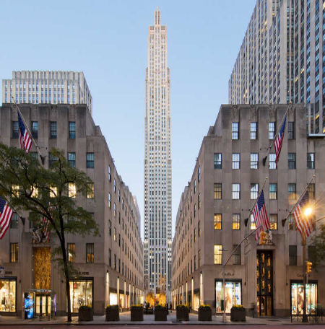
1945 – the American dream a reality or illusion – the rich
Rockefeller family
The Rockefeller family owned the largest share in the Standard Oil Company (along with I G Farben – a German chemical company that created the gas used in the chambers of Nazi death camps).
The planes that made up the Luftwaffe (Nazi air force) needed tetraethyl lead gasoline in order to fly. At the time, only Standard Oil, Du Pont, and General Motors had the ability to produce this vital substance. In 1938 the president of Standard Oil helped I.G. Farben to acquire 500 tons of tetraethyl lead. A year later they obtained an additional 15 million dollars worth of tetraethyl lead which was to be turned into aviation gasoline back in Germany.
After the war began in Europe, the British became angry about U.S. shipments of strategic materials to Nazi Germany. Standard Oil immediately changed the registration of their entire fleet to Panamanian to avoid British search or seizure. These ships continued to carry oil to Tenerife in the Canary Islands, where they refueled and siphoned oil to German tankers for shipment to Hamburg.
This deception was exposed on March 31, 1941 when the U.S. State Department issued a detailed report on refueling stations in Mexico and Central and South America that were suspected of furnishing oil to Italian and German merchant vessels. The report listed Standard Oil of New Jersey and Standard Oil of California among those fueling enemy ships, but there is no record of any action being taken as a result of this discovery.
Rockefellers were also majority shareholders in Chase Bank. A controversy arose during the occupation of France by the Nazis. From the late 1930s until June 14, 1941, when President Franklin D. Roosevelt issued an Executive Order freezing German assets, Chase National Bank worked with the Nazi government. Within hours of Roosevelt’s order, Chase unblocked the accounts and the funds were transferred through South America to Nazi Germany.
Following the end of WWII, the Rockefellers donated New York land worth $8.5m for the building of the United Nations headquarters
Rockefeller Centre NYC

Slide 24
What can you do next?
We would love to see your completed work – photos can be sent to History@xaverian.ac.uk
Take advantage of the further reading and viewing recommended in this session and investigate this topic further
We have also created a special podcast on the topic in this lesson – feel free to give it a listen – it is available via Spotify, Apple and youtube

