Slide 1


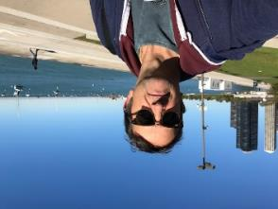
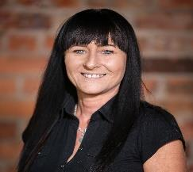
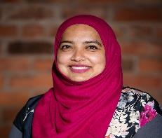

Welcome to Xaverian college
IT OCR / BTEC - 2020
Mark Pouncey – Curriculum Leader
Steph Bailey
Shiuli Begum
Plus one other
This Multi-Media Presentation was substantially put together as part of the Upper Sixth BTEC Course

Slide 2
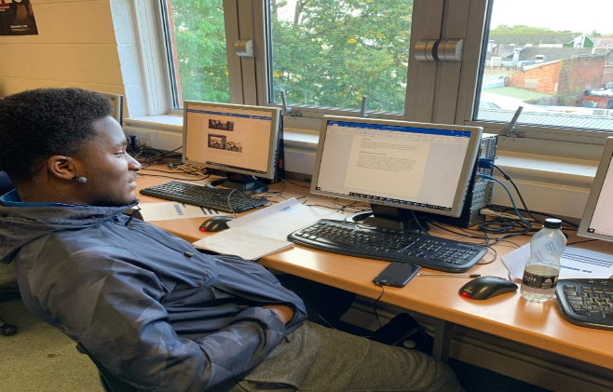


Welcome!
A very warm welcome to Xaverian College, we are delighted that you are considering joining our community to continue your education.
There are many reasons why Xaverian is an outstanding college, our commitment to supporting you to develop intellectually, socially, as well as spiritually. We are also very proud of our reputation as “Outstanding in all areas” by Ofsted.
Not only do we help our students grow academically, but we also help them grow as people. You are given a space to breath with our large campus where you can hang out with friends between lessons, as well as quiet spaces to get stuck into revision and learning – take a walk from Ward Hall to Mayfield.

Slide 3

Information Technology
IT is all about Computer Hardware and Applications. It covers many areas of technology and its use within Information & Communication and how it has changed and developed over the years.
Course Content - examples
Unit 1 Fundamentals of IT- Exam
Unit 2 Global Information - Exam
Unit 13 Social Media & Digital Marketing - Coursework
Unit 4 Computer Networks - Coursework
Unit 21 Web Design & Prototyping – Coursework
Unit 15 Games Design & Prototyping - Coursework
With both coursework and exams, the course will have you learning in many different forms and you will have the chance to work in practical scenarios found in businesses to help you fit them in future careers – the animation above was created by a student to promote healthy eating.
The course can be taken as either an Introductory Diploma, a Diploma or an Extended diploma.

Slide 4
OCR Cambridge Technical
You will complete a number of units over a 2-year course as a single, double or triple course.
They are graded as Distinction, Merit or Pass.
At Xaverian, these can be taken as equivalent to 1, 2 or 3 A-Levels, and may be combined with other A-Level subjects.
Extended Diploma – equal to 3 A-Levels
Diploma – equal to 2 A-Levels
Introductory Diploma – equal to 1 A-Level
Walk through a couple of our IT classrooms

Slide 5
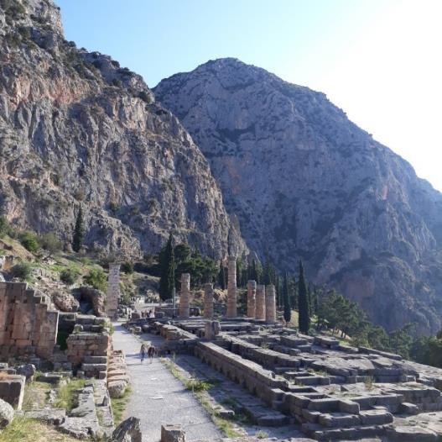
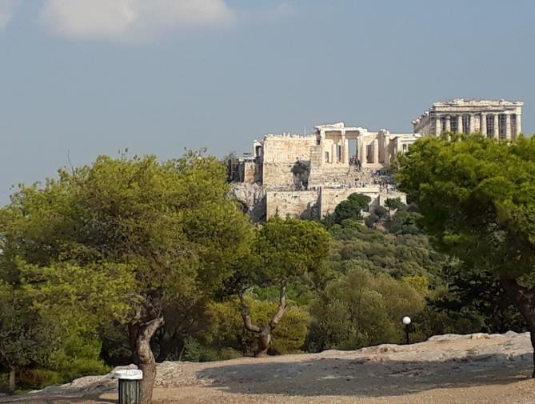
Trips!
Across the college, courses offer opportunities to see new places, from days out at Museums, Businesses and Universities, to week long trips to places like Geneva, Berlin, Athens and New York.
Depending on the subject(s) that you choose there may be trips, sometimes abroad. These pictures were taken in Athens which was a trip for the Ancient History students – IT visits have included Barcelona, Geneva and Berlin.

Slide 6
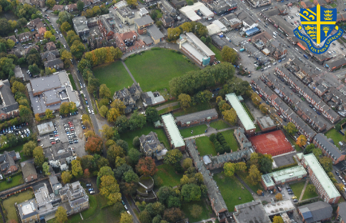
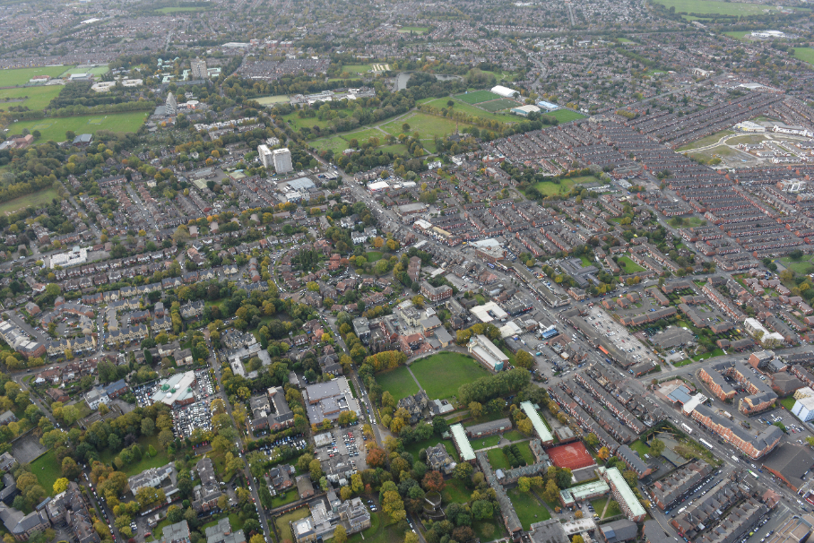
How to Get to College
There are many ways to get here, the easiest thing would be to use google maps to plan your journey and work out the best transport.
Our address is on the right and if you choose to go by bus then students born between Sept 2001 and 31st August 2004 are eligible for a free Our Pass by pressing the button below.
You can also find the buses that come to college.
Xaverian College
Lower Park Road
Manchester
M14 5RB
Our Pass
TFGM
From Piccadilly – Bus numbers 40, 41, 42, 42A, 42B, 43, 44, 45, 45A, 46, 47, 48, 53, 54, 141, 142, 143, 157.
From other Manchester areas – Bus numbers 11, 14, 15, 16, 50, 130
Check tfgm.com to plan your journey

Slide 7
OCR Cambridge Technical
The core units involve an exam where classroom learning is supported by exam based assignments and tests.
On this and the next page are some examples of learning Topics and their definitions – plus some links to try out and have a look at.
The Internet of Things - a concept describing a future where everyday physical objects will be connected to the Internet and be able to identify themselves to other devices.
http://www.techopedia.com/definition/28247/internet-of-things-iot
A hypervisor is a hardware virtualisation technique that allows multiple guest operating systems (OS) to run on a single host system at the same time.
Hybrid cloud is a cloud computing environment which uses a mix of on-premises, private cloud and public cloud services with orchestration between the two platforms. http://whatis.techtarget.com/definitions/H/page/7
Change management is a systematic approach to dealing with change, both from the perspective of an organisation and on the individual level.

Slide 8
OCR Cambridge Technical
Voice over Internet Protocol (VoIP) is a technology that allows telephone calls to be made over computer networks like the Internet.
Social engineering is a non-technical method of intrusion used by hackers that relies heavily on human interaction and often involves tricking people into breaking normal security procedures.
http://searchsecurity.techtarget.com/definition/social-engineering
RFID tags are integrated circuits that include a small antenna. They are typically small enough that they are not easily noticeable and therefore can be placed on many types of objects.
A privacy filter is a panel or filter that is placed over a display to make it difficult or impossible for someone to see the screen without being directly in front of the display.
http://www.computerhope.com/jargon/p/privfilt.htm
Radio-Frequency Identification (RFID) is a system used to track objects, people, or animals using tags that respond to radio waves.

Slide 9
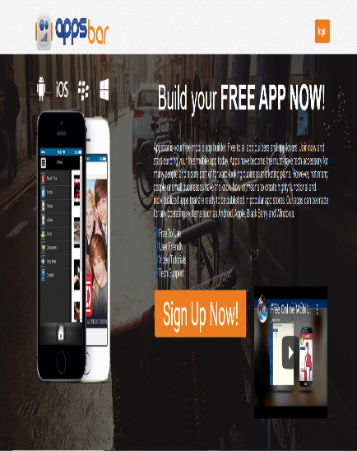
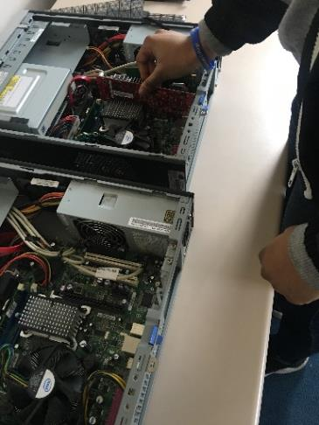
OCR Cambridge Technical
Please look at the following as a classroom activity
Students could create an informative app demonstrating
computer hardware, components and connectivity methods.
(using a media of their own choice or an app developer e.g. http://www.appsbar.com )
We could also use an old PC taken apart to show computer components
At the end of the activity the learners would have created a detailed app showing their understanding of computer hardware, components and connectivity methods

Slide 10
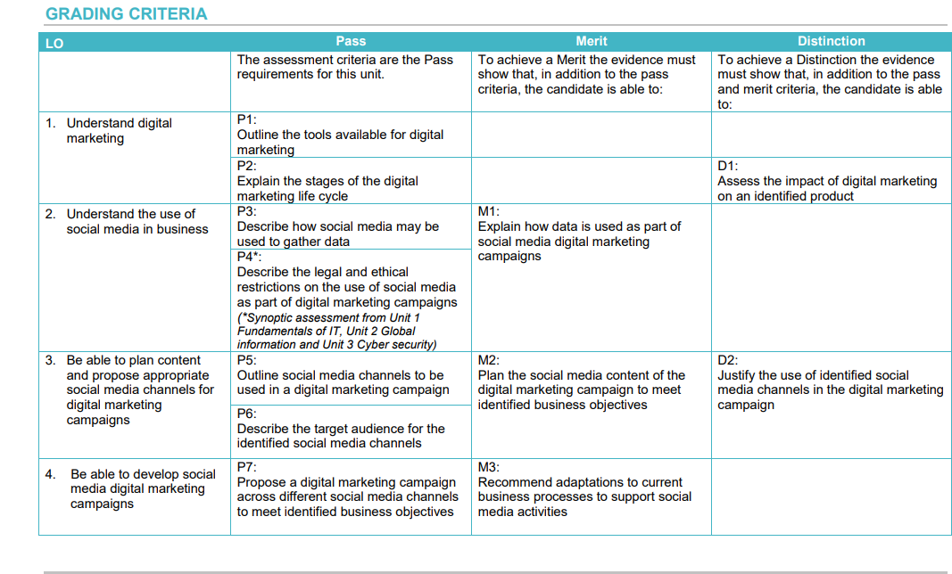
OCR Cambridge Technical
A Coursework Unit
Please look at the following as the assignment structure of Unit 13 - Social Media & Digital Marketing

Slide 11
OCR Cambridge Technical
Please look at the following as the coursework instructions for P1 of Unit 13
LO1 Understand digital marketing
P1: Learners must outline the tools available for a digital marketing campaign as outlined in the learning outcome below.
The outline must provide a clear indication of what the tool is and how it is used within a digital marketing campaign.
Evidence can be in the form of a written report, presentation with detailed speaker notes, a video of the information being presented to an audience, an information guide or an information-poster with detailed annotations.
Learning Outcome
1.1 The role of marketing within business, i.e. market research, raising awareness and affecting perception of need via promotion, advertising and product selling
For preparation for your BTEC in IT, you could have a go at this activity over the summer months.

Slide 12

Thank you for coming! Hope to see you again!

