Slide 1
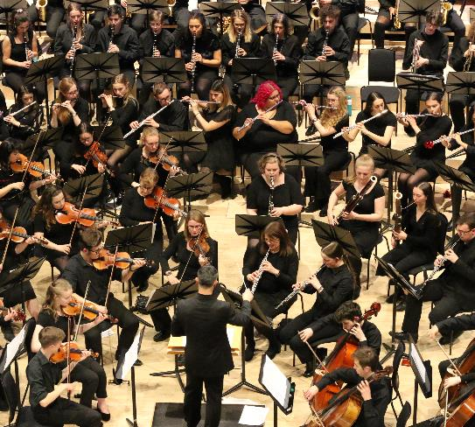
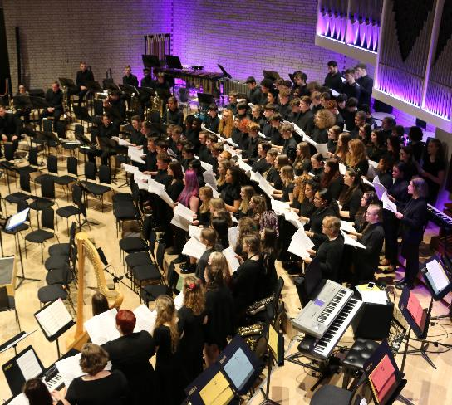
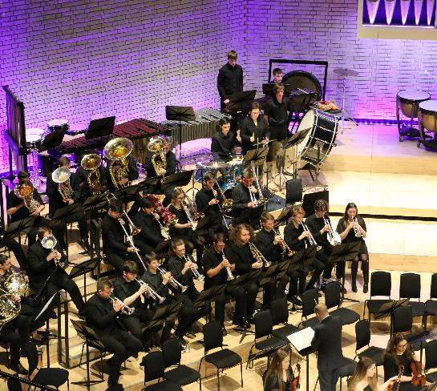
A level music xaverian college Click HERE to view our YouTube channel

Slide 2
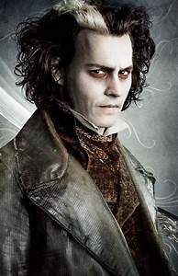
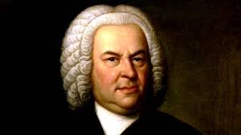
Welcome To Xaverian College’s Taster Day 2020 and to the Music Department Today You Will have, what I hope Will Be, An Exciting and Inspiring Online Lesson.

Slide 3
Events And Successes 2019-2020
Regrettably, we have all had a difficult 2020 but we still managed to have some great events and successes in such a small amount of time.
The following slides highlight these:
RNCM annual performance Masterclass
The Xaverian College Young Musician of The Year Competition
The Chamber Choir performing at Manchester Cathedral
Christmas Concert at The RNCM
Academic successes
Charity Concert dedicated to the NHS and Key Workers – 11th September

Slide 4
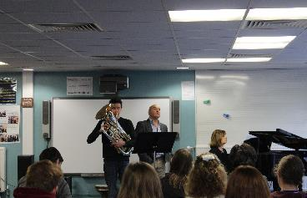
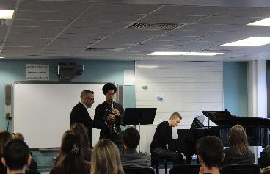
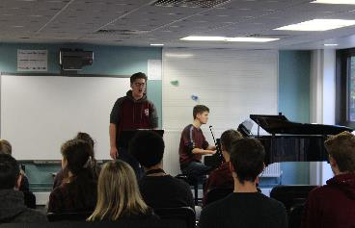
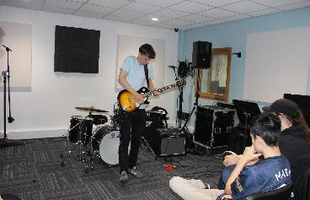
RNCM Performance Masterclass
The RNCM visit Xaverian College on an annual basis to run a Performance Masterclass. Students receive extensive feedback for their performances and are guided on how to prepare for auditions, competitions and recitals.
The RNCM visited Xaverian on the 30th of October 2019 and spent 3 hours coaching our fantastic students, they conducted 2 classes simultaneously; 1 for classical and 1 for pop/jazz musicians. Senior representatives, Chris Hoyle (Head of strings), Kevin Gowland (Director of Woodwind and Deputy Head of Wind, Brass and Percussion) and Andy Stott (Head of Popular Music) led the event. The feedback enabled students to improve posture, communication, phrasing, interpretation, technique and musicianship.

Slide 5
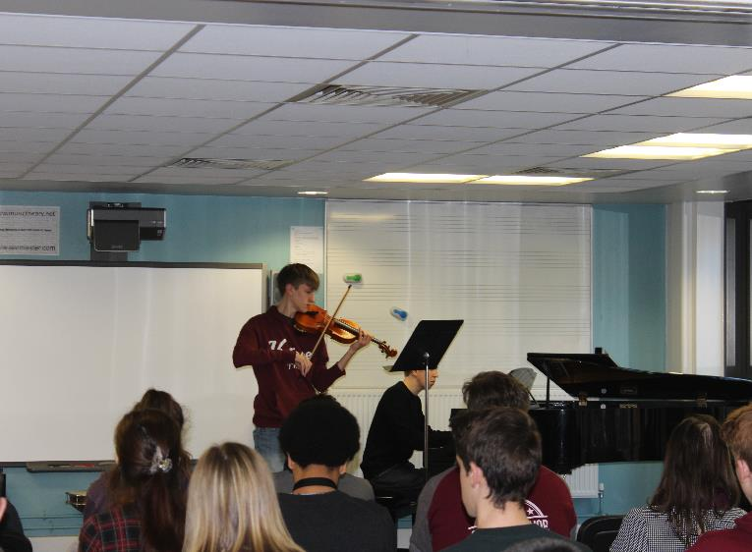
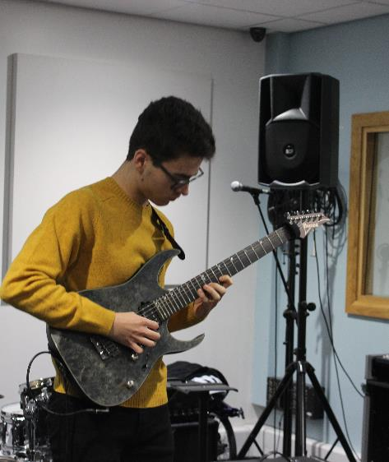
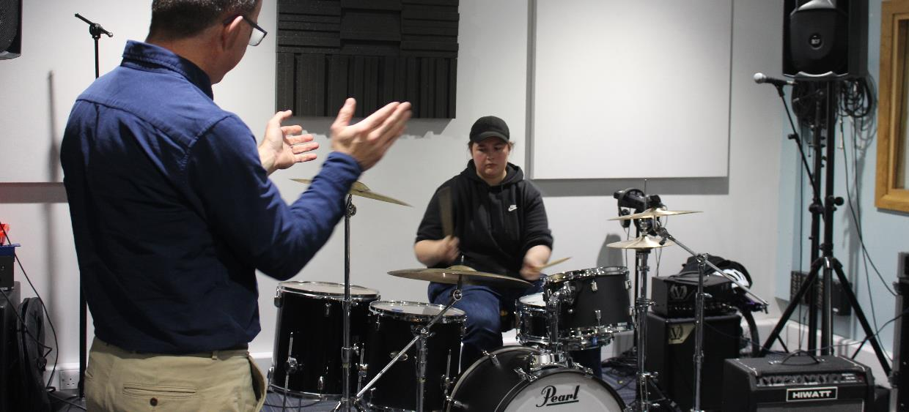
RNCM MASTERCLASS

Slide 6
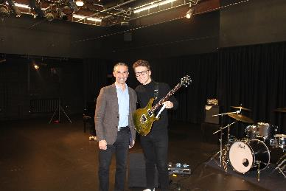
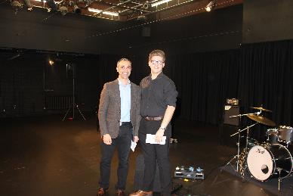
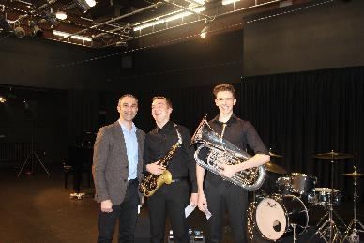
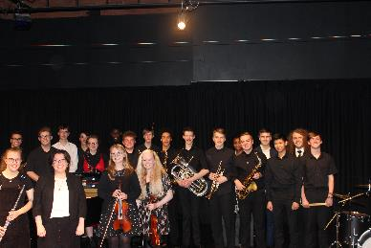
Xaverian College Young Musician of The Year 2019-2020
The Xaverian College Young Musician of The Year Competition was held on Wednesday 6th of November 2019. The competition took place in front of a packed house in the college’s Drama Studio. There was a record number of entries this year and the musicians demonstrated an extremely high level of performance.
The competition has been running for many years and assists students in their preparations for conservatoire and university auditions; giving them invaluable performance experience.
The panel consisted of Xaverian College music teachers and peripatetic instrumental tutors.
The results are as follows:
1st – Josh Hart
2nd – Eden Devaney
Joint 3rd – Alfie Bousfield & Bradley Gore

Slide 7
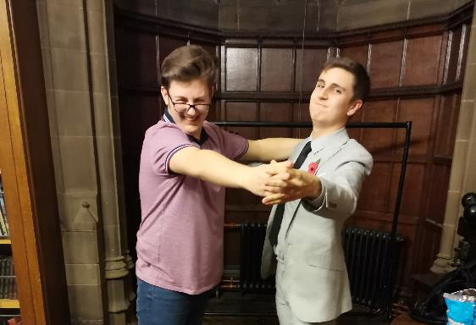
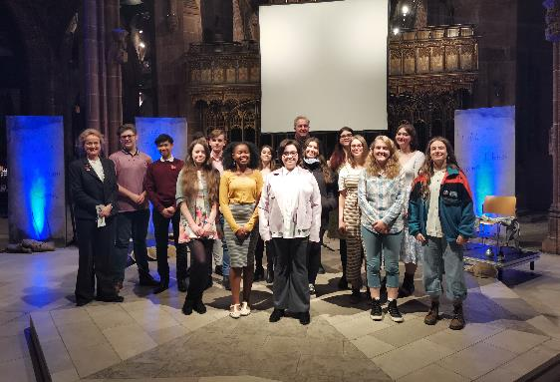
These Days The Manchester Peace Song Cycle
A selection of the college’s finest Chamber Choir members were invited on Sunday 10th November 2019 to perform in a concert at the Manchester Cathedral. The concert was part of remembrance Sunday and was directed by our very own choral/vocal tutor Thomas D Hopkinson, assisted by Rachel Abbott, another of Xaverian’s vocal tutors. The students sang 2 songs by Nicola LeFanu; These Days Text by Tony Walsh and The Parting Shot Text Simon Armitage.
The Peace Cycle from Feelgood Theatre Productions Website
With words by the acclaimed Manchester poet Tony Walsh These Days is a stunning accessible music drama piece set in Heaton Park. It is a beautiful story of one day in the park from sunrise to sunset told through the eyes of the iconic Heaton Park lions. Reflecting on all they have seen Arthur and Amelia share the tears of war and the laughter and joy of peace time over the last 100 or so years. From Suffragette rallies to William Grimshaw’s joyous gramophone concerts; to the Manchester Pals First World War army camp and the 1939 RAF base. From Pope John Paul II’s visit, to family picnics, boat rides, Oasis concerts and generations of photos of children sitting next to them. This unique show is for everyone. Songs of warmth and humour revel in the sunshine days of childhood alongside reflective poignant harmonies that commemorate our universal quest for peace. Projected images shine against the ancient cathedral organ completing the journey.
Director and Dramaturge: Caroline Clegg Musical Director: Thomas D Hopkinson
Performed by - Joseph Jordan, Christopher Littlewood (tenor), Jenny Carson (soprano), Cheetwood Primary School, the Xavarian Chamber Choir, and special prologue by students at CAM the Co-Op Academy. Played by chamber ensemble; Danny Mills, (trumpet), Peter Mitchel, (percussion), Madeline Fitzgerald (violin), Amy Surman (cello) and Emily Wilson (clarinet).

Slide 8
Xaverian College Christmas Concert 2019
The Xaverian College Christmas Concert was held at the RNCM on Tuesday 17th December 2019 and was performed in front of a sold-out audience, this included the top tier balcony, which is a remarkable feat for any concert at the RNCM. The Honourable Lord Mayor of Manchester and the Bishop of Salford Diocese were guests of honour. The concert consisted of 130 Xaverian students, music staff, peripatetic staff, prospective Xaverian students and some of the college’s finest former pupils. On show were the highly acclaimed Xaverian ensembles; performances can be seen and heard via the Xaverian Music Department YouTube Channel.
The concert began with the college’s wonderful Concert Choir, directed and conducted by Ged Marciniak, they set the festive tone for the evening by performing a selection of movements from A Ceremony of Carols by Benjamin Britten. The Concert Choir was accompanied by the wonderful harpist Elinor Nicholson and was also conducted by one of the college’s finest lower 6 students, Alfie Bousfield. Following this the Flute Group, directed by Jennifer Dyson, performed a selection of movements from The Nutcracker by P. I Tchaikovsky. Neil Bowden then conducted the college’s brilliant Brass Band in a performance of Born Free by John Barry and Wrath by Peter Graham. The concert continued with the Clarinet Group performing some folk inspired music composed and arranged by Coen Wolfgram, they performed his klezmer Suite. The Clarinet Group were directed by Katherine Blumer.The incredible Xaverian Big Band, directed by Neil Bowden, then performed Conga by Gloria Estefan/Enrique and Smooth Operator by Sade Adu/Ray St. John. Following the Big Band, Kyran Matthews directed the Jazz Group in a performance of Spain by Chick Corea. The first half concluded in the Christmas spirit with the college’s String Orchestra performing Corelli’s Christmas Concerto. The String Orchestra were conducted and directed by Duncan Reid with Pascal Darley and Megan Hindle on solo violin with Andrew Rogers on solo cello.
The second half opened with the vibrant and flamboyant Percussion Group directed by Joe Luckin. They performed with their usual energetic manner, starting with Clapping Music by Steve Reich followed by Alarm by Brian Blume. Thomas Hopkinson and Rachel Abbott then directed the Chamber Choir, they set a reflective, spiritual and seasonal mood. The Chamber Choir have enjoyed a number of exciting performance opportunities in 2019, including premiering the first piece of their programme at Manchester Cathedral in November. They sang The Parting Shot by Nicola Lefanu, Adam Lay Ybounden by Boris Ord and Nativity Carol by John Rutter. Before the Orchestra took to the stage the internationally acclaimed and award-winning A4 Brass Quartet performed some well-known Christmas songs. A4 Brass are Xaverian’s professional ensemble in residence. The quartet comprises of principal players from some of the UK’s top brass bands, including Black Dyke, Grimethorpe Colliery, Brighouse & Rastrick and Foden’s. With “technical virtuosity in abundance” these four astonishing musicians perform both lyrical and high-octane works, forming a distinctive and new take on chamber music. They dazzled the audience with Carol of The Bells arranged by Jonathan Bates, Locus Iste by Anton Bruckner arranged by Chris Robertson and Now Bring Us Some Fuguey Pudding arranged by Jonathan Bates.
The Xaverian Orchestra made up of 120 musicians concluded the concert, they are by far the largest 6th form college ensemble in the UK. Andrew Levendis conducted the ensemble with an ambitious programme of Persian March by Johann Strauss, Game of Thrones arranged Jay Bocook, Music from The Incredibles by Michael Giacchino, the ”1812” Overture by P. I Tchaikovsky and A Christmas Festival by Leroy Anderson. To end the evening, the Xaverian Orchestra performed Leroy Anderson’s Sleigh Ride as an encore. The audience gave 3 standing ovations during the Orchestra’s powerful performance.

Slide 9
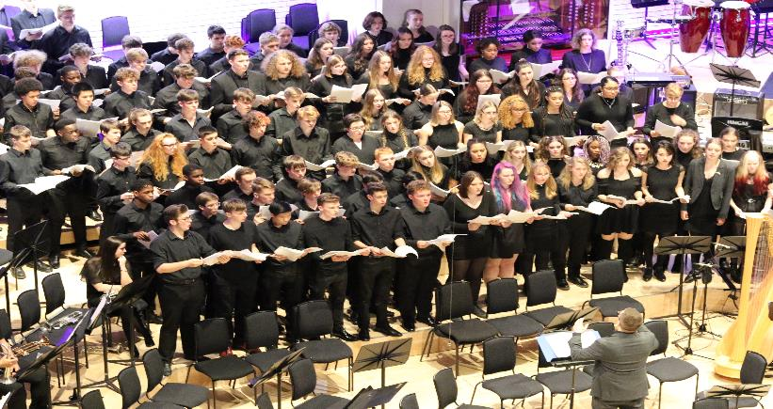
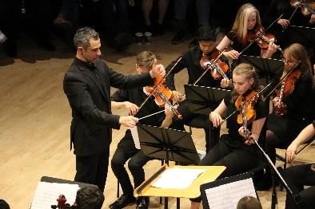
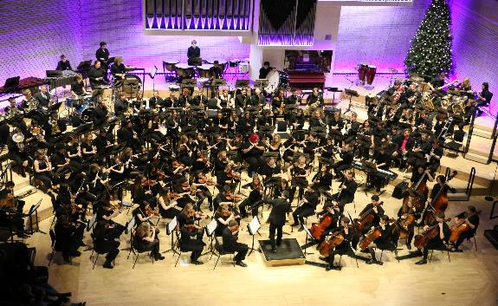
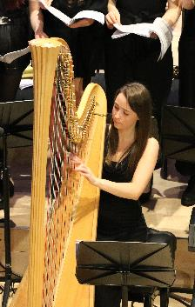
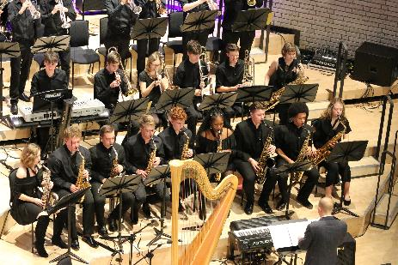
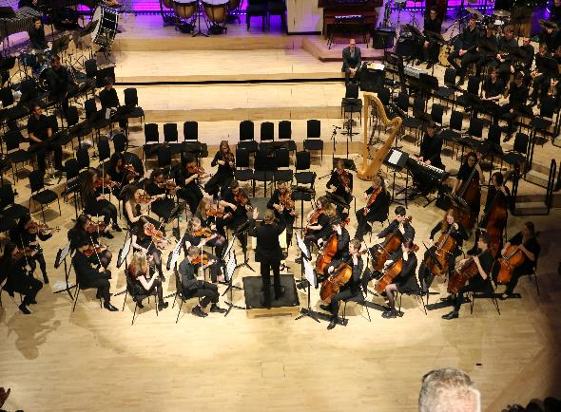
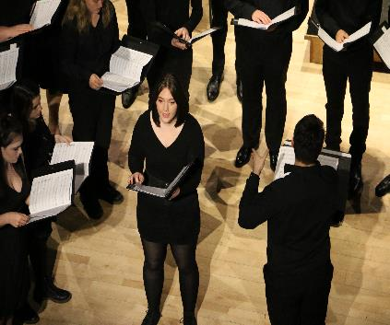
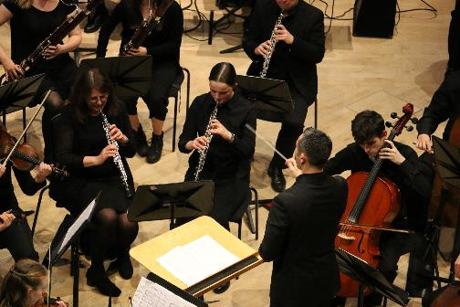
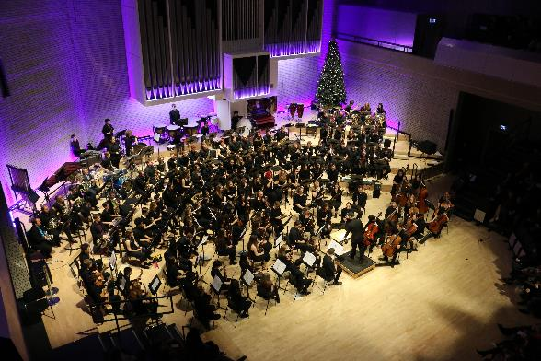
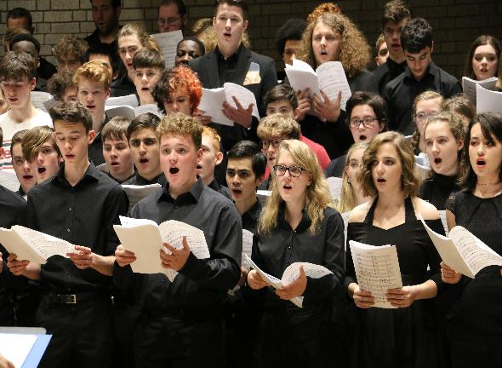
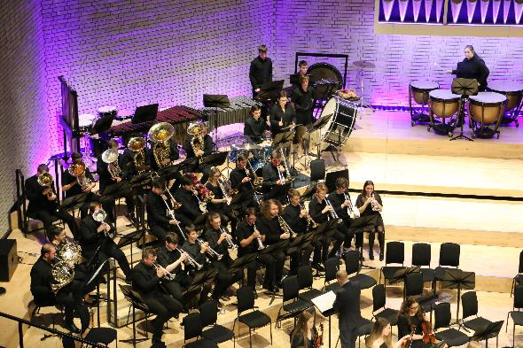
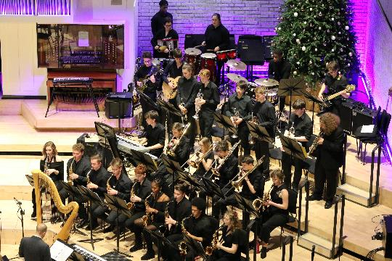
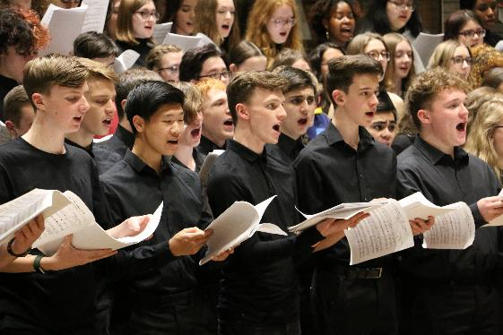

Slide 10
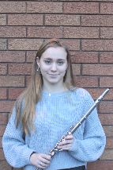
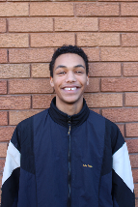
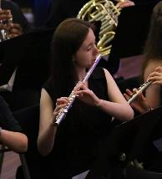
Successes 2019-2020
Xaverian College music students have been auditioning at the finest universities and conservatoires in the UK and USA. The courses that they have applied for range from classical, pop, jazz, performance and music technology degrees.
Abigail Turner
Flute/Voice
University of Leeds
University of Glasgow
University of Birmingham
University of Edinburgh
University of Bristol
Miles Pillinger
Drum Kit
Leeds College of Music
Carmen Craven
Flute
Leeds College of Music

Slide 11
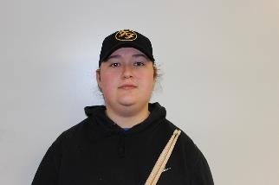
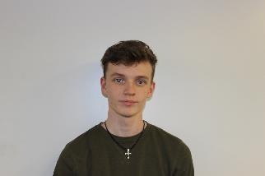
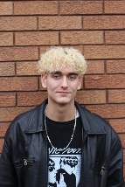
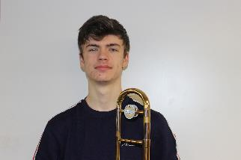
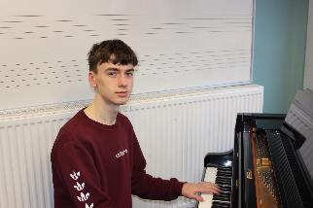
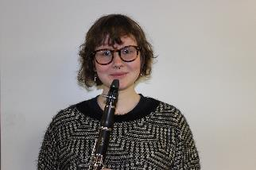
Amber Griffin
Drum Kit
Royal Northern College of Music
Harry Earnshaw
Voice
University of Huddersfield
Mile Lavelle Golding
Jazz Piano
Leeds College of Music
Royal Conservatoire of Scotland
Guildhall School of Music and Drama
Joseph Edwards
Piano/Trombone
University of Salford
Nathan Chambers
Electric Guitar/Piano
LIPA
University of Nottingham
Leeds College of Music
University of Leeds
Dulcie Scott
Clarinet
University of Manchester
University of Salford
University of Birmingham
University of Liverpool

Slide 12
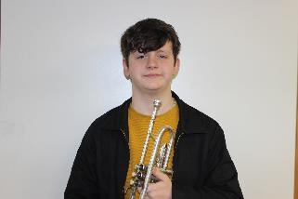
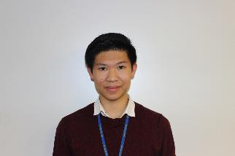
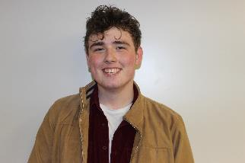
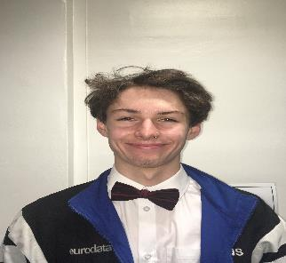
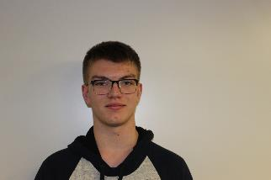
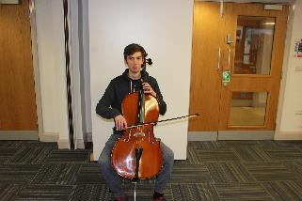
Will Fermer
Trumpet
University of Manchester
University of Liverpool
University of Durham
University of Leeds
University of York
Joshua Cheung
Voice
Scholarship - Royal Welsh College of Music and Drama
Royal Northern College of Music
Royal College of Music
Julliard School of Music
Jack Littler
Electric Guitar
Leeds Arts University
University of Liverpool
Jonathan Calladine
Bass Guitar -
Music, Multimedia & Electronics
University of Leeds
Alex Jacklin
Saxophone/Music Technology
University of Hertfordshire
University of Huddersfield
Guilford School of Acting
Andrew Rogers
Cello
University of Huddersfield
University of Glasgow

Slide 13
A level music Course
40% Exam
Area Study 1: Western Classical Tradition 1650-1910
Baroque Solo Concerto (Purcell, Vivaldi, Bach)
Mozart Opera
Romantic Piano Works (Chopin, Grieg, Brahms)
Area Study 4 & 5:
Music for Theatre
Jazz
25% Composition:
2 Compositions – Free Composition and 1 to a Brief
35% Performance:
10-12 Minutes Solo Performance
The music department has a 100% pass rate and 80+% high grade rate, this has been the case for over 20 years.
Here is an audio recording of a student’s composition. It is written for violin and piano. Statistically we consistently achieve the best composition results in the country.

Slide 14
During Your First Year You Will Be studying these Set Works from The Baroque Period And Musical Theatre. Towards The End Of the year you will also begin to study the development of Jazz.
Purcell
Trumpet Sonata
D Major
Vivaldi
Flute Concerto
D Major
The Goldfinch
J.S Bach
Violin Concerto
A minor
Richard Rodgers Carousel
The King and I
The Sound of Music
Stephen Sondheim
A Little Night Music Sweeney Todd
Claude-Michel Schönberg Les Misérables
Miss Saigon

Slide 15
The Big Band Era Duke Ellington
The great composer, pianist and bandleader Edward ‘Duke’ Ellington was born in Washington DC in 1899. His family were relatively well off, and he was able to study the piano and harmony as a child. As a teenager he played in various bands and produced his earliest compositions, while supporting himself with a day job as a sign painter. His early career occasionally involved engagements in other cities on the American East Coast, including New York.
In 1924 Ellington formed the first version of his ‘Washingtonians’ big band. He got his ‘big break’ in 1927, when he managed to secure a residency for the band at Harlem’s Cotton Club.
During the 1930s ad 1940s he recorded a string of hits , including ‘Mood Indigo’, ‘In a Sentimental Mood’, ‘It Don’t Mean a Thing (If It Ain’t Got That Swing)’, ‘Cotton Tail’, ‘Caravan’, ’Take the ”A” Train’ and ‘Koko’.

Slide 16
koko first recorded in 1940
Koko was originally written for his unfinished opera – Boola
It is a 12-bar blues in Eb Minor and there is an introduction, 7 choruses and a coda.
Ellington drew his inspiration from the drum ceremonies based on African religious rites that used to take place in New Orleans’ Congo Square.
The soloists are - Juan Tizol on valve trombone, Joe “Tricky Sam” Nanton on trombone, Duke Ellington on piano and Jimmy Blanton on Bass.

Slide 17
Koko – a short analysis
Listen to this link https://www.youtube.com/watch?v=wFW_3UYgaxY
Follow the enclosed score and track the analysis on the score.
Listen out for the following features too:
Introduction (8 bars): Opening rhythm in the tom-tom and baritone saxophone, set up against the high pitch chromatic harmonies in the trombone section. The Rhythms are played straight.
Chorus 1 (12 bars): Valve trombone, in a syncopated call and response pattern with the high-pitched syncopated saxophones. The rhythms are swung.
Chorus 2 (12 bars): Muted trombone, answered by brass section, moving bass line.
Chorus 3 (12 bars): Muted trombone, growing in intensity and dynamics, mute placed tighter against the bell for a different timbre.
Chorus 4 (12 bars): Piano solo uses the Whole Tone scale for its solo and the left hand interjects dissonant harmonies.
Chorus 5 (12 bars): Trumpets with the main theme.
Chorus 6 (12 bars): Figure ascends through the trombones and the trumpets, then breaks for the bass solo. There are thickly scored chords.
Chorus 7 (12 bars): Full orchestra
Coda (12 bars): Recapitulation of the introduction. The opening figure is passed around in imitation on the last page, there are augmented chords and the last chord is Eb minor 7, 9, 11 (Eb minor with Db major = bitonal cadence).

Slide 18
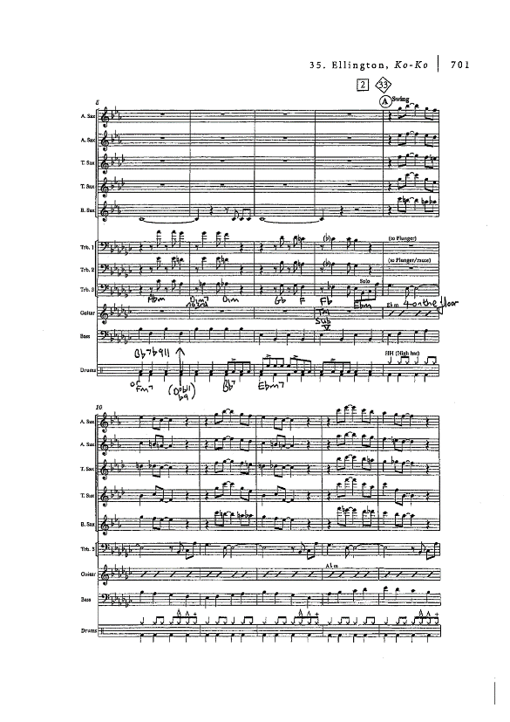
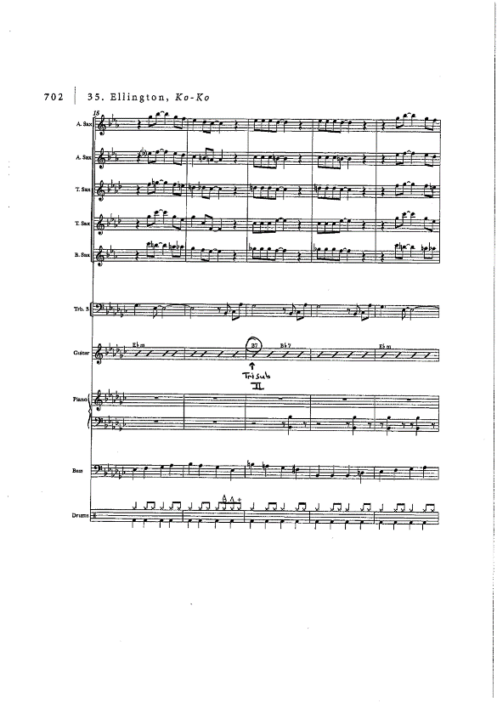
koko

Slide 19
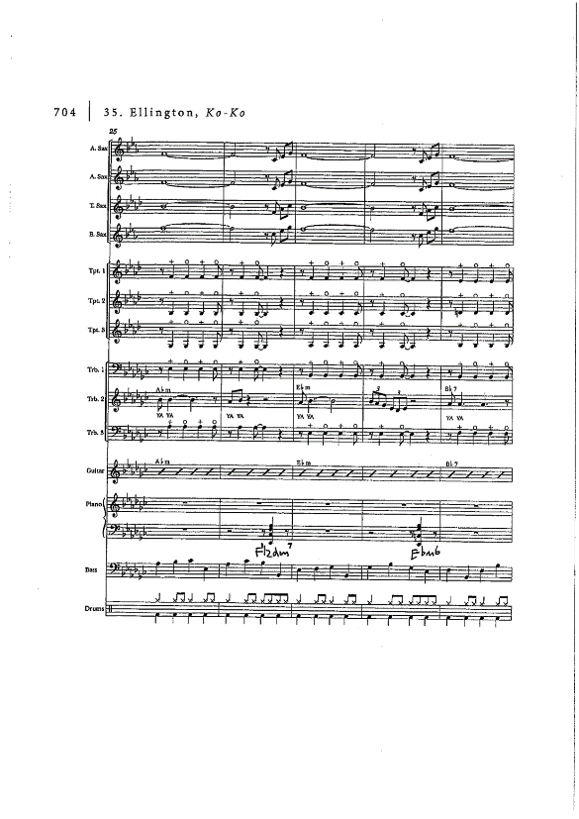
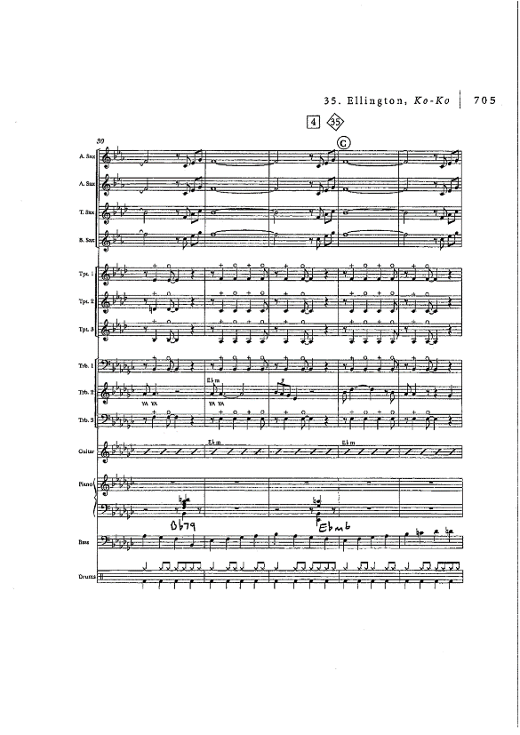

Slide 25
Listening Question Duke Ellington’s Cotton Tail
Click on this link https://www.youtube.com/watch?v=qAZWFafX6o8 and answer the following questions, the answers are on the next slide.
Listen to “0:27” - “2:05” of Cotton Tail
Name the instrument that plays the solo at the start of the excerpt?
Which one of the following represents the rhythm of the brass chords heard during the bridge of the first solo chorus?
Which two types of instrument harmonise the melody in the section immediately following the first solo?

Slide 26
Answers:
Tenor Saxophone
B
Trumpets and Trombones

Slide 27
Clapping Exercise: 👏
To end the lesson we are going to learn and perform this exercise:
It is in 6/8 time
. = a crotchet rhythm
Z. = a crotchet rest
= a crotchet rhythm
= a quaver rhythm
= 3 quavers
Clap clockwise starting at 12, clap each bar twice.
Clap anti-clockwise starting at 12, clap each bar twice.
Clap clockwise starting at 12, clap each bar twice, but go in even numbers only.
Clap anti-clockwise starting at 12, clap each bar twice, but go in even numbers only.
Clap clockwise starting at 1, clap each bar twice, but go in odd numbers only.
Clap anti-clockwise starting at 11, clap each bar twice, but go in odd numbers only.

Slide 28
🥁 Now it’s Your turn to be the composer and the teacher!
Can you devise your own composition? Will you be going in even or odd numbers? Will you be going diagonally? Could you go clockwise then go anticlockwise without stopping?
Can you now teach this exercise to a member of your family or a friend? Can you perform it together?
Could you and your family member or friend perform two different patterns at the same time? This might create counterpoint/polyphony or even imitation.

Slide 29
🎺 THE END 🎵
That concludes today’s taster lesson.
I hope you all enjoyed it and can take something from it to enhance your musical development?
I hope to see you all in September.
Have a lovely summer, stay safe! 🎻

