Slide 1


Psychology at xaverian

Slide 2


The psychology department at xaverian
Psychology is the most popular single A level at Xaverian
The teachers are experienced and Psychology specialists
Experience of examining AQA A level Psychology
Psychology is taught in the Mayfield building (see photo on this slide)

Slide 3


What is psychology?
The British Psychological Society defines psychology as:
“The scientific study of people, the mind and behaviour.”
(British Psychological Society, 2007)
If you are reading this, you probably are interested in people and are curious about what is going on in other people’s minds and you want to understand more about why people behave as they do.

Slide 4
What is psychology?
The most 'important and greatest puzzle' we face as humans is ourselves
(Boring, 1950)
Psychologists put forward a range of explanations about why people feel, think and behave the way they do.

Slide 5

TRY OUT THE ACTIVITY BELOW
Activity – 5 minutes
In the photograph you can see David and Victoria Beckham - just two people in a romantic relationship with each other.
Can you explain, in general, what it is that makes people attracted to each other and form romantic relationships?
You can give as many explanations as you want, even some that you don't agree with but think other people might come up with.

Slide 6

DISCUSSION
There are lots of possible explanations for this. Have a look at the list below and compare it with yours. It doesn't matter if your responses are different, that only goes to show how complicated explaining behaviour is!
It is because she is physically attractive and he has financial security (evolutionary theory claims explanation! Psychologists acknowledge this is an outdated view)
It is because they have a similar attitude towards things like work and family?
Right place, right time? People tend to form relationships with people that they are around...same college, workplace, city?
Is it because they are both as good looking as each other?
Is it because they have invested in each other? In terms of time and children etc?
Do the benefits of being in that relationship outweigh the costs of being apart?
Does the relationship compare favourably to their past experiences? Or other romantic options?
These are some of the theories we study in the Relationships topic ☺

Slide 7

WHAT MAKES US WHO WE ARE?
The psychology course covers different explanations and theories for a wide range of behaviours to help try and answer some of those questions about human behaviour. Including:
Why do people develop depression? OCD? Phobias?
Why do people obey authority figures even if it means hurting another person? And what about those people that don’t obey?
Why do people form addictions?
What effect does stress have on the body? How can it be treated?
Are our memories accurate enough to be used as evidence in court?
What long term effects are there on a person who grows up with no attachment figure?
Do our brains physically change as a result of new experiences? Such as playing a new computer game or learning to drive?

Slide 8
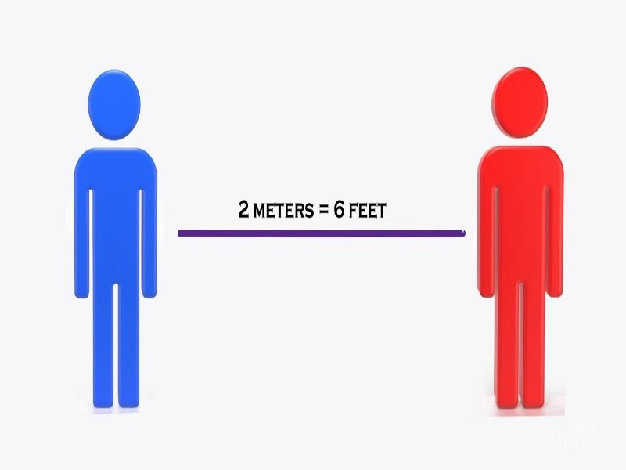
Psychology is RELEVANT – THINK ABOUT the current situation in the uk
Psychologists have even played a role in influencing our behaviour during the coronavirus pandemic
Psychologists such as Professor Stephen Reicher (who is an expert in social psychology) is on a panel that advises the government on behavioural science
For instance, how can the government persuade the public to comply with rules such as social distancing and isolation during the lockdown?
He was a guest on a podcast HERE talking about how psychologists have advised the government on how to communicate to the public

Slide 9


WE FOLLOW THE AQA SPECIFICATION
Paper 1 | Paper 2 | Paper 3
Memory | Approaches | Issues & Debates
Social Influence | Biopsychology | Relationships
Attachment | Research Methods (double section) | Addiction
Psychopathology |  | Stress
Assessed by 3 exams at the end of 2 years
Each paper is 2 hours long
Here is the link to the Psychology page on the AQA website:
https://www.aqa.org.uk/subjects/psychology/as-and-a-level/psychology-7181-7182

Slide 10

ENTRY REQUIREMENTS
Grade 5 in English, Maths and Science (Grade 4 is considered)
10% of the course is maths
Essay writing (less than 1,000 words)
There are some topics that contain some biology e.g. the Biopsychology and Stress topics

Slide 11

WHAT DO PSYCHOLOGY STUDENTS SAY ABOUT STUDYING A LEVEL PSYCHOLOGY AT XAVERIAN?

Slide 12

CLICK TO WATCH THE VIDEO
Aisha is has just finished her studies at Xaverian and hopes to study Psychology at university next year

Slide 13

CLICK TO WATCH THE VIDEO
Simi has just finished her studies at Xaverian and took the Psychology A level

Slide 14

Taabish says…
“Doing Psychology at A level has introduced me to some amazing topics such as Psychopathology where we learnt about the causes of depression, OCD, phobias and ways of treating these mental disorders.
I chose Psychology because it is a subject that has allowed me to evaluate and take into account many arguments for different theories and helped me develop my critical thinking skills. As Psychology is such a broad subject, it’s beneficial to have it as an A level because it contributes massively when applying to university.
My plans after college are to study Pharmacy at the University of Manchester.”

Slide 15

Hannah says…
“I've just finished my two years at Xaverian and I loved studying Psychology at A-level. It was really enjoyable and interesting. If you're hard working and interested in learning more about human behaviour, you'll enjoy it. My favourite topics were psychopathology and attachment. However all the topics are interesting, engaging and exciting to learn about and are relevant and thought provoking. I would definitely recommend studying this at A-level especially at Xaverian! I plan on taking Psychology at university this September and hopefully going into a career in Psychology”

Slide 16

Iqra says…
“I chose to study Psychology as an A level because it has always intrigued me due to its depth of theories and fascinating topics. Therefore studying it at A level has not only given me the understanding of social, biological and cognitive approaches, but has also allowed me to examine the correlation between human behaviour and the impact it holds on the human mind. The topic Social Influence really captured my attention as it introduced me to the different types of conformity, as well as analysing various reasons of why people choose to conform in society today. My passion for this subject has positively influenced my future plans which is to study Psychology at Liverpool university.”

Slide 17
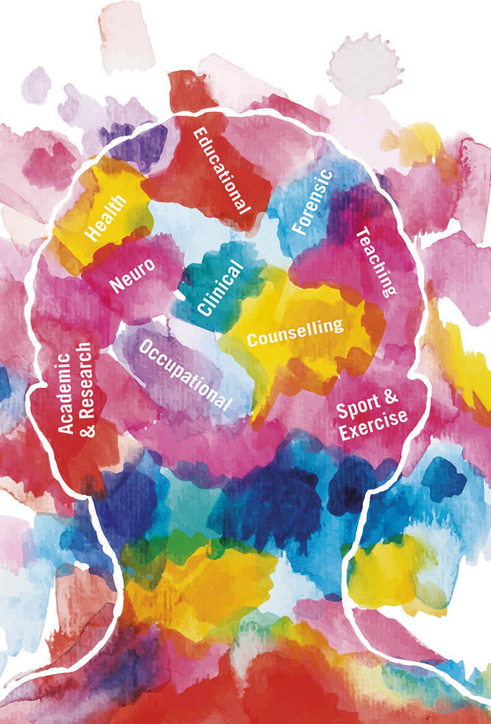
WHERE CAN PSYCHOLOGY TAKE YOU?
With further study, you can become a Psychologist - https://careers.bps.org.uk/
But there are so many other career paths that Psychology can support you to with
75 out of 242 of our students from last year went on to do Psychology or Psychology related degree* at university - that is 31% *(neuro/educational/forensic/clinical counselling/psych with criminology)​

Slide 18
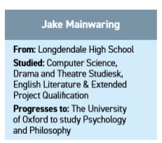
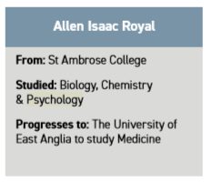
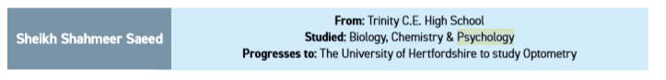
WHAT ELSE CAN YOU DO WITH PSYCHOLOGY?
But because Psychology develops skills + knowledge in ENGLISH, MATHS, SCIENCE and PEOPLE it compliments so many other career choices.

Slide 19

ENRICHMENT includes:
*Visits from Psychologists including Clinical, Forensic and Educational Psychologists
*Chester Zoo Psychology Workshop
*Manchester to Manhattan – Psychology trip to New York

Slide 20

ACTIVITY - How much do you know about psychology?
Click here to take the online multiple choice quiz

Slide 21

Ways you can look into psychology a bit more
Conduct your own piece of psychological research on yourself or people in your household (see next slide).
Remember – all people that take part in research need to give you informed consent (explain what the study is about and what it will involve doing)
2. Engage in relevant TV/ Films/ Books/ Podcasts/ articles (see list from the Psychology ‘Preparation for Year 12’ document)

Slide 22
Conduct your own
psychology study:
Music & Personality

Slide 23
Could the contents of your playlist reveal something about your personality?
People listen to music as a way to set the mood, to motivate a workout, or even to gain inspiration. How much are those choices influenced by underlying personality traits?

Slide 24
Measuring personality
Many contemporary psychologists believe that there are five basic dimensions of personality, often referred to as the ‘Big 5’ personality traits and measured using a questionnaire.
It is important to note that each represents a range between
two extremes as most people lie somewhere in between the
two polar ends of each dimension.

Slide 25

Personality trait: Extroversion
High score on questionnaire
Enjoys being the centre of attention
Likes to start conversations
Enjoys meeting new people
Has a wide social circle of friends and acquaintances
Finds it easy to make new friends
Feels energised when around other people
Say things before thinking about them
Low score on questionnaire (Introversion)
Prefers solitude
Feels exhausted when having to socialise a lot
Finds it difficult to start conversations
Dislikes making small talk
Carefully thinks things through before speaking
Dislikes being the centre of attention

Slide 26

Personality trait: Agreeableness
High score on questionnaire
Has a great deal of interest in other people
Cares about others
Feels empathy and concern for other people
Enjoys helping and contributing to the happiness of other people
Assists others who are in need of help
Low score on questionnaire (Disagreeableness)
Takes little interest in others
Doesn't care about how other people feel
Has little interest in other people's problems
Insults and belittles others
Manipulates others to get what they want

Slide 27

Personality trait: Conscientiousness
High score on questionnaire
Spends time preparing
Finishes important tasks right away
Pays attention to detail
Enjoys having a set schedule
Low score on questionnaire (Lack of conscientiousness)
Dislikes structure and schedules
Makes messes and doesn't take care of things
Fails to return things or put them back where they belong
Procrastinates important tasks
Fails to complete necessary or assigned tasks

Slide 28
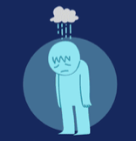
Personality trait: Neuroticism
High score on questionnaire
Experiences a lot of stress
Worries about many different things
Gets upset easily
Experiences dramatic shifts in mood
Feels anxious
Struggles to bounce back after stressful events
Low score on questionnaire (Emotional stability)
Emotionally stable
Deals well with stress
Rarely feels sad or depressed
Doesn't worry much
Is very relaxed

Slide 29

Personality trait:
Openness to experience
High score on questionnaire
Very creative
Open to trying new things
Focused on tackling new challenges
Happy to think about abstract concepts
Low score on questionnaire (Closed to experience)
Dislikes change
Does not enjoy new things
Resists new ideas
Not very imaginative
Dislikes abstract or theoretical concepts

Slide 30
Previous research on the link between personality and music taste
One large-scale study conducted by researchers at Heriot-Watt University looked at more than 36,000 participants from all over the world.
Participants were asked to rate more than 104 different musical styles in addition to offering information about aspects of their personalities (using the ‘Big 5’ personality traits questionnaire).
The following are some of the personality traits the study correlated to certain musical styles:

Slide 31

Pop Music
Fans of the top 40 pop hits tend to be extroverted, honest, and conventional. While pop music lovers are hardworking and have high self-esteem, researchers suggest that they tend to be less creative and more uneasy.

Slide 32


Rap and Hiphop Music
In spite of a stereotype that rap lovers are more aggressive or violent, researchers have actually found no such link. Rap fans do tend to have high self-esteem and are usually outgoing.

Slide 33

Country Music
Country music fans are typically hardworking, conventional, and outgoing. While country songs are often centered on heartbreak, people who gravitate towards this genre tend to be very emotionally stable. They also tend to be more conservative and rank lower on the trait of openness to experience.

Slide 34

Rock/Heavy Metal Music
Despite the sometimes aggressive image that rock and heavy metal music project, researchers found that fans of this style of music are usually quite gentle. They tend to be creative, but are often introverted and may suffer from low self-esteem.

Slide 35

Indie Music
Fans of the indie genre are typically introverted, intellectual, and creative. According to researchers, they also tend to be less hardworking and less gentle. Passivity, anxiousness, and low self-esteem are other common personality characteristics.

Slide 36

Dance Music
According to researchers, people who prefer dance music are usually outgoing and assertive. They also tend to rank high on the trait of openness to experience, one of the five major personality traits. People who prefer fast-paced electronic music also tend to rank low on gentleness.

Slide 37
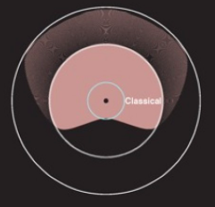
Classical Music
Classical music lovers are typically more introverted but are also at ease with themselves and the world around them. They are creative and have a good sense of self-esteem.

Slide 38

Jazz, Blues, and Soul Music
People who enjoy jazz, blues, or soul music were found to be more extroverted with high self-esteem. They also tend to be very creative, intelligent, and at ease.

Slide 39
Can you replicate this study’s results
(this makes the findings more ‘reliable’)?
STEP 1:
Answer the following ‘Big 5’ personality traits questionnaire by scoring each non-bolded question (where 1 = disagree strongly) as indicated on the left below, and by reverse scoring each bolded question (where 5 = disagree strongly) as indicated on the right below.
SCORING SYSTEM
REVERSE SCORING SYSTEM
Disagree strongly: 1
Disagree a little: 2
Neither agree nor disagree: 3
Agree a little: 4
Agree strongly: 5
Disagree strongly: 5
Disagree a little: 4
Neither agree nor disagree: 3
Agree a little: 2
Agree strongly: 1

Slide 40
I see myself as someone who...
Don’t forget to reverse score
all the bolded questions!
1. Is talkative
2. Tends to find fault with others
3. Does a thorough job
4. Is depressed, blue
5. Is original, comes up with new ideas
6. Is reserved
7. Is helpful and unselfish with others
8. Can be somewhat careless
9. Is relaxed, handles stress well
10. Is curious about many different things
11. Is full of energy
12. Starts quarrels with others
13. Is a reliable worker
14. Can be tense
15. Is ingenious, a deep thinker
16. Generates a lot of enthusiasm
17. Has a forgiving nature
18. Tends to be disorganised
19. Worries a lot
20. Has an active imagination
21. Tends to be quiet
22. Is generally trusting

Slide 41
I see myself as someone who...
23. Tends to be lazy
24. Is emotionally stable, not easily upset
25. Is inventive
26. Has an assertive personality
27. Can be cold and aloof
28. Perseveres until the task is finished
29. Can be moody
30. Values artistic, aesthetic experiences
31. Is sometimes shy, inhibited
32. Is considerate and kind to almost everyone
33. Does things efficiently
34. Remains calm in tense situations
35. Prefers work that is routine
36. Is outgoing, sociable
37. Is sometimes rude to others
38. Makes plans and follows through with them
39. Gets nervous easily
40. Likes to reflect, play with ideas
41. Has few artistic interests
42. Likes to cooperate with others
43. Is easily distracted
44. Is sophisticated in art, music, or literature

Slide 42
STEP 2:
Total your scores for each trait separately.
(The numbers by each trait below represent which questions were about that trait).
A very high score score represents that trait being a strong part of your personality.
A very low score represents the opposite of that trait being a strong part of your personality.
(You can also score anywhere in-between!)
Extroversion: 1, 6, 11, 16, 21, 26, 31, 36
Agreeableness : 2, 7, 12, 17, 22, 27, 32, 37, 42
Conscientiousness: 3, 8, 13, 18, 23, 28, 33, 38, 43
Neuroticism: 4, 9, 14, 19, 24, 29, 34, 39
Openness to experience: 5, 10, 15, 20, 25, 30, 35, 40, 41, 44
EXTROVERSION SCORE | AGREEABLENESS SCORE | CONSCIENSCIOUSNESS SCORE | NEUROTICISM SCORE | OPENNESS TO EXPERIENCE SCORE

Slide 43
STEP 3:
Rate the music styles used in the original study on a scale of 1-10 (where 1 = ‘I do not like the music style at all’ and 10 = ‘I really love this music style’)
Pop | Rap and Hiphop | Country | Rock/Heavy metal | Indie | Dance | Classical | Jazz, Blues and Soul

Slide 44
STEP 4:
Begin to analyse your data:
Which personality trait did you score the highest?
Which personality trait did you score lowest?
Which music style did you score the highest?
Look back at the original study’s findings about the link between your preferred music style and the participants’ personality traits.
Do you have similar personality traits (you may need to look back at the sub-categories of the ‘Big 5’ personality traits)? If you do, you have made the original findings more ‘reliable’ (or scientifically credible, as they are less likely to have occurred by chance)!

Slide 45
STEP 5:
Challenge yourself! Further questions to consider…
1. Do personality traits influence music taste or does music influence your personality, if at all?
2. What does the phrase ‘correlation is not causation’ mean? (Google it!)
3. What ‘third variables’ can you think of (e.g. living in certain regions of the country, are you more likely to adopt certain musical tastes, and therefore is it actually the community you live in which is more likely to influence your personality traits, and not the music you listen to?)
4. If you were to plot your data on a graph, what type of graph would you choose and how would you do it?
5. If you were to further this area of research, what would you investigate and how might you do it?

Slide 46
Congratulations!
You are now a budding psychologist :)

Slide 47
Questions?
If you have any questions or would like any further information about the Psychology A level course you can email Xaverian College’s admission team or the Curriculum Leader for Psychology – c.Bradshaw-smith@xaverian.ac.uk ☺

