Slide 1



Spanish at Xaverian

Slide 2
Languages A levels at Xaverian
¿Why study Languages?

Slide 3


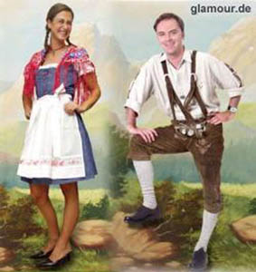

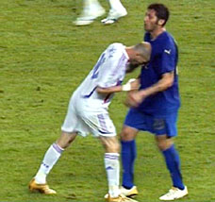
Why study a language?
It broadens our horizons
https://www.youtube.com/watch?v=kdxP85ouT9c

Slide 4
Languages A levels at Xaverian
The course you are studying is a linear A level. This means:
You will take all the exams that count towards your A level in the second year.
Occasionally students do AS level languages, if they have a native background or as an extra for very talented students

Slide 5
OUTLINE OF AS AND A- LEVEL EXAM
Both the AS and the A- Level exams are made up of 3 parts
SPEAKING 30%
LISTENING, READING AND TRANSLATION: 50%
CRITICAL AND ANALYTICAL RESPONSE IN WRITING ABOUT BOOK/FILM: 20%

Slide 6
AS Exam | A Level Exam | Key Skills
Speaking 30% Discussion of 2 stimulus cards (different themes) | Speaking 30% Discussion of stimulus card Presentation and discussion of independent research project | Expressing your ideas clearly, logically and accurately, when you speak Taking part in a conversation Demonstrating knowledge and understanding of Spanish-speaking world
Written examination: 50% Listening, reading and translation | Written examination: 50% Listening, reading and translation | Understanding of spoken and written language Writing accurately
Critical and analytical response in writing: 20% Essay about El Laberinto del Fauno | Critical and analytical response in writing: 20% Essay about a film: El Laberinto del Fauno Essay about a book: La Casa de Bernarda Alba | Demonstrating knowledge and understanding of film (and book) studied Expressing your ideas clearly, logically and accurately
(AS Level info for those taking as enrichment qualification)

Slide 7
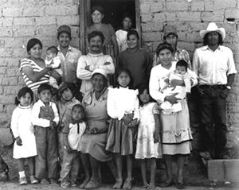
1st YEAR TOPICS
Being a young person in Spanish-speaking society
Family structures, traditional and modern values, friendships / relationships, citizenship
Youth trends, issues and personal identity
Educational and employment opportunities

Slide 8
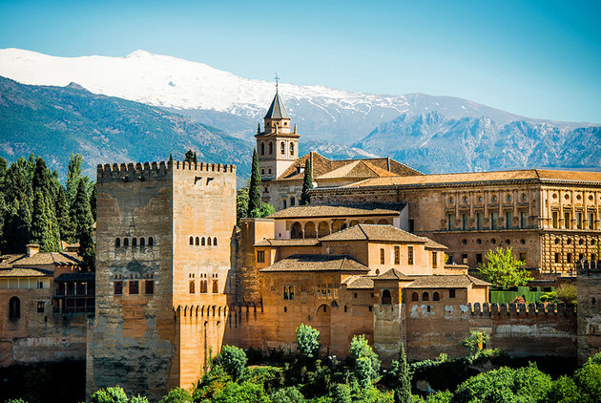
1st YEAR TOPICS
Understanding the Spanish-speaking world
Regional culture and heritage in Spain or countries and communities where this language is spoken
Literature, art, film and music in the Spanish-speaking world

Slide 9
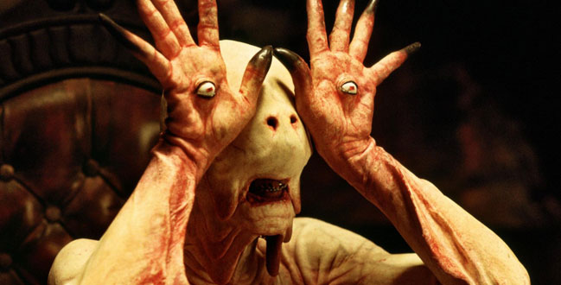
1st YEAR TOPICS- Spanish Film
El Laberinto del Fauno – film
https://www.youtube.com/watch?v=gpEh4O8Hb5Y

Slide 10
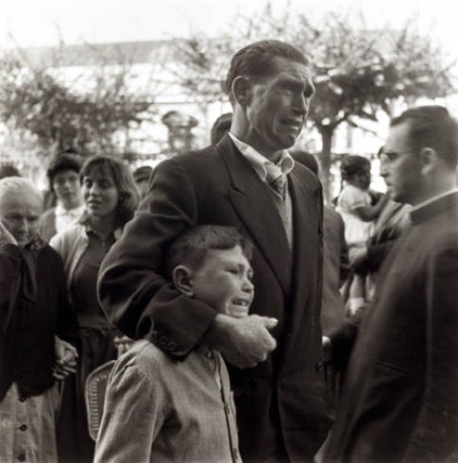
2nd Year Topics
Diversity and difference
Migration and integration
Cultural identity and marginalisation
Cultural enrichment and celebrating difference
Discrimination and diversity

Slide 11
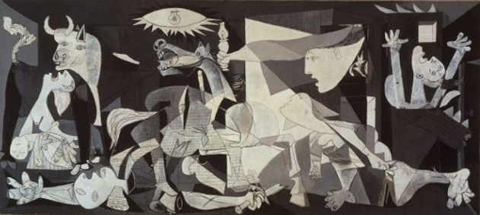
2nd Year Topics-History of Spain
The two Spains: 1936 onwards
El franquismo (Dictatorship of Franco)– origins, development and consequences
Post-Civil War Spain – historical and political repercussions
The Spanish Civil War and the transition to democracy (in cinema, literature, art and photography)
Spain – coming to terms with the past?

Slide 12
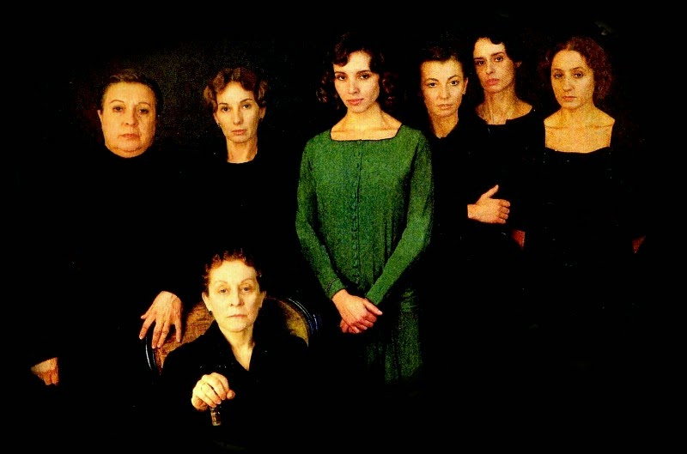
2nd Year Topics- Written Texts
La Casa de Bernarda Alba –play by Federico García Lorca

Slide 13
What we require of you
Arrive on time for your lessons and hand your assignments in on time.
Fill in absent/late form if you do not do this, and catch up on work missed.
Spend at least 4 hours outside the classroom on the subject.
Attend one hour conversation class with the assistant each week.
Mobile ‘phones must be switched off.
Food and drinks are not allowed in the classroom.
Use foreign language as far as possible in the classroom
If your teacher is absent, the lesson should be cancelled. Find and Inform another teacher after 10 minutes.
Enjoy studying!

Slide 14
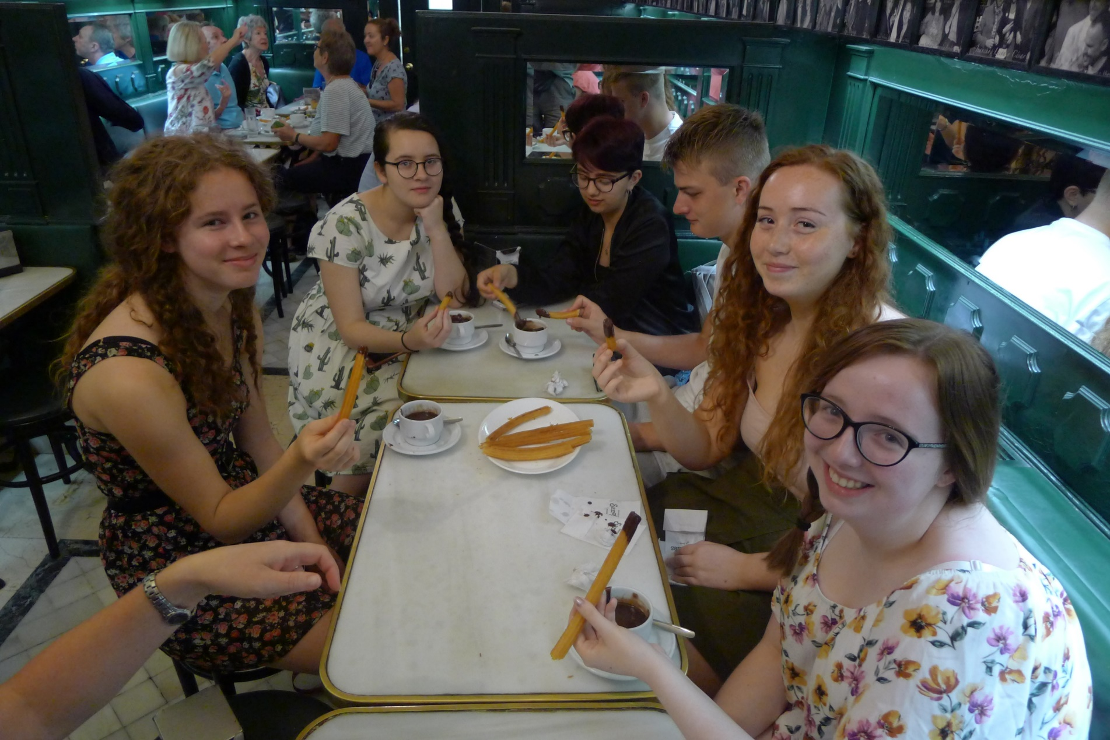

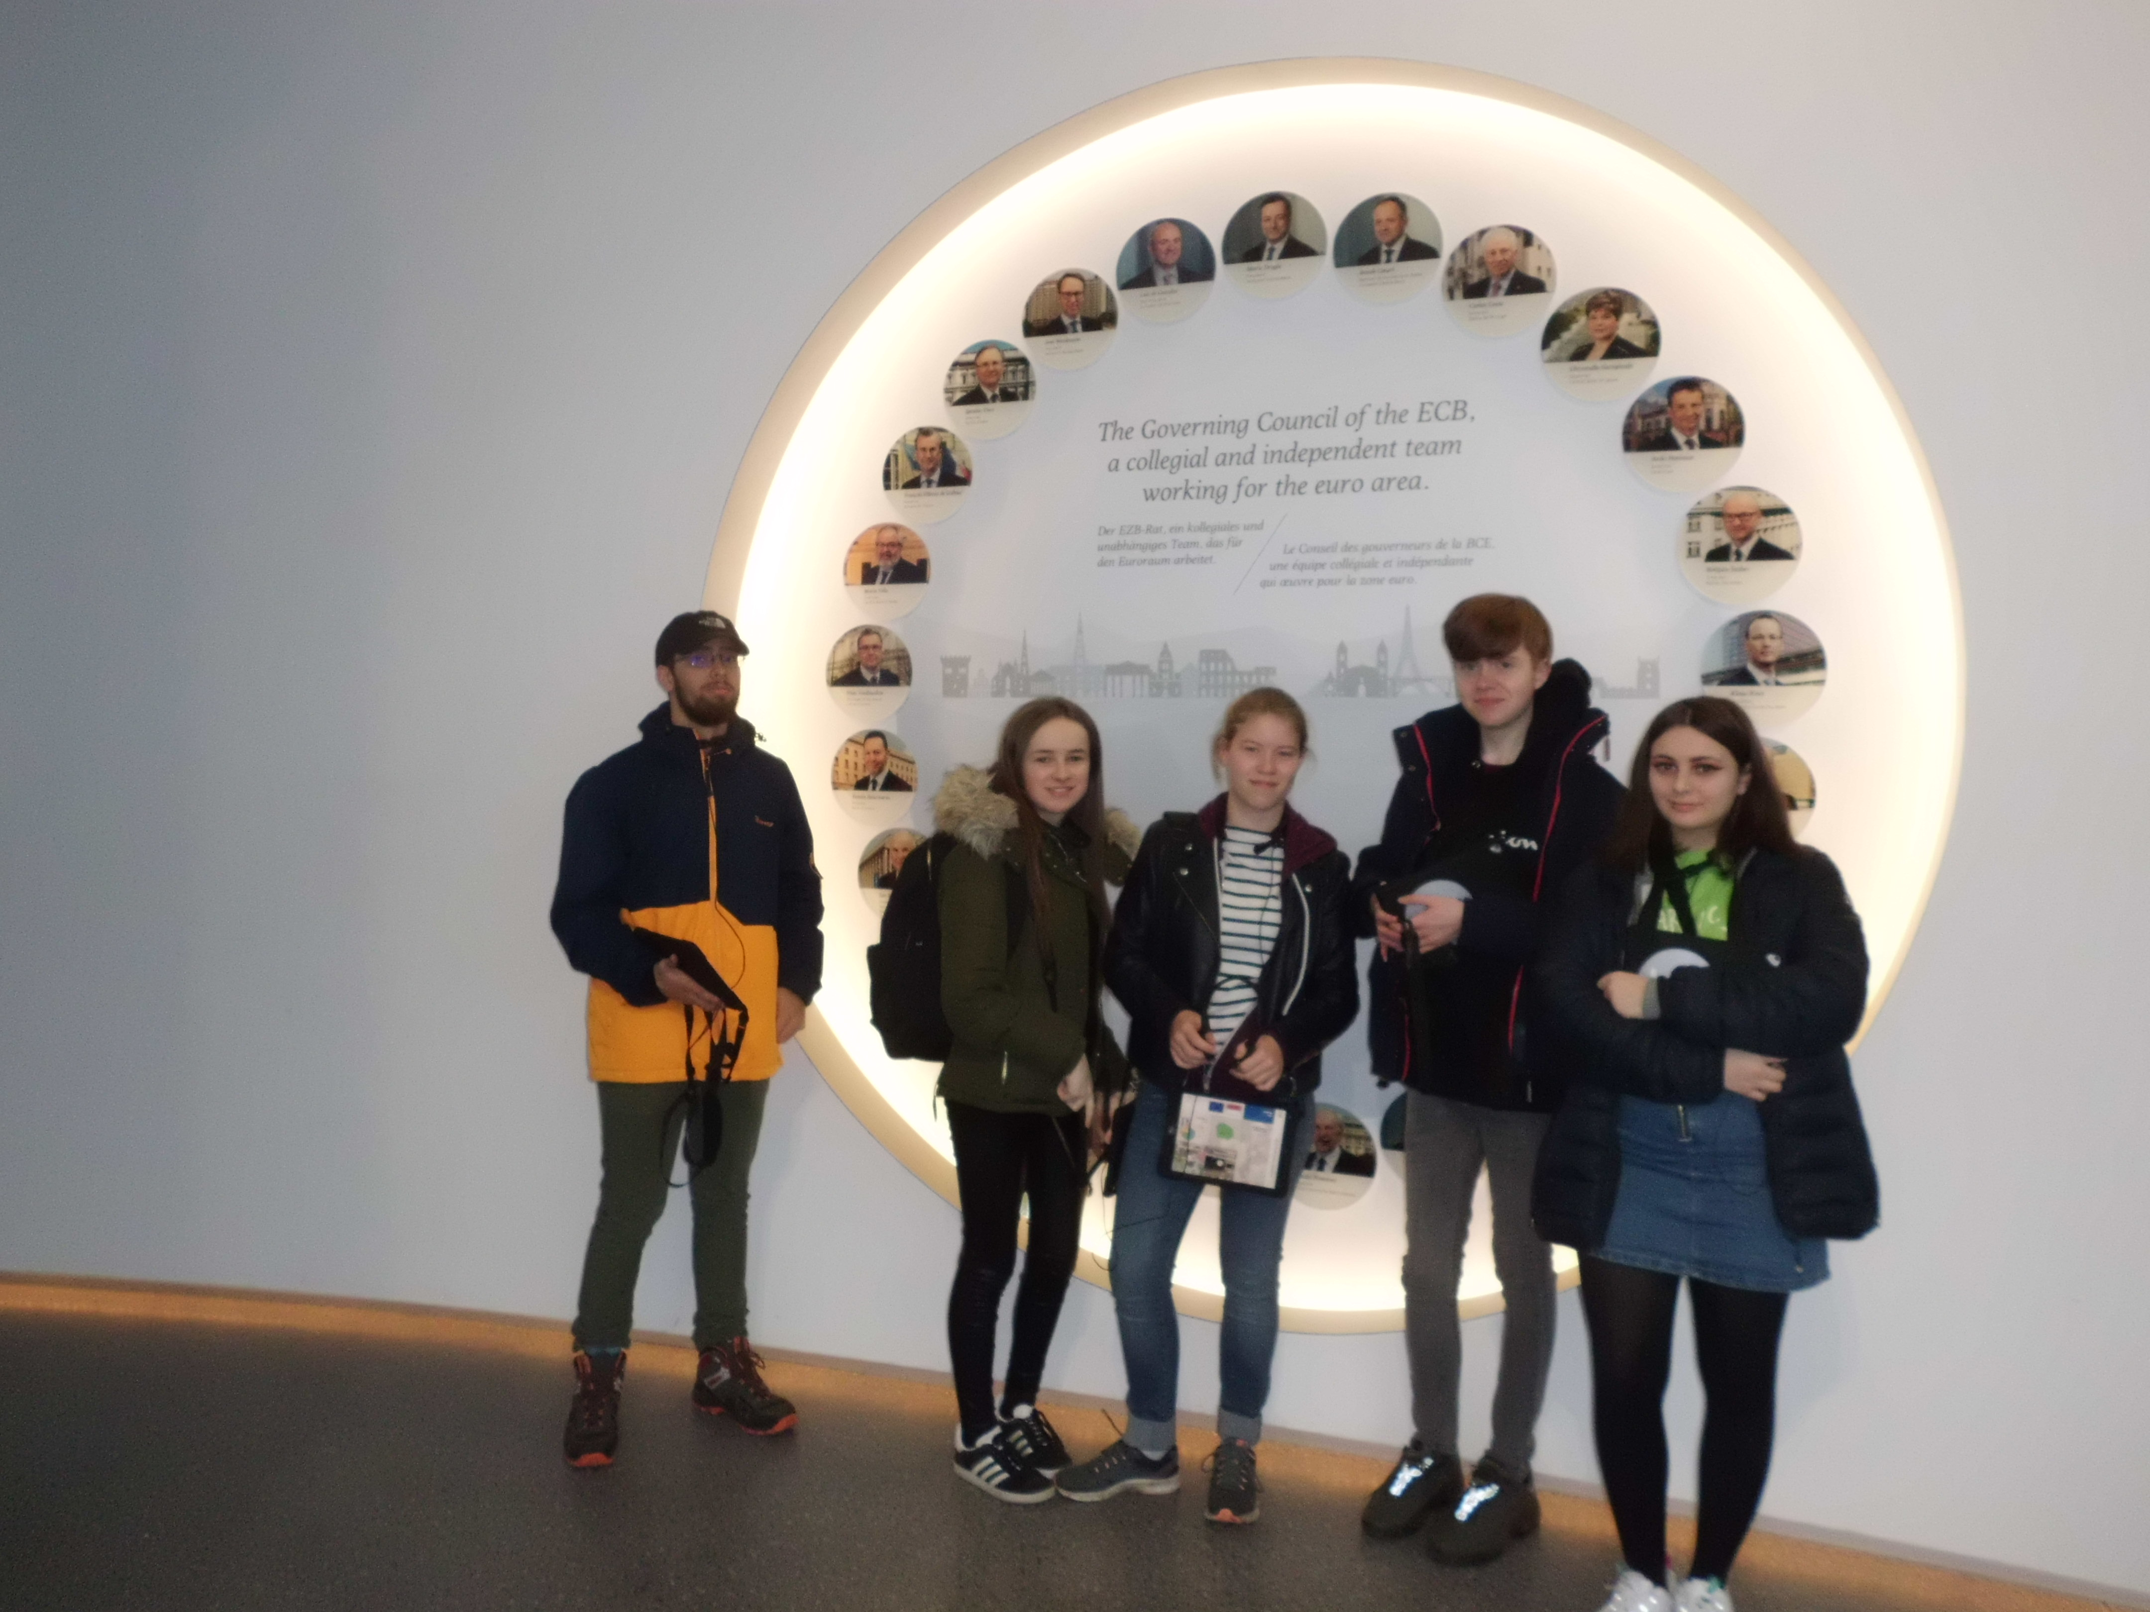
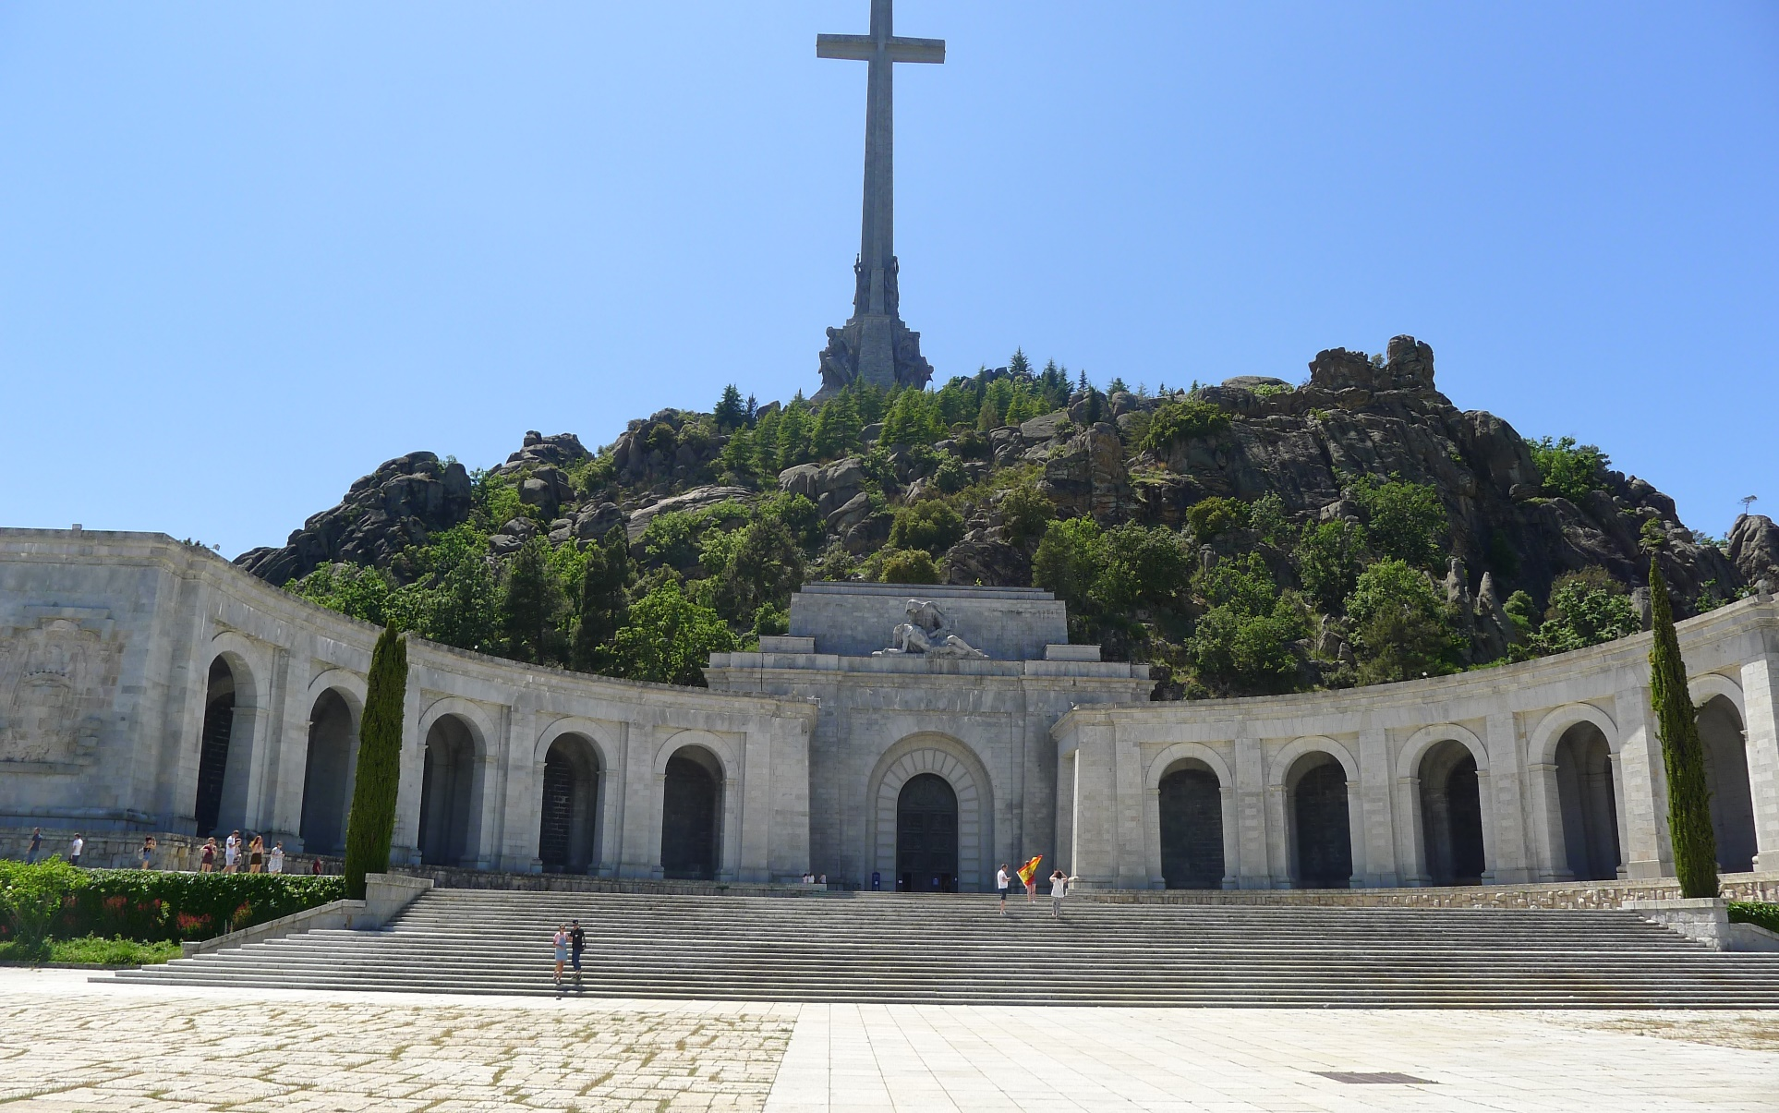
Extra Curricular
T
R
I
P
S
&
I
T
A
L
I
A
N

